Slide 1
Empowering local churches to care for families in developing Countries
Partnerships in Community Development

Slide 2

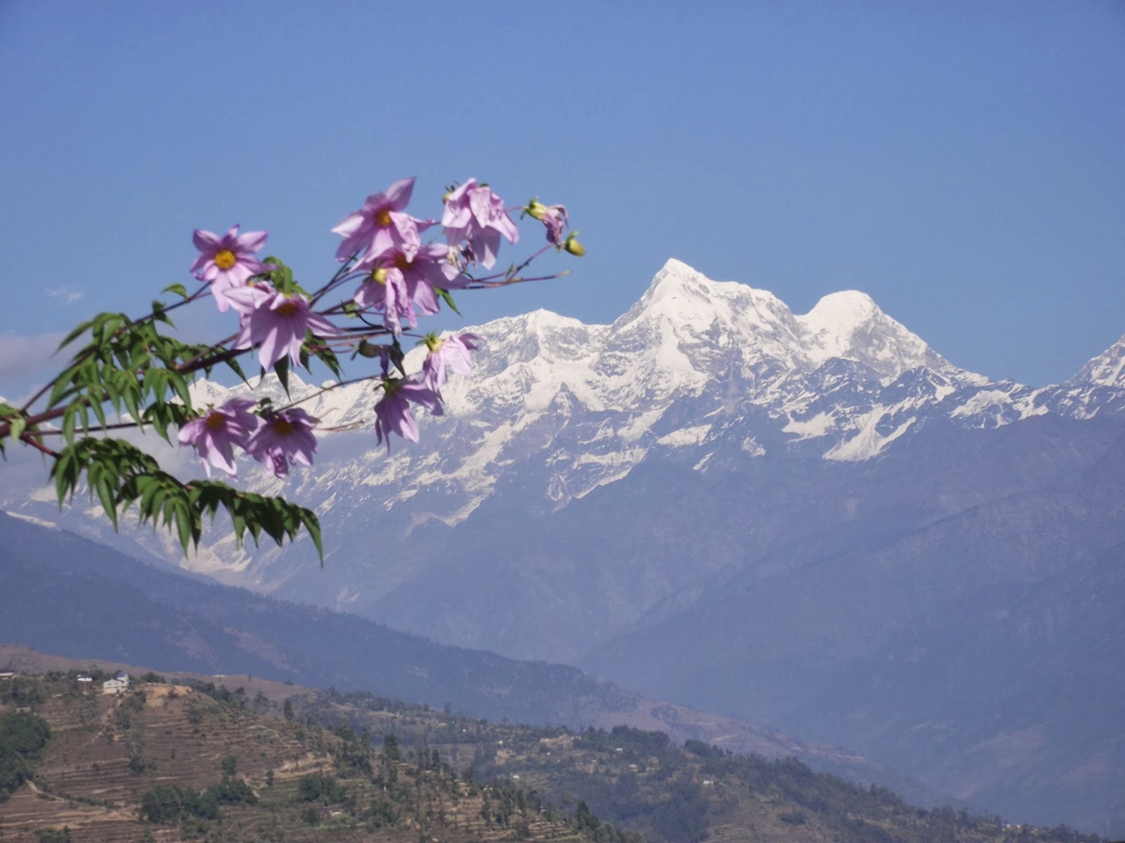
Case study - Nepal

Slide 3
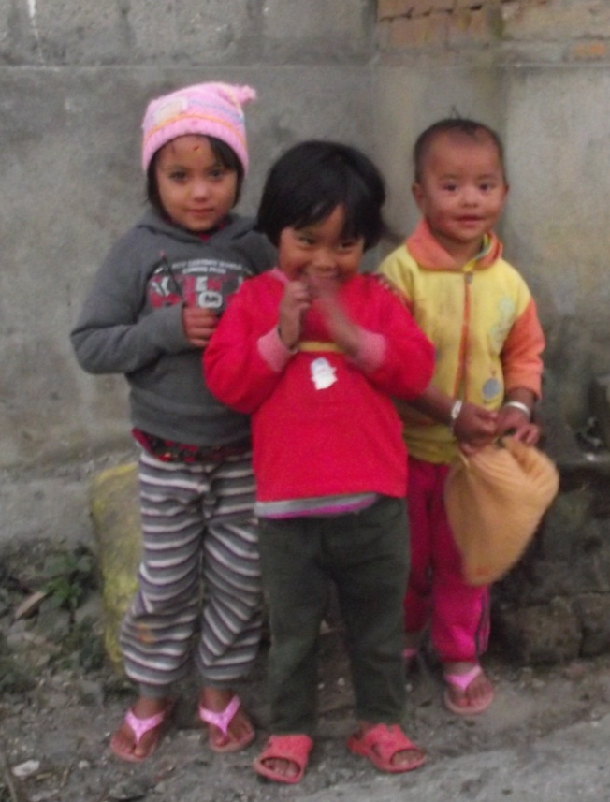

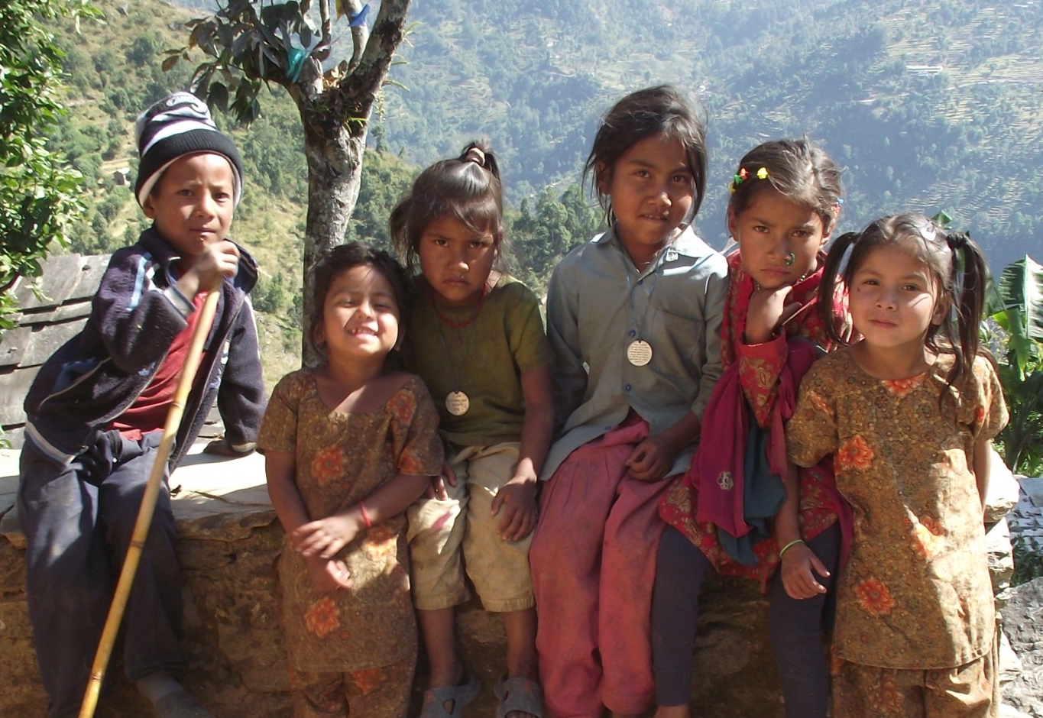
Nepal

Slide 4
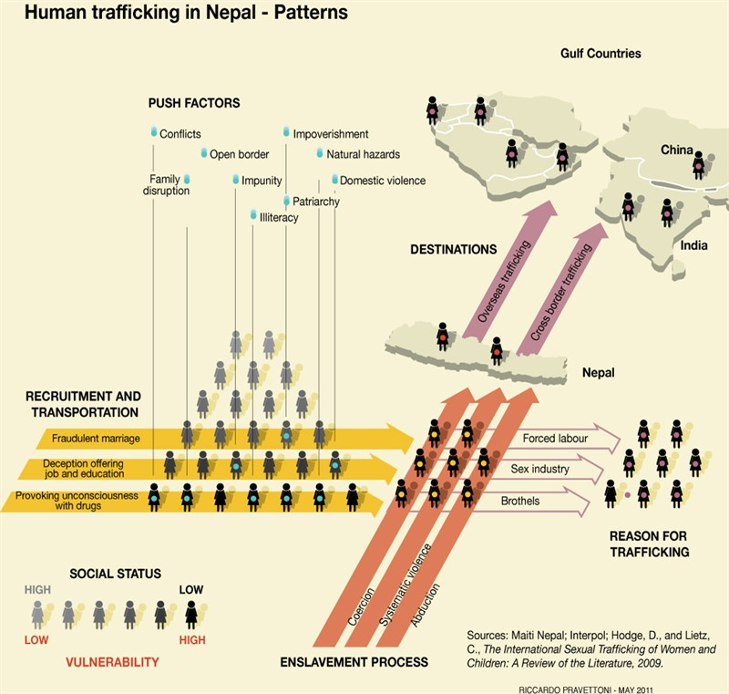
Trafficking in Nepal:
1990: 3,000 to 5,000 a year
2010: 12,000 to 20,000 girls a year
Today: 200,000 Nepalese girls work in Indian brothels
Age 10 to 20
Source: http://www.fmreview.org/FMRpdfs/FMR25/FMR2510.pdf
Notes:
Poverty and conflict-induced displacement in Nepal – have driven some two million Nepalese to work abroad
Nepal’s Human Trafficking (Control) Act 1986 made human trafficking punishable by imprisonment of up twenty years

Slide 5
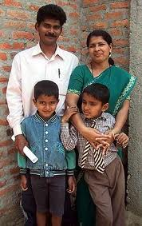
Every child deserves a family
1
2
We have a mandate
We have a goal
3
What’s the Plan?

Slide 6
1
Mandate:
We have a mandate
Define your faith by your care for the orphan
“Religion that God our Father accepts as pure and faultless is this: to look after orphans and widows in her distress and to keep oneself from being polluted by the world.” James 1:27 (NIV)
Psalm 68:6 God puts the lonely in families
Define your faith by working with excellence
“Whatever you do, work at it with all your heart, as working for the Lord, not for human masters.” Colossians 3: 23 (NIV)
Genesis 1: 28 God blessed them and said
‘fill the earth & subdue it.’

Slide 7
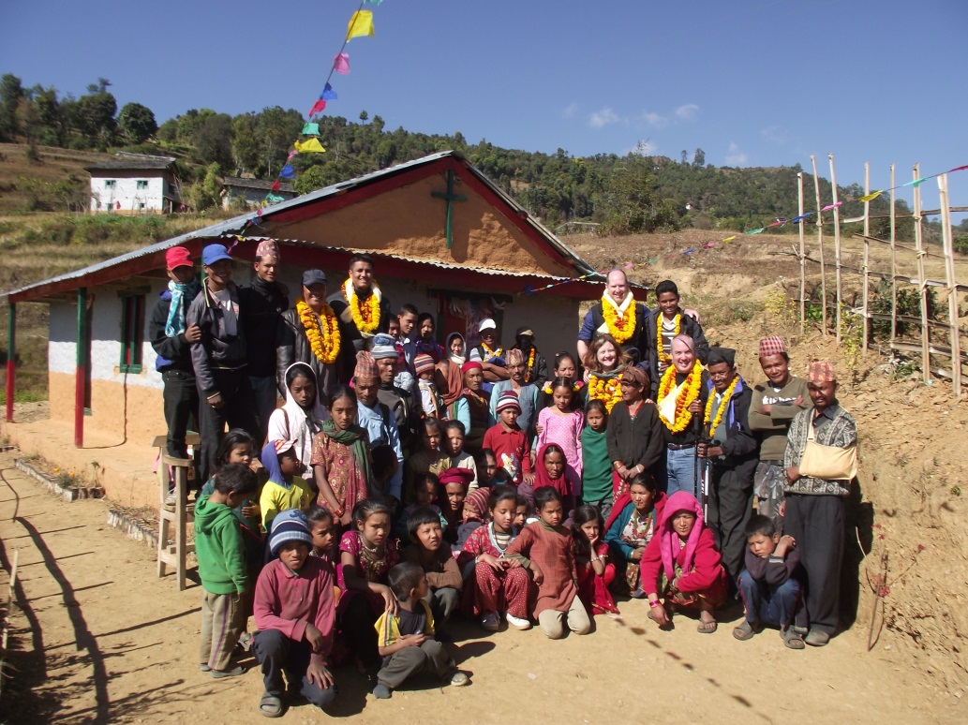
The LOCAL church is the target. The church mobilizes PEOPLE to help children receive a FAMILY of their own.
Working with the local church to bring:
Vision Tools
Training Technology
2
We have a goal

Slide 8
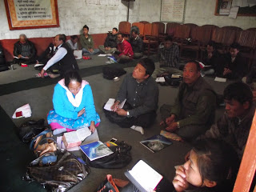
Focus groups with pastors business & social work
The ANSWER
Explore organizations and resources already in place.
Workshop with 40 leaders from 20 non-denominational churches in Kathmandu
Workshop with 33 pastors from 16 mountain churches
Churches are serving the poor & lowest castes.

Slide 9
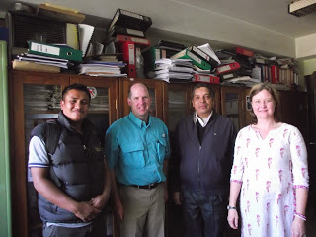
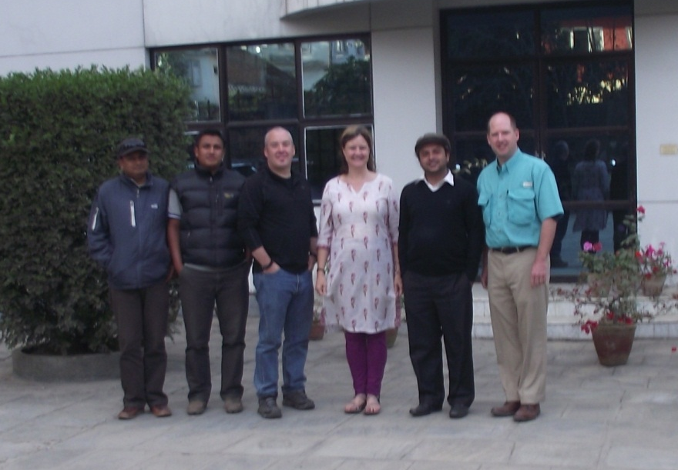
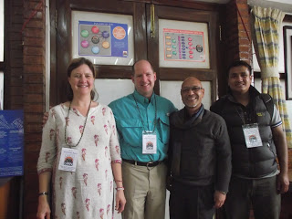
Department of Social Welfare
World Vision
United Missions in Nepal
Terre des Hommes
Higher Ground Ministries
Prison Fellowship

Slide 10
3
What’s the Plan?
Family Strengthening
/Foster Care
Education
City pastors wanted training in practical church leadership.
Rural pastors identified the need for a school as their top priority.
Assessment and monitoring of families at risk
Assistance with meeting basic needs
Kinship and foster care
Education – parenting, child development, health, importance of education, etc.
Business Development
Business knowledge
Revolving loan in church

Slide 11
Helping without hurting
“For we are God’s workmanship, created in Christ Jesus to do good works, which God prepared in advance for us to do.”
Ephesians 2:20 (NIV)
Partnership or Autocratic ?

Slide 12
Helping in a culturally appropriate sustainable way.
Working with local churches and people is not standard practice.
We show up and do our own thing.
We come with the answers and get the glory.
Local ownership, local problem solving, local resources.
Educate in best practices but let them lead.
Model for the local church.
Partnership or Autocratic ?

Slide 13
Accessing indigenous relationships, people, resources, ideas and items that are locally available instead of importing plans, ideas, people, and supplies.
Who will be the hero?
Developmental thinking and focus on sustainability.
Partnership or Autocratic ?

Slide 14
Collaborative approach mobilizes local church to lead.
If we do what someone else could do, we create dependency and non-sustainability.
Create transformations, not transactions.
Build trust through relationships.
Slow process but sustainable.
Partnership or Autocratic ?

Slide 15
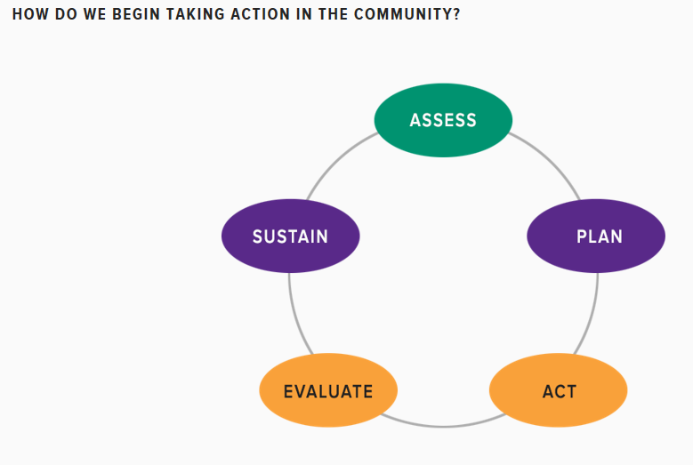
http://ctb.ku.edu/en/get-started

Slide 16
Assess
Begin by learning what issues matter to the community, and what resources may be available.
Using existing data.
Listening sessions and public forums
Interviews and focus groups.
Direct, and sometimes participant, observation.
Surveys.
Asset Mapping.
Handout on focus groups

Slide 17
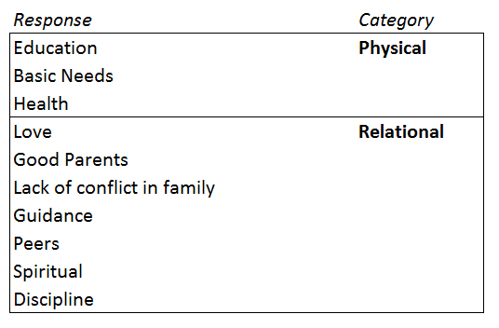
What do children need to be healthy?
Focus groups with pastors
~
families

Slide 18
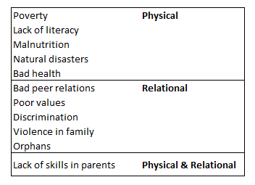
What are the barriers to families having the things they need to be healthy?
Focus groups with pastors
~
families

Slide 19
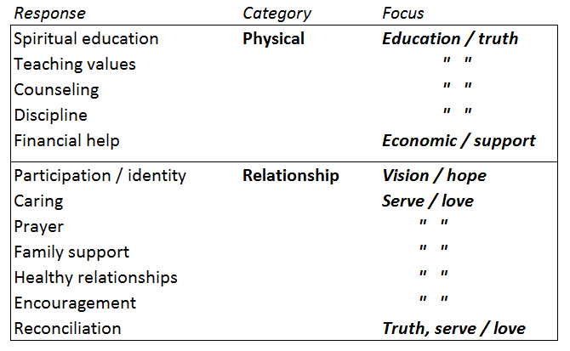
Role of the church in meeting child needs

Slide 20
Plan
Planning provides overall direction on the road that leads from where things are now to where we hope they will be. It can be helpful for a group to develop a clear vision, a mission statement, objectives, strategies, and an action plan.
  VISION (THE DREAM)
  MISSION (THE WHAT AND WHY)
  OBJECTIVES (HOW MUCH OF WHAT WILL BE ACCOMPLISHED BY WHEN)
  STRATEGIES (THE HOW)

Slide 21
ACT
You have identified something that you and your community care about, and it is time to take action. This involves mobilizing people around the effort and implementing some sort of intervention.
Determine why you need or want other people to get involved
Identify those who needs to be involved in order to accomplish your group's objectives or specific projects.
Handout on focus groups

Slide 22
ACT
Indicate core components of the effort to encourage participation and involvement.
Use particular sources and influential persons and organizations to reach the specific groups you hope to involve.
Assess whether the participation plan is effective and make needed adjustments.

Slide 23
EVALUATE
Why evaluate community programs?
How do we evaluate a specific program?
A framework for program evaluation
What are some standards for “good” evaluation?
Applying the framework: conducting evaluations

Slide 24
SUSTAIN
Work has started. How do you keep efforts going?
Create a business plan to anticipate what resources will be necessary to sustain the organization or effort.
Identify specific strategies to be used for financial sustainability.
Develop a marketing plan to secure resources for the organization or effort.
Handout on focus groups

Slide 25
http://ctb.ku.edu/en/get-started

Slide 26
END

