Slide 1
Rock Solid Foundation
Child Development - Part 2
GSP TRAINING SESSION 2B

Slide 2
Child Development - Part 2
In Part 1 of Child Development, we discussed a summary of the child development process and etiology of developmental delays
In Part 2 we will discuss the implications for treatment
Beginning with the Daily Routine and Schedule…..

Slide 3
Developing a Daily Routine and Schedule
Each of the following categories of children need much the same thing, albeit for different reasons
Inward style children need structure (rules, rewards, consequences, consistency) in order for them to make the link between cause and effect and experience the reinforcement necessary to manage behavior

Slide 4
Developing a Daily Routine and Schedule
Outward style children need structure so that they may begin to be able to evaluate themselves against an objective standard
Closed style children need a structure in order to know what to expect and feel secure

Slide 5
Developing a Daily Routine and Schedule
Therefore, each foster home will need to determine beforehand what the rules, rewards, consequences and daily schedule will be
These policies will need to be written and made to be a part of the daily program of the facility

Slide 6
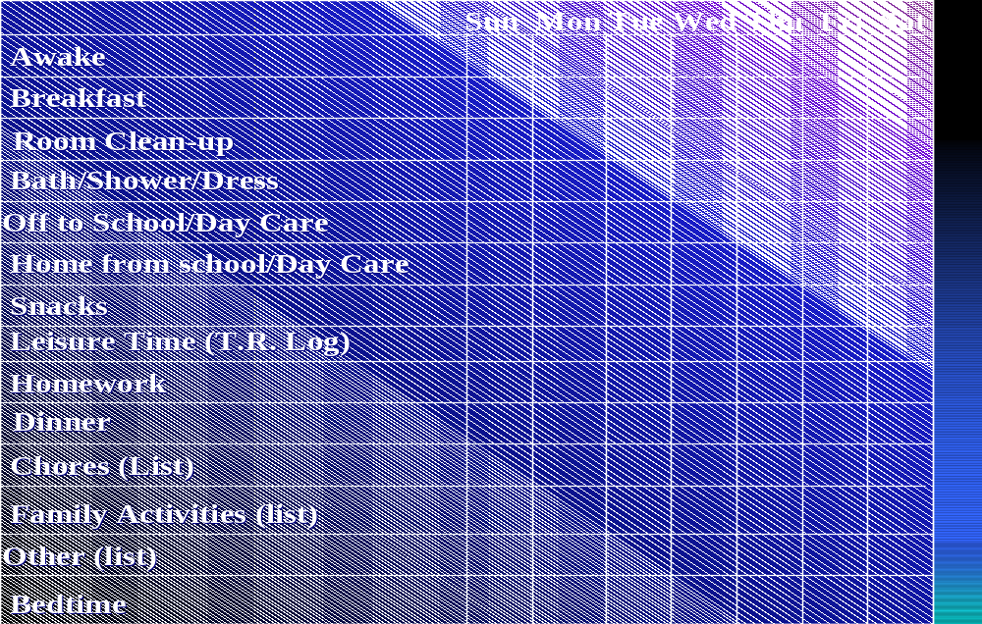
Developing a Daily Routine and Schedule
Daily Routine and Leisure Time Activities

Slide 7
Behavior Contracting
  Reason and Rules
  In giving children reasons, the child is able to reason out consequences and gives him a principle to follow

Slide 8
Behavior Contracting
  Rules About Rules
  Remember, rules are really for the adults
    Short
    Positive
    Easy to remember
    Specified behavior and consequences
    Easily enforceable
    Teachable

Slide 9
RULES, PAYMENTS, CONSEQUENCES
Rules | Payment | Consequences
Keep daily Schedule (Whereabouts at all times) | Privileges | Withdraw Privileges
Keep hands/feet to self (Health and Safety) | Special Contract | Redirection -Restriction
Knock/gain permission (Privacy) | Special Contract | Redirection Withdraw privileges
Ask/gain permission (Property) | Special Contract | Restitution - Fine
Obey FPS first time (Supervision/Authority) |  | Withdraw privileges or other
If don’t know…Ask (Cover all Bases) |  | Withdraw privileges or other

Slide 10
Behavior Contracting
  Trouble shooting the Behavior Contract
  The Contract
    Was the target behavior clearly specified?
    Did the contract provide for immediate reinforcement?
    Did it ask for small approximations to the desired behavior?
    Was reinforcement frequent and in small amounts?

Slide 11
Behavior Contracting
  The Contract
    Did the contract call for and reward accomplishment rather than obedience?
    Was the performance rewarded after its occurrence?
    Was the contract fair?
    Were the terms of the contract clear?
    Was the contract honest?

Slide 12
Behavior Contracting
  The Contract
    Was the contract positive?
    Was contracting as a method being used systematically?
    Was the contract mutually negotiated?
    Was the penalty clause too punitive?

Slide 13
Behavior Contracting
  The Client
    Did he understand the contract?
    Is he getting the reinforcer from some other source?
    Do the reinforcers have to be reevaluated?
    Has a new problem behavior developed that is drawing the mediator's attention away from the target behavior?

Slide 14
Behavior Contracting
  The Mediator
Did the mediator understand the contract?
Did he dispense the kind and amount of reinforcement specified in the contract?
Did he dispense it according to instructions, at the rate specified, and with consistency?
Did punishment accidentally accompany the performance being reinforced?
Did he stop mediating?
Do you need a new mediator?

Slide 15
Behavior Contracting
  The Measurement
Has the data been verified as accurate?
Did your data collector understand what he was supposed to count?
Did you rehearse the counting task with him?
Did you reinforce him for his behavior?
Is the data collection task too complex or too difficult?
Should you try to get another data collector?

Slide 16
Behavior Contracting
Contract
Effective Dates: From to
We, the undersigned parties, agree to perform the following behaviors:
If _________________________ Then ________________________
_________________________ ________________________
If _________________________ Then ________________________
_________________________ ________________________
Bonus _____________________________________________________ _____________________________________________________
Penalty _____________________________________________________ _____________________________________________________
_________________ Client
_________________
Mediator
_________________
Councilor
*This contract will be reviewed within 2 weeks of the date of agreement

Slide 17
A.I.M.
ASSESSMENT OF INHERENT MOTIVATION
Chester J. Singer, Ph.D. (1988)

Slide 18
A.I.M.
40 Questions Each for Examiner and Client
Read each statement carefully and darken the circle under
  YES if it "generally" describes the client (if client questionnaire YOU)
  NO if it does not describe the client (if client questionnaire YOU)
  Use the accompanying answer sheet to record your responses

Slide 19
A.I.M.
Record the number of “Yes” answers in each of the four columns
 | Closed | Inward | Outward | Open
25 |  |  |  |  | 25
………….
18 |  |  |  |  | 18
 |  |  |  |  | 17
………….
2 |  |  |  |  | 2
1 |  |  |  |  | 1

Slide 20
A.I.M.
If the “yes” answers to the questions were as follows for the examiner: Closed –12, Inward – 21, Outward – 9, Open - 8
And the “yes” answers to the questions were as follows for the client: Closed –7, Inward – 3, Outward – 16, Open - 14
The resulting A.I.M. chart would be as follows:

Slide 21
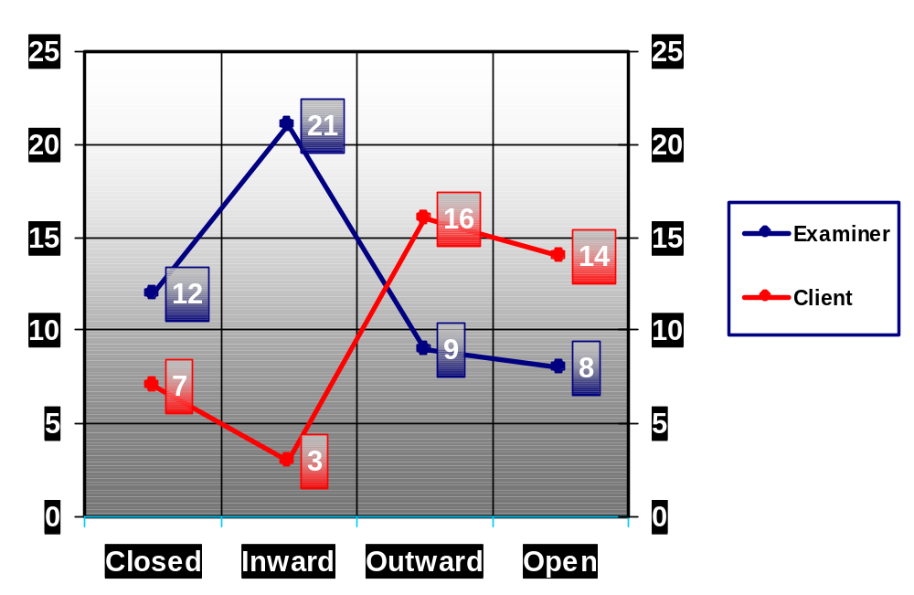
A.I.M. Chart Example

Slide 22
A.I.M.
Handouts for A.I.M. Activity
  Examiner Assessment
  Client Self Report
  Score Sheets
  Graph material

Slide 23
Child Development Feedback
What is the most important gift that a foster parent can give to a child in therapeutic foster care?
Love and affection
Consistent rules and consequences
Communication
Restrictions for rule violations
Rewards for positive behavior
B. Consistent rules…

Slide 24
Child Development Feedback
In the behavioral contract, what is the best evidence that a target behavior is clearly specified?
The child understands it
It can be observed and counted
The child accomplishes it
The child agrees with it
B. Observed and counted

Slide 25
Child Development Feedback
The most effective house rules are those which:
Tell the child what is prohibited
The child agrees with
Tell the child what (s)he should do
Are gratifying to the foster parent
C. Tell child what (s)he should do

Slide 26
Child Development Feedback
The most important reason behavioral reinforcement should be immediate is because:
Otherwise the foster parent may forget
Children are more likely to repeat a behavior that is positively reinforced immediately
That's what children want
Children will link their actions to the consequences and learn "cause and effect" more readily when reinforced immediately
D. Children will link…

Slide 27
Child Development Feedback
Threatening a child with removal from the foster home is not a good discipline tool because:
Children should never be denied basic human needs as punishment
Foster parents may not really mean what they say in the heat of emotion
Children are likely to test the threat
Regulations prohibit it
All of the above
E. All of the Above

Slide 28
Child Development Feedback
The most basic of human needs is:
Love and Affection
Approval
Self-esteem
Health and Safety
D. Health and Safety

Slide 29
Child Development Feedback
Children whose primary need is approval need foster parents who:
A. Praise them for good behavior
Disapprove of them for bad behavior
Seek their opinion on matters
Provide them opportunities for self-evaluation
A and C
C and D
F. C and D

Slide 30
Child Development Feedback
A child should be punished every time he or she does something wrong.
A. True
False
B. False

Slide 31
Child Development Feedback
Explain your answer to number 8:

Slide 32
Child Development Feedback
Define Locus of Information
The relative emphasis a person places on gaining information to make behavioral decisions from within her/himself

Slide 33
Child Development Feedback
State the Basic need for each of the following loci of information:
Closed/immature
Security, predictability, “script”
Inward/internal
Immediate self-gratification, behavior contract

Slide 34
Child Development Feedback
Outward/External
Acceptance, approval, self- monitoring program
Open
Self-Actualization; opportunity

