Slide 1
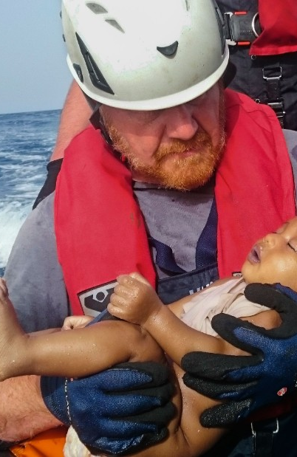
“Social workers
can suffer from moral injury too”
Dr. Lanny Endicott
Oral Roberts University
lendicott@oru.edu
Cell: 918-830-1523

Slide 2
Workshop Objectives
Define the terms moral injury (moral distress) and post traumatic stress along with their consequences on the professional social worker
Discuss options, including spiritual resources, for addressing moral injury
Address systems issues important for social workers and their administrations that contribute to staff experiencing moral injury and compassion fatigue

Slide 3
Moral Injury & the Soldier
Though MI has been around since the beginning of time, more recent efforts to study the issue came about to help explain the high rate of suicide among soldiers (warriors, veterans), both those in and discharged from the military
This presentation, Social Workers Can Suffer from Moral Injury too, begins with a brief look at MI experienced by military personnel

Slide 4


Moral-Spirit Injury
a
Wounding of the Soul
Prepared by Moral Injury committee of the
Warrior Partnerships of Eastern
Oklahoma
Community Service Council
1604 South Baltimore, Tulsa, Oklahoma
www.csctulsa.org

Slide 5
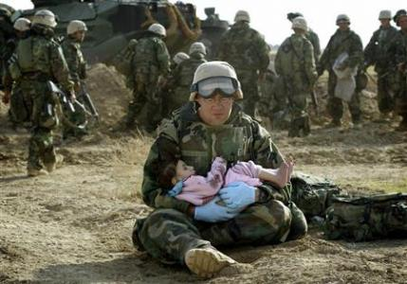
Moral Injury or Wounding of the Soul
Service members can
have experiences
which run counter
to, insult, or betray
their personal
values, moral code,
or sense of honor

Slide 6

Something Happens:
... something done,
... failed to do
... witnessed
... by acting alone or as
part of a group
... an experience such as
assault or betrayal

Slide 7

The Consequence:
Suffering from confusion, perplexity, guilt, shame, or self-judgement...
even if there's a rationale to the contrary

Slide 8
How it develops?
Military provides extensive training for tactical, strategic, & individual decision-making
But decisions made during complex situations may create questioning or regret afterward
...a beginning to moral injury

Slide 9

Moral Injury...Immediate to Long-term
Damage to self-esteem or
personal integrity
Complicated by receiving
awards and recognition
from the military or civilians
reminding of a line crossed
now regretted
Further complications
may come from personal assault or betrayal

Slide 10
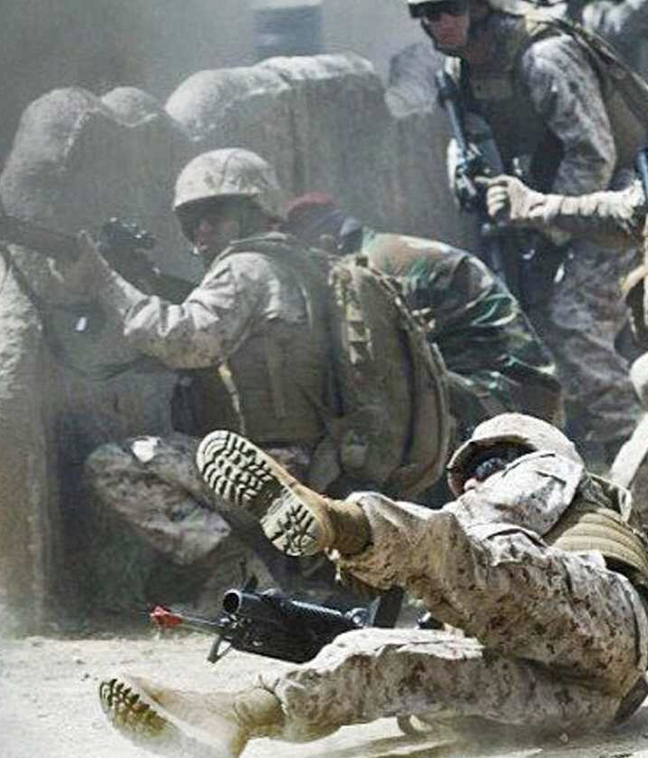
Complication > reluctance to talk
"I can't believe I did that"
"I wish I hadn't seen..."
"I'm bothered that I enjoyed..."
"I can't believe...happened to me"

Slide 11
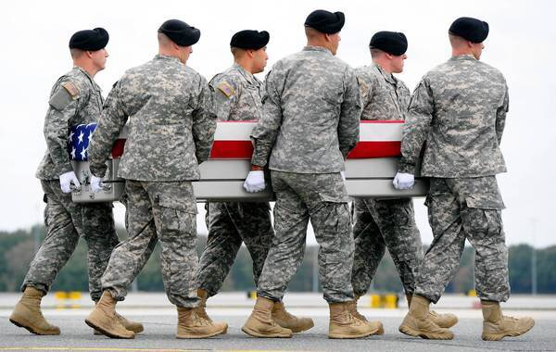
Important Responses
hopelessness,
frequent crying,
listless, sorrow,
grief, guilt,
regret, shame,
alienation

Slide 12
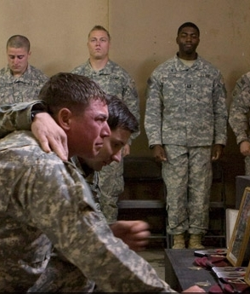
Talking About It
A trusted family member
Friend
Fellow service member
Coffee Bunker participant
Counselor, moral authority

Slide 13
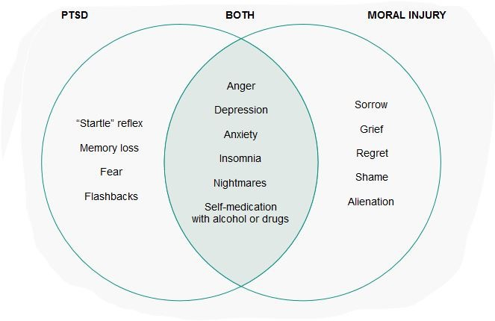
PTSD and Moral Injury: similar yet different
http://projects.huffingtonpost.com/moral-injury/the-grunts

Slide 14

Key Antidotes
Forgiveness
&
Honor

Slide 15

To help: Non-judgmental, Non-shock Listening
Referral

Slide 16
From “The Pacific”, Episode 2, at 39.36 min., Amazon Prime
Father (medical doctor) to his youngest son, after checking his son’s heart beat:
The worst things about treating those combat boys from the Great War wasn’t that they had had their flesh torn.
It was that that they had their souls torn out.
And I don’t want to look in your eyes someday and see no spark, no love, no…no life.
That would break my heart.
Give me some time to break the news to your mother.

Slide 17
Some Contacts:
Coffee Bunker - 6365 E. 41st., Tulsa, OK 74135 918-637-3878, https://www.coffeebunker.org
Look for Coffee Bunker on Facebook
Veterans Crisis Line: 1-800-273-8255, Press 1
Confidential Chat at VeteransCrisisLine.net or text to 838255

Slide 18
Some Key Terms
Compassion Fatigue (CF) - general term related to addressing client trauma & work place stress
Secondary Traumatic Stress (STS) - experiencing trauma from client situations & stories
Vicarious Trauma (VT) - reliving events of trauma from stories provided by others - “overly empathetic”
Primary Exposure - experiencing trauma directly
Secondary Exposure - experiencing trauma indirectly through others’ stories
Moral Injury - conflict in one conscience: values, morals

Slide 19
Moral & the Social Worker

Slide 20
MI & the Social Worker
Experiencing feelings also related to:
      perpetrating
      failing to prevent
      or witnessing actions that transgress deeply held moral beliefs
Nursing uses the term “moral distress”
                http://www.socialworktoday.com/news/eoe_021814.shtml

Slide 21
Some Examples
Being involved in the removal of children from their homes
Termination or scaling back of services to vulnerable clientele
Lies told to clients by agency staff/colleagues
Witnessing unethical agency practices
Experiencing agency transition to maximizing profits

Slide 22
Forcing workers to follow questionable policies/practices
Pain of believing that one’s actions or inactions has caused harm in another
Being involved in cases of extreme maltreatment to children and those vulnerable

Slide 23
Have any of us encountered MI as defined here?

Slide 24
Our Clients Can Suffer from MI Too
Clinicians in a wide variety of settings encounter clients who struggle with moral injury:
    Parents who have abused their children
    Police officers mistakenly shooting an innocent bystander or testifying in court against a falsely accused defendant
    Couples’ extramarital affairs

Slide 25
Some Consequences for the Social Worker
  Compassion Fatigue Demoralization
                Anxiety Workplace Alienation
  Isolation Anger Sense of Powerlessness
  Somatic Complaints Use of Chemicals
  Depression Health Issues
  Guilt Shame

Slide 26
PTSD and Moral Injury: similar yet different
http://projects.huffingtonpost.com/moral-injury/the-grunts

Slide 27
Nursing
  Moral complexity:
    emerges when events do not fit within learned rules
  Moral distress:
    the condition of knowing the morally right thing to do, but institutional, procedural, or social constraints make doing the right thing nearly impossible
    can threaten core values and moral integrity
Moral resilience:
    the ability and willingness to speak and take right and good action in the face of an adversity that is moral/ethical in nature

Slide 28
Leadership Can:
1. Encourage members to revisit past situations to understand current dilemmas
2. Leaders and staff formulate policies that encourage discussion of concerns in morally complex cases, without threat of retribution
3. The talk and actions of leaders are in sync with a culture that supports an ethical work environment

Slide 29
Aids to Moral Injury
Speaking with a trusted colleague(s)
Listening without showing shock or judgement
Ascribing attribution: percentages of blame
Adaptive disclosure
Forgiveness of self and/or others

Slide 30
Client/Family
Me/My Team
Agency/System
Dr. Erv Janssen

Slide 31
Compassion Satisfaction
Encouragers
  I gain pleasure from helping
  I perceive my agency as supportive
  I personally enjoy this work
  I have supportive personal relationships
  I’m able to do the work
  I see my work as fulfilling
  “I think I have a calling to this work”
  Adapted from Beth Stamm

Slide 32
Compassion Fatigue
Discouragers
I’m missing pleasure from helping
I don’t see my agency as supportive
I’m not enjoying this work
I’m missing supportive personal relationships
I question my ability to do the work
I’m unfulfilled, feel disillusioned in my work

Slide 33

Dimensions of
“Compassion” Satisfaction "Compassion" Fatigue
Personal Self-Care Practice Secondary Traumatic Stress
Workplace Encouragers Vicarious Trauma
                Primary Exposure
                Secondary Exposure
                Moral Injury
                Workplace Discouragers
Burnout

Slide 34
ProQOL 5
Professional Quality of Life Sale: A 30 Question self-assessment covering Compassion Satisfaction, Compassion, and Burnout.
Developed by Beth Stamm, Ph.D, now retired
See: http://www.proqol.org/About_us.html

Slide 35
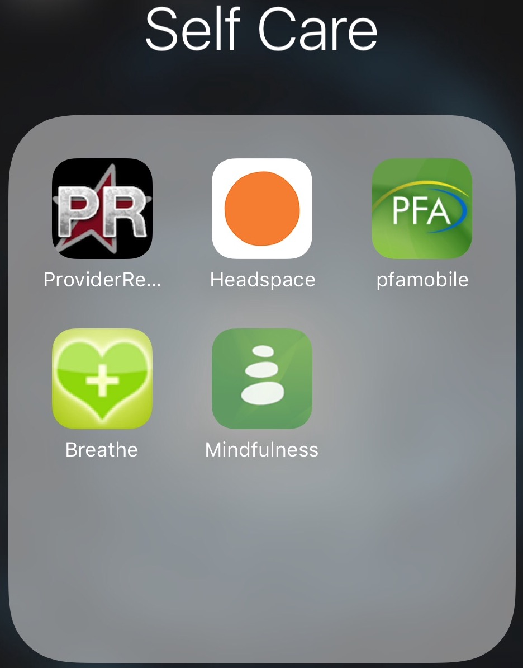

Slide 36

Some Strategies for the Workplace
Making use of the Unit, Team, Informal Group
Intentional or “natural" opportunities to share
Nurturing an encouraging atmosphere
Keeping personal information confidential
Spending social time together
Maintaining an atmosphere of safety
Evaluate

Slide 37
Some Moral Injury Resources
http://projects.huffingtonpost.com/moral-injury
http://projects.huffingtonpost.com/moral-injury/the-grunts
http://www.huffingtonpost.com/news/moral-injury/
http://www.npr.org/2014/11/11/363288341/moral-injury-is-the-signature-wound-of-today-s-veterans
http://nation.time.com/2013/04/17/moral-injury-a-profound-sense-of-alienation-and-abject-shame/

Slide 38
Epstein, E.G., Delgado, S., (Sept 30, 2010) "Understanding and Addressing Moral Distress" OJIN: The Online Journal of Issues in Nursing Vol. 15, No. 3, Manuscript 1.
Lachman, V.D. (2016). Moral resilience: Managing moral distress and moral residue. MEDSURG Nursing, 25(2), 121-124.
Clebourn-Jacobs, Toya V., "How Does a High Profile Child Death Impact Child Protective Service Workers?" (2013). Doctorate in Social Work (DSW) Dissertations. 44. http://repository.upenn.edu/edissertations_sp2/44
Reamer, Frederic. Moral Injury in Social Work. http://www.socialworktoday.com/news/eoe_021814.shtml
Janssen, Scott. Moral Distress in Social Work Practice - When Workplace and Conscience Collide. http://www.socialworktoday.com/archive/052416p18.shtml

Slide 39
Compassion Fatigue Resources
Beth Stamm, ProQOL5: http://www.proqol.org
Headington Institute: http://www.headington-institute.org/Default.aspx?tabid=1379
Authentic Happiness Website: http://www.authentichappiness.sas.upenn.edu/Default.aspx
David Baldwin Trauma Information: http://www.trauma-pages.com/disaster.php
Figley Institute: http://www.figleyinstitute.com/indexMain.html
Compassion Fatigue Awareness Project: http://www.compassionfatigue.org/
Veterans Administration Resources for addressing PTSD: http://www.ptsd.va.gov/index.asp
Sidran Institute: http://sidran.org
International Society of Traumatic Stress Studies: http://www.istss.org/
The National Child Traumatic Stress Network: http://www.nctsn.org/products/secondary-traumatic-stress-fact-sheet-child-serving-professionals%20

Slide 40
Mayo Clinic. (2015). Stress management. Retrieved from:
http://www.mayoclinic.org/healthy-lifestyle/stress-management/in-depth/social-support/art-20044445?pg=1
Simmons University. (2015). Self care tips. Advice from professional clinicians. Retrieved from:
https://socialwork.simmons.edu/self-care-tips-advice-from-professional-clinicians/
University of Buffalo: School of Social Work. (2017). Our self care starter kit. Retrieved from
https://socialwork.buffalo.edu/resources/self-care-starter-kit.html

