Slide 1
Creating optimizing practices for endurance with trauma informed clients
North American Association of Christian in social work
Presenters:
Dezette C. Johnson, PhD
LaSonya Townsend, DSW, MSW
November 4, 2017

Slide 2
Workshop objectives
The learning outcomes for this presentation are:
(1.) To discuss the scope of and need for complementary alternative treatment approaches to reduce mental health stressors.
(2.) Introduce a trauma informed healing framework for understanding trauma and helping clients in their healing practice.
(3.) Discuss holistic complimentary interventions for working with victims of trauma.

Slide 3


Why create optimizing practices for endurance?

Slide 4
Trauma informed services
Trauma-Informed Approach
According to SAMHSA’s concept of a trauma-informed approach, “A program, organization, or system that is trauma-informed:
Realizes the widespread impact of trauma and understands potential paths for recovery;
Recognizes the signs and symptoms of trauma in clients, families, staff, and others involved with the system;
Responds by fully integrating knowledge about trauma into policies, procedures, and practices; and
Seeks to actively resist re-traumatization."
A trauma-informed approach can be implemented in any type of service setting or organization and is distinct from trauma-specific interventions or treatments that are designed specifically to address the consequences of trauma and to facilitate healing.

Slide 5
Traditional trauma treatment
Psychotherapy
Psychoeducation
Psychiatric Services
Medication Management

Slide 6
Non traditional trauma services- HEALING ART MODALITIES
Acupuncture
Biofeedback
Coaching
Color Therapy
Energy Healing/Reiki
EMDR
Qigong
Yoga

Slide 7
Benefits to non traditional forms of treatment
Non traditional or complementary alternative practices to healing trauma is centered around an approach to support the whole person in returning to balance by improving the body’s ability to heal.
Many non traditional approaches utilize the mind, body, and spirit approach to healing instead on just one area which helps with the integration of self.
Treatment is non invasive, driven by the client

Slide 8

The cope program
The purpose of Creating, Optimizing, Practices, for Endurance is to reduce mental health stressors in JCSU students by introducing alternative behavioral practices,

Slide 9
Program components
Nine week complimentary alternative method program using yoga, mindfulness, guided imaginary, essential oils, Reiki, and diet to reduce mental and behavioral health stressors.
Student Interns
Focus Groups
Pre and Post Evaluations

Slide 10
How trauma impacts college students
College can be a stressful time for many students dealing with trauma due to the stress of academic performance, social interaction, and personal development.
Trauma and its affects on college students:
Lack of ability to focus
Poor concentration
Emotional instability
High levels of stress, anxiety
Poor social interactions
Unstable intimate relationships

Slide 11
Lessons learned
Definition of stress/trauma
Types of stress college students are confronted with
Barriers college students who have experienced trauma face
How college students cope with stress/trauma
Support systems

Slide 12
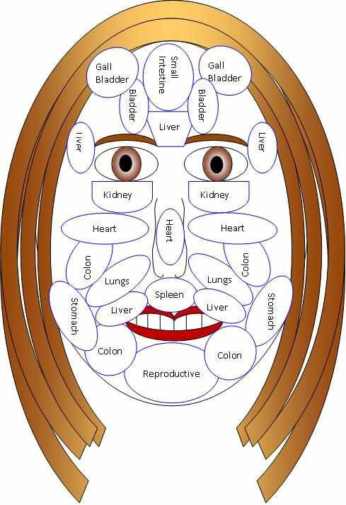

Complimentary methods

Slide 13

Energy work (reiki)
Reiki is a Japanese technique for stress reduction and relaxation that promotes healing. It is administered by “laying hands "and based upon the unforeseen life force energy that flows throughout our bodies. It is a passive, gentle and non invasive technique. Reiki treats the whole person, including the body. It helps to facilitate peace and wellbeing in the body, mind, and spirit. It is known as a safe and effective healing process and works excellent with trauma victims to reduce stress and somatic body complaints.

Slide 14

Yoga & meditation
Yoga is an ancient Indian system of complementary techniques that promote healing and wellness of the physical, emotional, and energetic body. Healing comes through integrating the whole self through movement, breath work and mediation to calm and center the mind. Yoga is an evidenced based practice to assist in alleviating trauma and/or trauma symptoms.

Slide 15
Benefits of Essential oils
Essential oils can be used for a wide range of emotional and physical wellness applications.
Aromatic Essential oils are quickly absorbed by the smell receptors, which have a direct link to the limbic system by way of the olfactory nerve.
Topical - Topical application is a very effective method for applying essential oils.
Internal - When ingested, essential oils directly enter the blood stream via the gastrointestinal tract, where they are transported throughout the rest of the body.

Slide 16
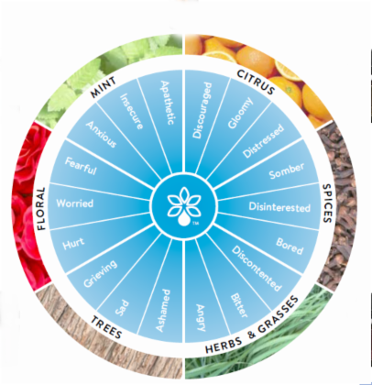
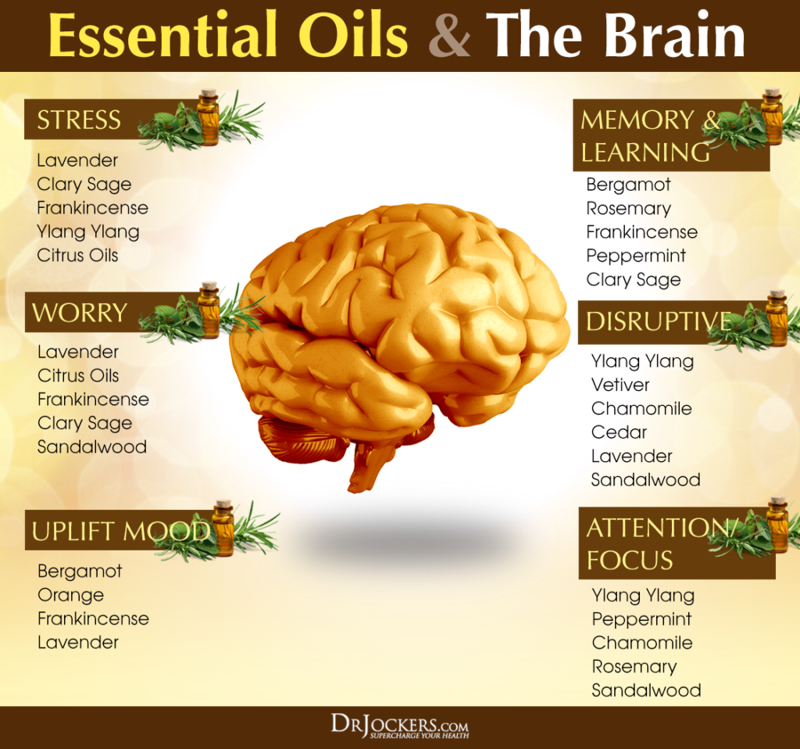
Essential Oils

Slide 17
mindfulness
Is a form of meditation
Means to be “conscious of the present moment in all that you do” (Seaward, 2004, p. 359).
Involves being aware of your surroundings, feelings, emotions, and how they impact you.
Can be conducted within any setting.
Benefits:
  Builds self-awareness
  Assists in handling emotions
  Ease stress
  Prevent burnout (Davis, 2015).

Slide 18
Christian application (biblical connection, purpose, impact)
Cope Concepts and Christian beliefs
Christian Model of Mindfulness Meditation
      Presence of Mind
      Acceptance
      Internal Observation
Christian –Accommodative Breath Meditation
Christian-Accommodative Loving Kindness Meditation

Slide 19
CHRISTIAN APPLICATION (biblical connection, purpose, impact)
Christian Yoga
Essential Oils
    Scripture
Reiki (Healing Touch)

Slide 20

Next steps

Slide 21

Questions and Answers

Slide 22
Contact information
Dr. Dezette Johnson
dzjohnson@jcsu.edu
Asha Sims, LPC
asims@jcsu.edu
Dr. LaSonya Townsend
ltownsend@jcsu.edu

