Slide 1
The Value of Self-care in social Work Practice
Dr. Kimberly N. Mudd-Fegett

Slide 2
The impact of Secondary Trauma
“Social work by its very definition has always meant working with vulnerable patients and those who have experienced trauma” (Getz, 2013)
Secondary Traumatic stress is the emotional duress when one hears The firsthand experience of another
26% of Therapist are at high Risk of Experiencing secondary Trauma
50% of Child Welfare Workers are at high risk of experiencing Secondary Trauma
Traumatized Organizations are less likely to address Client’s past/current trauma

Slide 3
Secondary Trauma in Child Welfare
Every year in the united states more than 10 million children endure trauma
Dr. Brian Bride Secondary Trauma Stress Scale
Bride’s Study found 70.2% experienced at least one symptom of STS
Mudd-Fegett’s Study on Secondary Trauma in Child Welfare

Slide 4
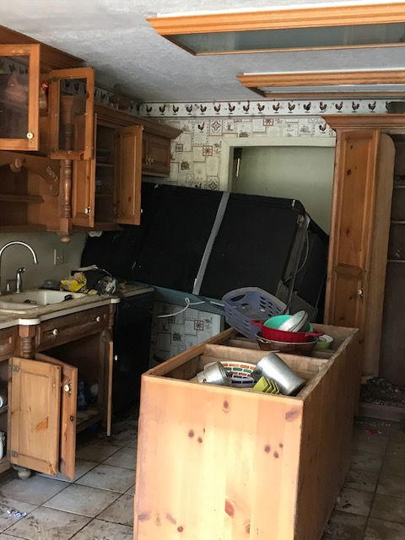
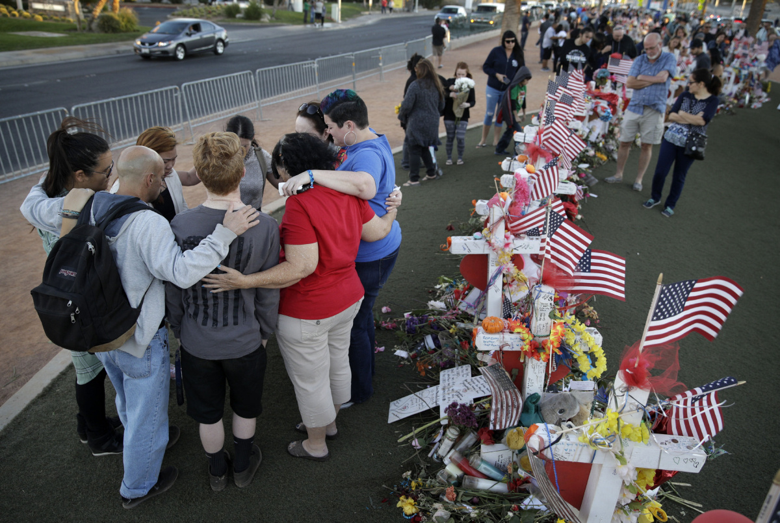
Secondary Trauma in our Society impacting Social Work Practice

Slide 5
Secondary Trauma in higher Education
Service trips
Experiences of students
NASW Code of Ethics- 4.05 Impairment
Implementing realistic trauma training
Educate and aid in Self-care plan development

Slide 6
What is self-Care?
“Reduces stress and maintain and enhance our short-Term and long-term health and well-being”

Slide 7
How do you cope now?
How do you currently manage stress?
What do you currently do for Self-care?
Lack of self-care often leads to Clinical and Ethical Errors
Lack of Time and/or Energy
Vulnerability

Slide 8
Burnout in social work Practice
When a practitioner becomes “Inoperative” (Freudenberger, 1975)
Emotional, Physical, Personal and Workplace Indicators
Increased Resignation, Irritability and numbness to professional practice
Impact of social and Supervisory Support
Often ignored until symptoms become overwhelming

Slide 9
Professional Quality of Life Scale
What do your results say about your self-care plan?

Slide 10
Effective Self-care Plan Development
Physical, Psychological, Emotional, inspirational and Professional
Take small steps
Make it Practical
Recognize barriers to self-care
Listen to your inner Coach not inner Critic

Slide 11
References:
Bride, B. (2007). Prevalence of secondary traumatic stress among social workers. Social Work , 52 63-70.
Endicott, L. (2006, October). Self-Care of the Professional: Managing Compassion Fatique and Burnout in One's Practice. NACSW Convention 2006, Philadephia, Pennsylvania .
Getz, L. (2013). Trauma-informed social work education. Social Work Today, 13(2) 18.
Jackson, K. (2014). Social worker self-care — The overlooked core competency. Social Work Today, 14(3) 14.
LLyod, C., King, R., & Chenoweth, L. (2011). Social work, stress and burnout: A review . Journal of Mental Health.

Slide 12
References:
McDermott, S. (2017, October 15). Creating Your Holistic Self-Care Plan. Retrieved from http://www.spiritwise.ie/wp-content/uploads/2013/02/SpiritWise-Holistic-Self-Care-Plan.pdf
Secondary Traumatic Stress. (2017, October 15). Retrieved from The National Child Traumatic Stress Network: Trauma-Informed Social Work Education
Smullens, S. (2012). What I wish I had known: Burnout and self-care in our social work profession. The New Social Worker.
Stamm, B. H. (2009). Professional Quality of Life: Compassion Satisfaction and Fatique Version 5.
Thomas, E. (2017, October 15). Your Self Care Plan . Retrieved from http://www.albany.edu/ssw/assets/Self-Care_plan_9-15.pdf

Slide 13
Dr. Kimberly N. Mudd-Fegett
Knmudd-fegett@Campbellsville.edu
(270) 505-5696

