Slide 1
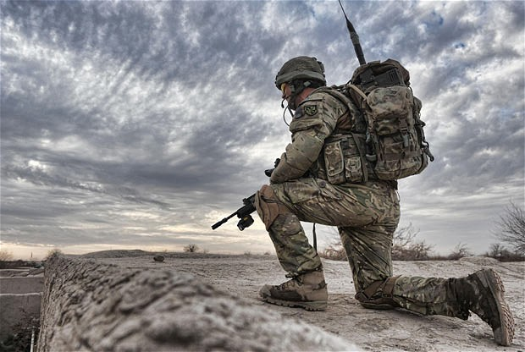
Moral Injury and the American Veteran
Tim Olsen, MSW, LCSW
University of Kentucky

Slide 2
Presenter Affiliation
The views and opinions expressed in this presentation are solely those of the authors and do not reflect an endorsement by the U.S. Government, DoD, Department of the Army, the Kentucky Army National Guard, or the Department of Veterans Affairs.

Slide 3
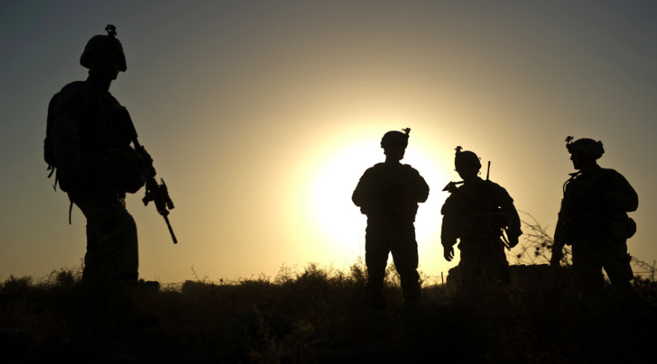
Moral Injury
The violation of core moral beliefs in war

Slide 4
Scope of Modern Challenges
Over 2.5 million U.S. troops have deployed in the wars in Iraq and Afghanistan
10-20% of returning veterans meet criteria for mental health diagnosis: PTSD, depression, anxiety, adjustment (Hoge et al., 2004, Litz & Schlenger, 2009)
Suicide rates 2-3 times general population
  Regularly outpacing combat deaths
Notes:
Pic here?

Slide 5
PTSD has received large clinical and research attention:
Approx. 13% of OEF/OIF veterans meet criteria & 11% of Vietnam Veterans currently reported to meet criteria (Hoge et al., 2004, Litz & Schlenger, 2009)
PTSD can result in debilitating symptoms and social/occupational impairment

Slide 6
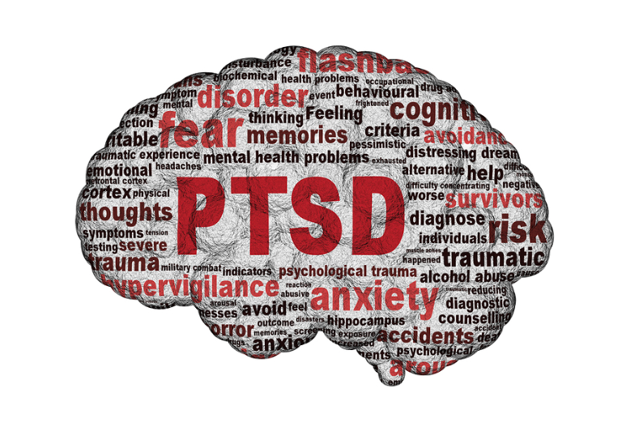
1) Intrusion
2) Avoidance
3) Negative alterations in cognitions and mood
4) Alterations in arousal and reactivity

Slide 7
Predominant Treatments for PTSD
DoD and VA clinical practice guidelines endorse 3 Evidence-based treatments:
  Cognitive Processing Therapy (CPT)
  Prolonged Exposure (PE)
  Eye Movement Desensitization and Reprocessing (EMDR)*
*Dissemination efforts have been focused primarily on PE and CPT (Litz & Maguen, 2015). EMDR has received comparatively small funding for VA and DoD research

Slide 8
Treatment Effectiveness
Dropout during treatment has been a significant issue for PTSD treatment in veterans:
  “Stigma, confidentiality concerns, perceived inefficacy, and discomfort with therapist.” (p. 497, Steenkamp et al., 2015)
60-72% of those who complete PE or CPT retain PTSD diagnosis
  Treatments reported to provide clinically significant improvement: Frequently defined as 10-12 point drop in assessment measures

Slide 9
Commonly used PTSD treatments are focused on resolving the impact of events involving intense fear/danger
Growing body of researchers and clinicians suggest reconsidering this conceptualization

Slide 10
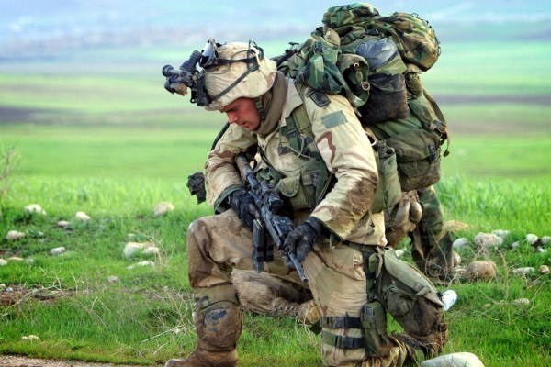

Slide 11
PTSD is
NOT
a catch-all diagnosis for
Every post-deployment challenge

Slide 12
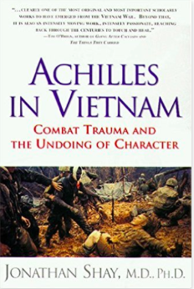
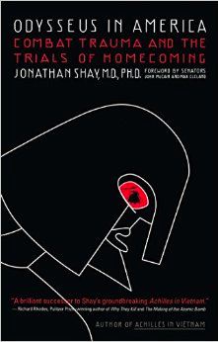
Early Discussion
Shay: Proposed term “moral injury”
  Worked with veterans of Vietnam War
  Described perceptions of betrayal by leaders and transition challenges as especially damaging…analogous to Iliad and Odyssey
Notes:
WWII, Native American Cultures
Shay focused primarily on betrayal by others

Slide 13
Early Discussion
Tick: Warrior transitions and identity: “Soul Wound”
Departure
Initiation
Return
“The Hero’s Journey” (Joseph Campbell)

Slide 14

Tick: Discussed cultures with alternative traditions of treating warriors:

Slide 15
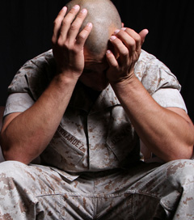
Feelings of guilt and shame
reported by veterans who:
  Kill
  Kill women or children
    (especially doing so in a state of fear or rage)
  Failed to prevent death
  Participating in or witnessing atrocities
Associated with increased PTSD symptoms (particularly re-experiencing), suicidality, and weakening in religious faith (Litz et al., 2009)

Slide 16
Event: Chief Symptom:
Danger/Life Threat ➔ Anxiety/Hyperarousal
(physiological arousal)
Acting/Failing to Act ➔ Guilt/Shame
Perceived Betrayal ➔ Anger
(Intrusion/Avoidance & Anger may be common to all)

Slide 17
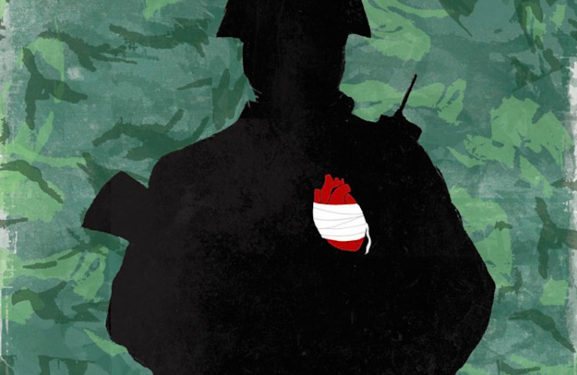
Moral Injury:
“Perpetrating, failing to prevent, bearing witness to, or learning about acts that transgress deeply held moral beliefs and expectations.”
(Litz et al., 2009)
  Military culture fosters intense moral and ethical codes of conduct

Slide 18
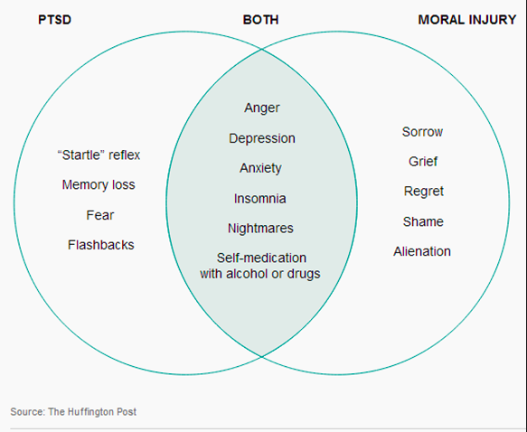
Contrast with PTSD

Slide 19
Examples:
Committing acts inconsistent with core values or beliefs (often religious/spiritual)
  “Thou shalt not kill”
  Using unnecessary force
  Killing out of anger/enjoyment vs. killing out of necessity
  Prepared to kill enemy soldier, not woman/child

Slide 20
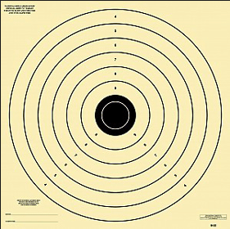
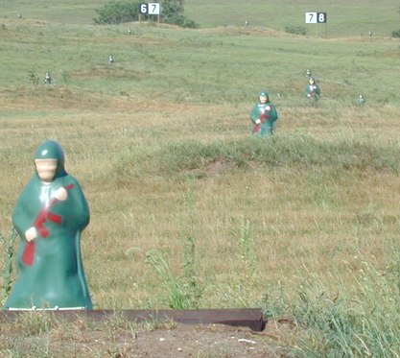
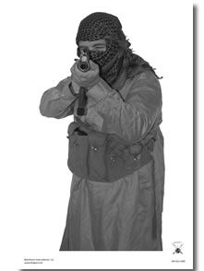
Difficulty with Killing (Grossman)

Slide 21
Examples:
Not taking action one perceives as being right
  Perceived failure to save fellow soldier
  Rules of Engagement restrict taking action
  Witnessing child physical/sexual abuse, unable to intervene
Notes:
(be careful with perception regarding rational guilt-warrior
culture/identity may have different expectations)

Slide 22
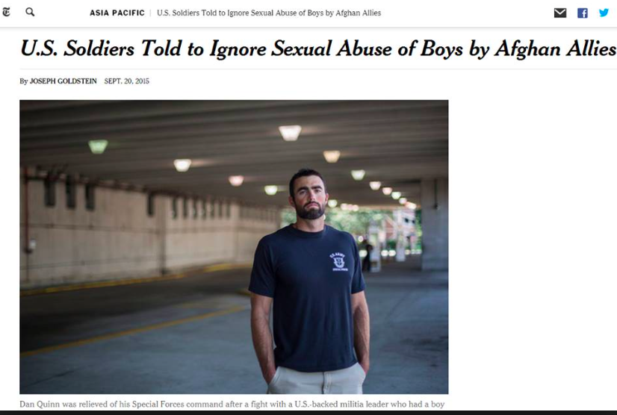
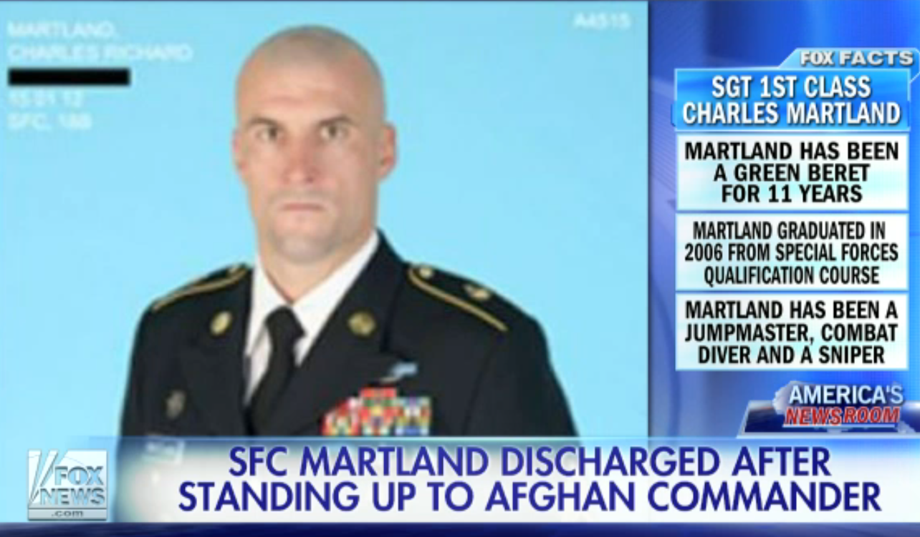
Guidance conflicts with personal values

Slide 23
Examples:
Belief of being betrayed by commanders or peers
  Unnecessary missions/loss “Chasing OER bullets”
  Being placed in a role without preparation (COIN Ops)
Perceiving one is betrayed by nation
  Went to war to fight terrorism, but did I?
  Coming home to a community that doesn’t understand or care (Vietnam, college campuses)

Slide 24
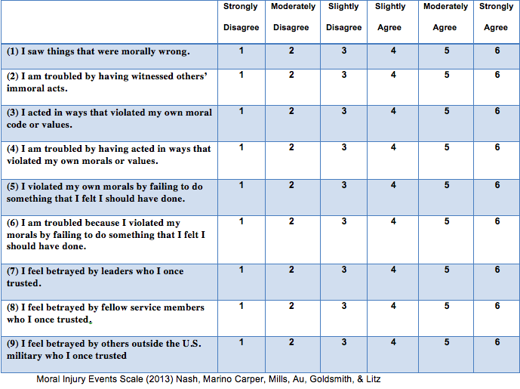
Moral Injury Events Scale

Slide 25
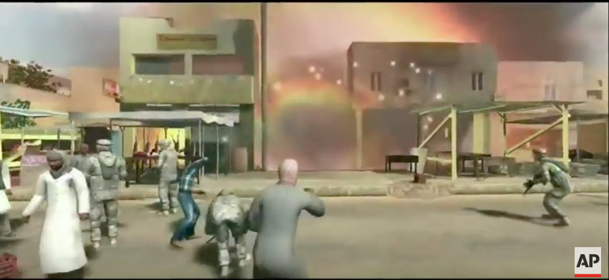
https://www.youtube.com/watch?v=WNROYryPo0A

Slide 26
Potential Concerns with Traditional PTSD Approaches
CBT-based Treatment:
  Source of distress may be rational
  (or rational in context of value system)
  Challenging as “distorted” may be problematic
Exposure-based Treatment:
  Distressing events may be genuinely immoral
  Systematic desensitization may be problematic

Slide 27
Micro, Mezzo, and Macro Approaches
Individual Therapy and relationships:
  Understanding, Acceptance, Forgiveness, Meaning Making
Group healing
  Acceptance from peers, reduced isolation
Society offering support?
  Support from community, acknowledgement of shared responsibility, diffusion of guilt?

Slide 28
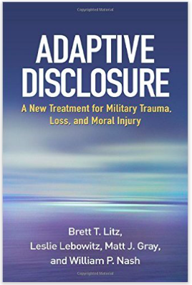
Micro-Interventions
Adaptive Disclosure Therapy
  Short-term 6-8 session
  (planting seed for healing)
  CBT and Exposure Elements
  Focus on cultural competence
  Incorporation of imaginal interaction with benevolent authority (empty chair)
  Grief module
Results with Marine sample comparable to CPT/PE studies

Slide 29
Micro-Interventions
Acceptance and Commitment Therapy
  Focus on accepting internal experiences and making behavioral commitments to live in ways that reflect values
Existential/Meaning Approaches- Logotherapy
  Those who have a 'why' to live, can bear with almost any 'how'. ~Victor Frankl
Specific Spiritual Interventions
  Pastoral Counseling to interpret scripture, etc.

Slide 30

Mezzo-Interventions
Group Therapy:
  Modified adaptive disclosure therapy
  Co-facilitated groups with chaplains and mental health professionals
Alternative Programming:
  Save A Warrior
  Outward Bound
  Warrior Adventure Quest

Slide 31
Ideas for Community Involvement:
(Tick, 2014)
Create safe and sober gathering places for veterans in every community
Create religious services that bring veterans healing and comfort
Restore meaning, respect, and commemoration to Memorial Day and Veterans Day (close malls, gather in churches & cemeteries)
Invite veterans to educate others about the reality of war in schools
Create community restoration projects for veterans to grow and develop something (as opposed to destroying)
Advocate for military training programs to effectively prepare for moral challenges
Train mental health workers, teachers, employers…in warrior culture and psychology
______________________?

Slide 32
Future Directions
Need for continued development of construct
Development of effective interventions
Collaboration between MH, clergy, and others
Training and education for service members?

Slide 33
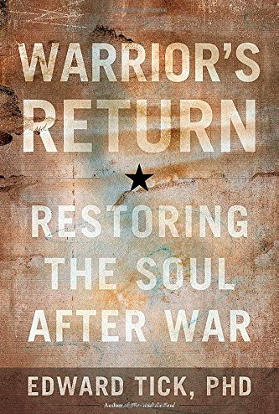
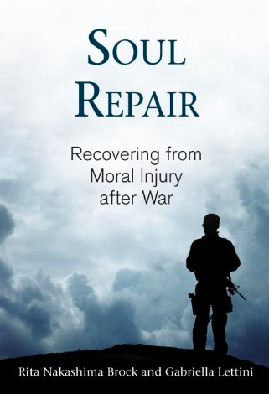
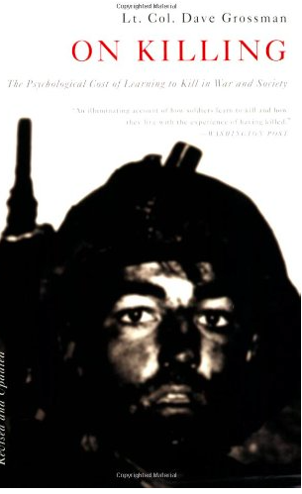
Resources

Slide 34
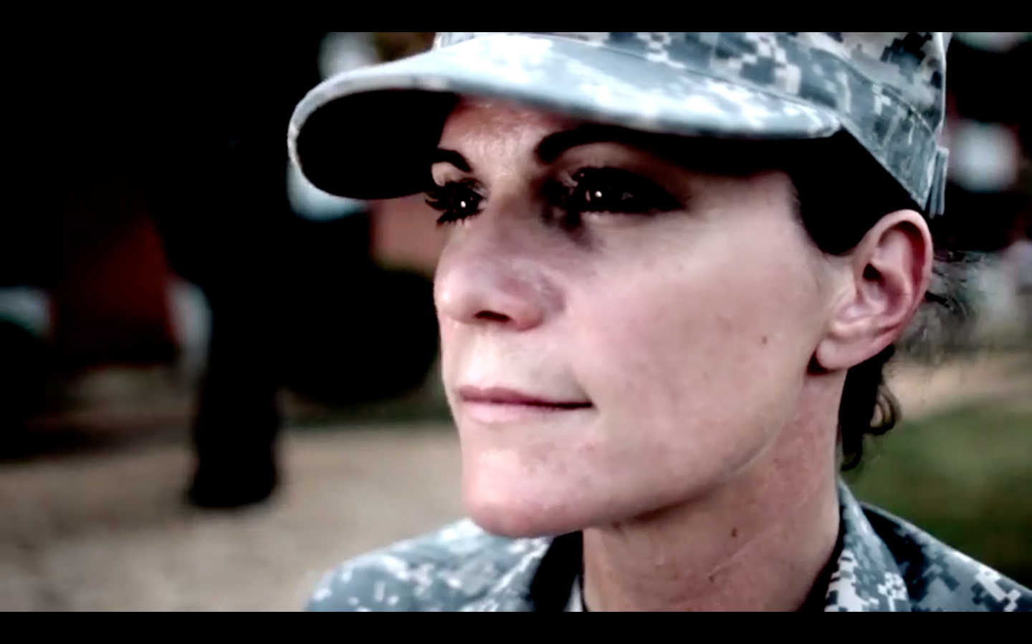
Questions?

Slide 35
References
American Psychiatric Association. (2013). Diagnostic and statistical manual of mental disorders (5th ed.). Washington, DC:
Author.Beckham, J. C., Feldman, M. E., & Kirby, A. C. (1998). Atrocities exposure in Vietnam combat veterans with chronic posttraumatic stress disorder: Relationship to combat exposure, symptom severity, guilt, and interpersonal violence. Journal of Traumatic Stress, 11, 777−785. doi: 10.1023/A:1024453618638.
Fontana, A., Rosenheck, R., & Brett, E. (1992). War zone traumas and posttraumatic stress disorder symptomatology. Journal of Nervous and Mental Disease, 180, 748-755
Fontana, A., & Rosenheck, R. (1999). A model of war zone stressors and posttraumatic stress disorder. Journal of Traumatic Stress, 12, 111-126.
doi: 10.1023/A:1024750417154.
Fontana, A., & Rosenheck, R. (2004). Trauma, change in strength of religious faith, and mental health service use among veterans treated for PTSD. Journal of Nervous and Mental Disease, 192, 579-584. doi: 10.1097/01.nmd.000013 8224.17375.55
Gray, M. J., Schorr, Y., Nash, W., Lebowitz, L., Amidon, A., Lansing, A., et al. Adaptive Disclosure: An open trial of a novel exposure-based intervention for service members with combat-related psychological stress injuries. Behavior Therapy. doi: 10.1016/j.beth.2011.09.001.
Hendin, H., & Haas, A. P. (1991). Suicide and guilt as manifestations of PTSD in Vietnam combat veterans. American Journal of Psychiatry, 148, 586-591.

Slide 36
References
Hoge, C. W., Castro, C. A., Messer, S. C., McGurk, D., Cotting, D. I., & Koffman, R. L. (2004). Combat duty in Iraq and Afghanistan, mental health problems, and barriers to care. The New England Journal of Medicine, 351(2), 13-22.
Litz, B.T., Lebowitz, L., Gray, M.J., & Nash, W.P. (2015). Adaptive Disclosure. New York: The Gilford Press.
Litz, B. T., Stein, N., Delaney, E., Lebowitz, L., Nash, W. P., Silva, C., et al. (2009). Moral injury and moral repair in war veterans: A preliminary model and intervention strategy. Clinical Psychology Review, 29, 695-706. doi: 10.1016/j.cpr.2009.07.003.
Litz, B.T., & Schlenger, W.E. (2009). PTSD in service members and new veterans of the Iraq and Afghanistan wars: A bibliography and critique. PTSD Research Quarterly, 20(1), 1-8.
Maguen, S., & Litz,B.T. (2012). Moral Injury in veterans of war. PTSD Research Quarterly, 23(1).
Nash, W., & Litz, B.T. (2013). Moral injury: A mechanism for war-related psychological trauma in military family members. Clinical Child & Family Psychology Review, 16, 365-375.
Nash, W, Carper, T. L., Mills, M.A., Au, T., Goldsmith, A., & Litz, B.T. (2013). Psychometric evaluation of the Moral Injury Events Scale. Military Medicine, 178(6), 646-652.
Shay, J. (2014). Moral injury. Psychoanalytic Psychology, 31(2), 182-191.
Steenkamp, M., Litz, B.T., Hoge, C.W., & Marmar, C.R. (2015). Psychotherapy for military-related PTSD: A review of randomized clinical trial. Journal of the American Medical Association, 314(5), 489-500.
Steenkamp, M., Litz, B.T., Gray, M.J., Lebowitz, L., Nash, W., Conoscenti, L., Amidon, A., & Lang, A. (2011). A brief exposure-based intervention for service members with PTSD. Cognitive and Behavioral Practice, 18, 998-107.
Tick, E. (2014). The Warriors Return. Boulder, CO: Sounds True Inc.
Wilkins, K.C., Lang, A.J., & Norman, S.B. (2011). Synthesis of the psychometric properties of the PTSD checklist (PCL) military, civilian, and specific versions. Depress Anxiety, author manuscript.

