Slide 1
Promoting Emotional Intimacy:
The Blessings of Marriage and Family Counseling
Jonathan C. Robinson, Ph.D.
Margaret M. Robinson, Ph.D.

Slide 2


Intimacy as the Air of Healthy Relationships
1. The Context for Social Exchange
2. Measures the Intensity of Relationship
3. Promotes Depth and Growth in Relationship

Slide 3
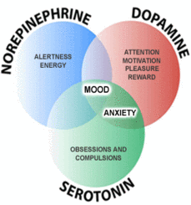
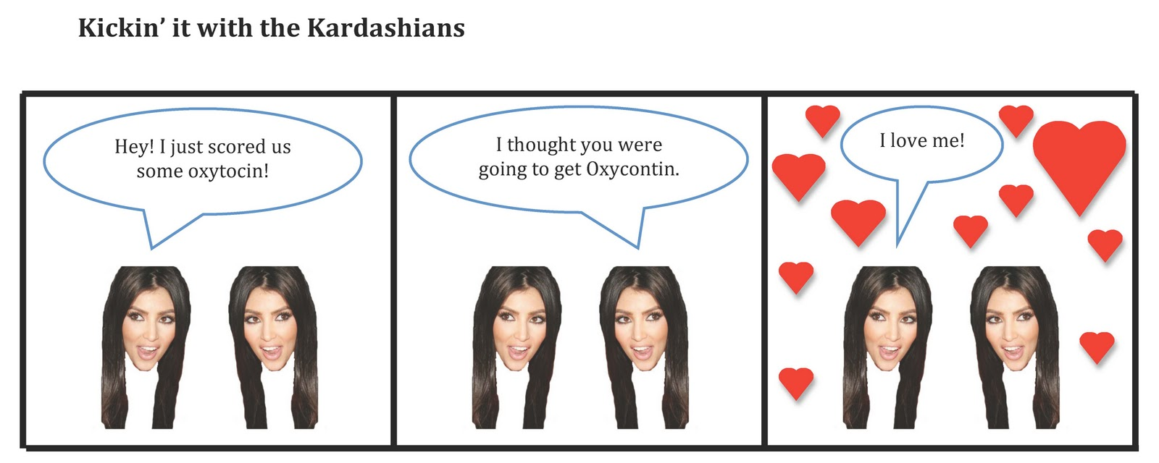
Three Forms of Intimacy
1. Verbal/Nonverbal Synchrony
2. Physical/Sexual Expression, Neurochemically Driven
      Oxytocin ---The power of touch
      Serotonin, Dopamine, Norepinephrine --- The foundation for attachment
3. Emotional Connection, “The surest path to transcendence.”
      All in balance generate emotional intimacy

Slide 4
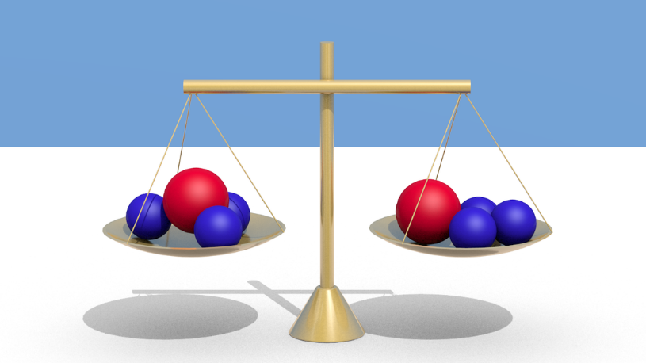
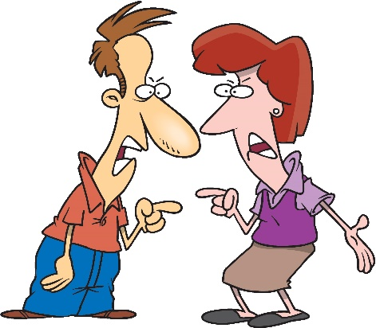

All in Balance Generate Emotional Intimacy
Without All Three Forms of Intimacy,
There Can Be No Relationship

Slide 5
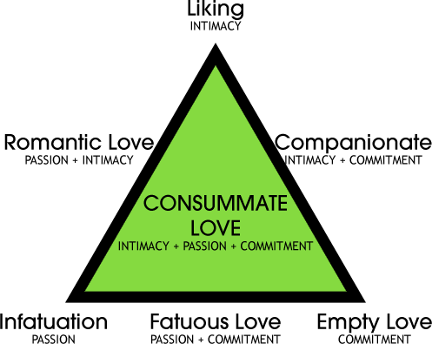

Slide 6
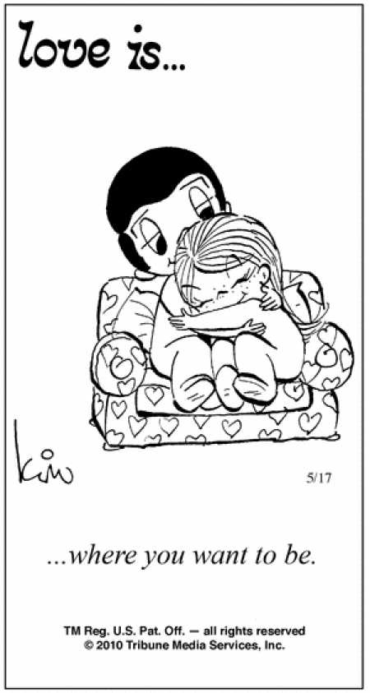

The E.I. Equation
E.I. = R + V
T
    Emotional Intimacy =
    Vulnerability + Risk
    Time

Slide 7

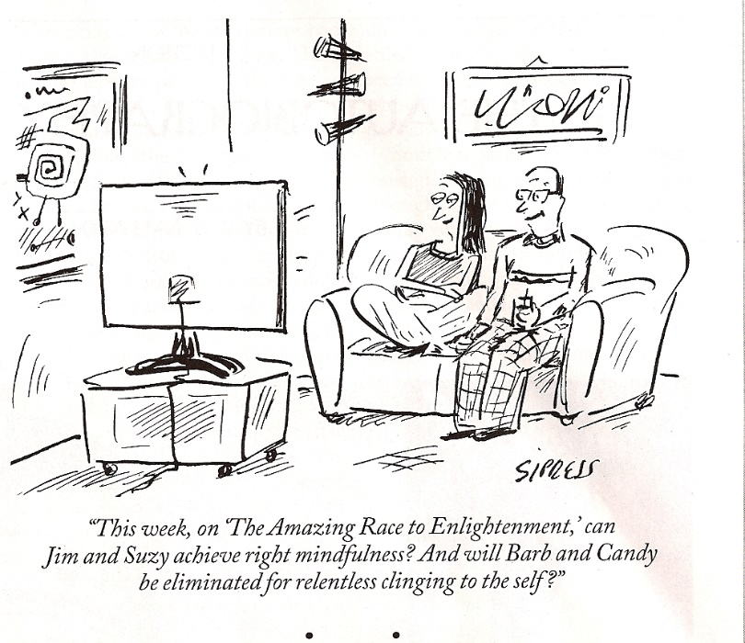
Vulnerability in Marriage & Family
Occurs when you share unknown parts of yourself
Three Examples of times and context
    1. Words and Actions in the Moment
    2. Sharing of Personal History
    3. Time with Family of Origin

Slide 8

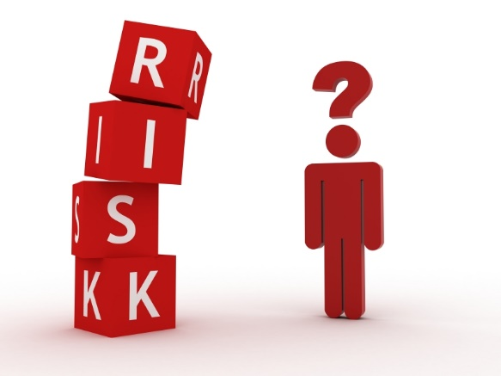
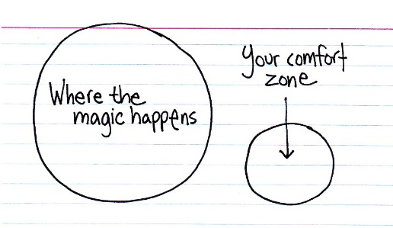
Risk-Taking Behavior
For the benefit of the marriage and family
Usually spontaneous and often unfiltered
Is outside of your usual comfort zone
Assumes positively the other’s words and actions

Slide 9


How To Develop Consistency Over Time
1. Make sharing thoughts and feelings routine.
2. With meaningful discussion, debrief afterward.
3. Schedule check-ins and follow-ups.

Slide 10

Emotional Intimacy Happens with Communication
The Message Behind Intimate Communication
    1. I want your input.
    2. You are important to me.
    3. We are in this together.

Slide 11


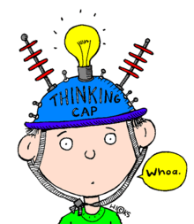
Four Types of Daily Communication
1. Directive
2. Instructional
3. Check-In
4. Teachable Moments

Slide 12
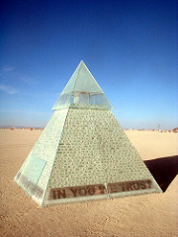
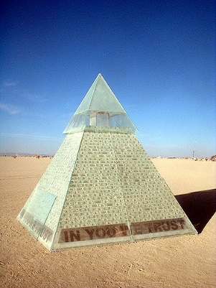
Emotional Intimacy Has A Spread of Effect.
The Plexiglas Pyramid of Relational Priority
------------------------To God
---------------To Spouse
---------To Children
To Extended Family-
To Friends----------
To Co-Workers--

Slide 13


Emotional Intimacy Is Interactive
1. Interactive Circles of Me-You-Us
2. Balancing Self-Care with Other-Care (Matt 22-36)

Slide 14
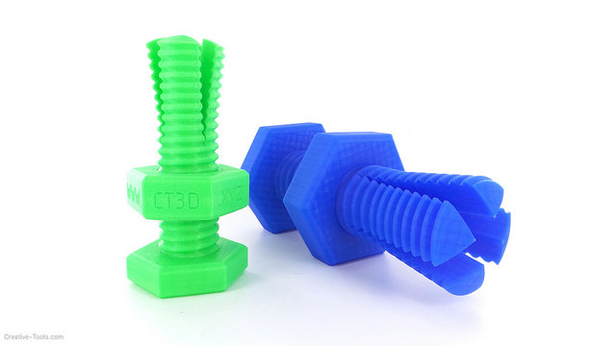


Nuts & Bolts of Promoting
Emotional Intimacy
1. Time Management
2. Consistency
3. Behavior Management
4. Making Emotional Intimacy a Priority

Slide 15


Active Listening: The Heart of Healthy Couple/Family Interaction
When the other is running an emotional fever.
When you are blind-sided.
When you are trying to figure things out.
Four variations on the theme
Three cautionary tales.

Slide 16

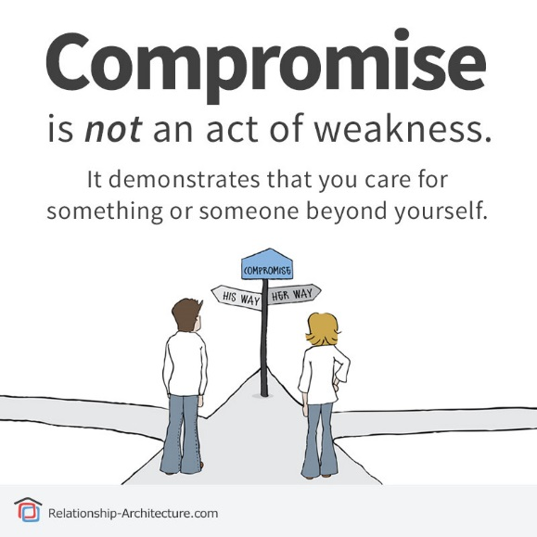

The Flip Side of Emotional Intimacy,
Effective Confrontation
Composing an elegant, 3-part, I-Message
Expecting increased tension, switch gears, re-group
When stuck, compromise and problem-solve

Slide 17



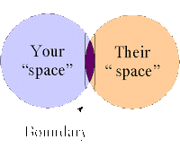

Maintaining Emotional Intimacy
Requires Healthy Boundaries
1. The freedom to say “no”
2. The conundrum of codependence
3. The blessings of boundaries

Slide 18

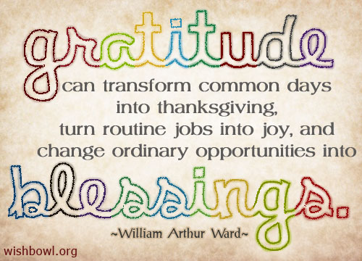

Hallmarks of
Marriage and Family Blessings
1. Concept of time passage. “Time flies when you’re having fun.”
2. Savoring the moment. “Life doesn’t get any better than this.”
3. Three visual images. Reaction time, deception, mindfulness.

Slide 19



Pulling It All Together
Teachable Marriage & Family Moments: Avoid Pressure & Pitfalls
        1. Scheduling before
        2. Debriefing after
        3. Mindfulness ---Staying on top of feelings and events
        4. Cognitive Re-Framing---Scripture verses
            2 Timothy 1:7
            Genesis 50:20
            Luke 18:27
            Phillippians 4:13
            John 10:10

Slide 20



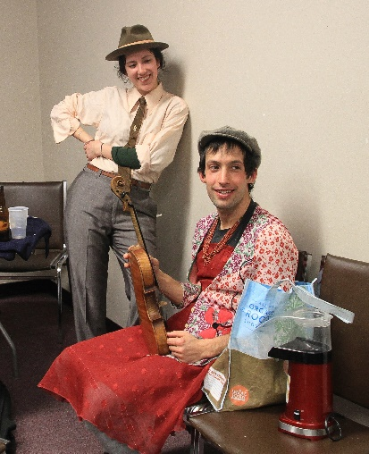

Tools for Clinical Practice
Cognitive re-framing problems into opportunities
Modelling emotional intimacy
Shadowing marriage and family interaction
Promoting role reversal in relationship

Slide 21





TEACHABLE MOMENTS
CHRISTIAN PARENTING, INC.
Jonathan C. Robinson, Ph.D.
BUILDING BLOCKS of CHRISTIAN PARENTING
www.jonathancrobinson.com
www.linkedin.com/jonrobinson
@jonrobinsonphd
www.facebook.com/jonrobinsonauthor

