Slide 1

Universal Substance Use Screening in Faith-Based Work?:
An SBIRT Overview
Annette Ward, LCSW, LCAS
NACSW Conference, Charlotte, NC
November 4, 2017

Slide 2
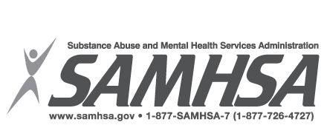




Acknowledgements:
David P. Miller, MD, MS, FACP
Associate Professor of Internal Medicine and Public Health Sciences and serves as Director of Research for the Internal Medicine Residency Program, Wake Forest University
Sebastian Kaplan, Ph.D.
Associate Professor of Psychiatry and Behavioral Medicine at Wake Forest School of Medicine. National trainer for Motivational Interviewing

Slide 3
By the end of this session, participants…
Will be able to articulate an understanding of current and historical research linking faith and overall health and recovery.
Will have a general understanding of SBIRT & why universal screening is important
Will be able to identify opportunities for more in- depth training in SBIRT and articulate possibilities for SBIRT implementation in their own practices.

Slide 4
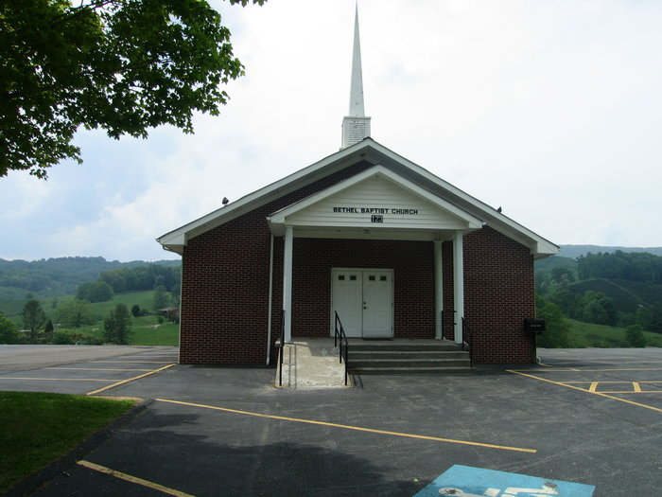
What this presentation does NOT do….
Try to start a debate about whether substance use is against God’s word.
Change church doctrine
Challenge the leadership of the
church
Challenge the leadership of the Holy Spirit

Slide 5
Faith & Health: Before 2000
1900’s- early 1970’s: The “view of religion’s relationship to health among both medical and social scientists was apathetic at best, and actively hostile at worst” (Marks, 2005, p. 174)
1970’s: Research began indicating that “religiosity inversely correlated with psychopathology”(as cited in Marks, 2005, p. 174).
2001: Koenig, McCullough, and Larson “reviewed 1,200 research studies that were conducted during the past century…(the) study indicates that a vast body of research shows a link between religion & good health” (Hester, 2002, p. 172)

Slide 6

Faith & Health: Since 2000
More recent research continues to focus on supporting previous findings
Researchers are trying to determine what factors contribute to these correlations: religious practices, beliefs, & communities as well as “bio-psycho-social variables including well-being, physical health longevity, mental health, psychological coping, and social support” (Marks, 2005, p. 183)
Researchers are struggling with consistent definitions of terms:
  Spirituality
  Religion
  Faith
  Faith-based practice (FBP)
  Clergy/Pastoral training for SUD

Slide 7

Positive Correlations Include:
Protective factors for physical health
  Cancer
  Hypertension
Protective factors for mental health
  Anxiety
  Depression
Better response to illness
Increased longevity
Substance Abuse Prevention & Recovery
  Intrinsic faith
  Adolescents, along with parental religiosity & monitoring
  Adults w/o family bonds gained more from religiosity
(Acheampong et al., 2016; Davis, 2014; Hester, 2002; Lund, 2016; Marks, 2005; Wang et al., 2016)

Slide 8
What does the Bible say?
Old Testament Examples
Ecclesiastes 9:7
⁷ Go, eat your bread with pleasure, and drink your wine with a cheerful heart, for God has already accepted your works.
Proverbs 20:1
1 Wine is a mocker, beer is a brawler,
and whoever staggers because of them is not wise.
Proverbs 23:19-21
¹⁹ Listen, my son, and be wise;
keep your mind on the right course.
²⁰ Don’t associate with those who drink too much wine
or with those who gorge themselves on meat.
²¹ For the drunkard and the glutton will become poor,
and grogginess will clothe them in rags.
Holman Christian Standard Bible (HCSB)

Slide 9

What does the Bible say?
Old Testament Examples continued…
Proverbs 23:29-30
²⁹ Who has woe? Who has sorrow?
Who has conflicts? Who has complaints?
Who has wounds for no reason?
Who has red eyes?
³⁰ Those who linger over wine,
those who go looking for mixed wine.
Isaiah 5:22-23
²² Woe to those who are heroes at drinking wine,
who are fearless at mixing beer,
²³ who acquit the guilty for a bribe
and deprive the innocent of justice.
Holman Christian Standard Bible (HCSB)

Slide 10
What does the Bible say?
New Testament Examples
1 Timothy 3:8
⁸ Deacons, likewise, should be worthy of respect, not hypocritical, not drinking a lot of wine, not greedy for money,
1 Timothy 5:23
²³ Don’t continue drinking only water, but use a little wine because of your stomach and your frequent illnesses.
Holman Christian Standard Bible (HCSB)

Slide 11

What does the Bible say?
New Testament Examples continued…
Ephesians 5:18
¹⁸ And don’t get drunk with wine, which leads to reckless actions, but be filled by the Spirit:
Romans 14:21
²¹ It is a noble thing not to eat meat, or drink wine, or do anything that makes your brother stumble.
Holman Christian Standard Bible (HCSB)

Slide 12
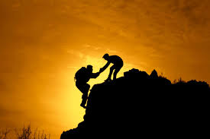
What does the Bible say about helping others?
Galatians 6:2
² Carry one another’s burdens; in this way you will fulfill the law of Christ.
James 5:14
14 Is anyone among you sick?
He should call for the elders of the
church, and they should pray over him
after anointing him with olive oil in the name of the Lord.
Holman Christian Standard Bible (HCSB)

Slide 13
What does the Bible say about helping others? (continued….)
2 Corinthians 1:4
4 He comforts us in all our affliction, so that we may be able to comfort those who are in any kind of affliction, through the comfort we ourselves receive from God.
1 Thessalonians 5:14
14 And we exhort you, brothers: warn those who are irresponsible, comfort the discouraged, help the weak, be patient with everyone.
Holman Christian Standard Bible (HCSB)

Slide 14
Our greatest strength…
None of these articles acknowledge the power of God, however.
Phillipians 4:13
¹³ I am able to do all things through Him^{[a]} who strengthens me.
Colossians 1:17
¹⁷ He is before all things, and by Him all things hold together.
1 John 4:4
⁴ You are from God, little children, and you have conquered them, because the One who is in you is greater than the one who is in the world.
Psalm 46:1
1 God is our refuge and strength, a helper who is always found
in times of trouble.
Holman Christian Standard Bible (HCSB)

Slide 15
Bottom line:
People are hurting, dying and in need of help
Substance abuse is a physical, emotional, financial, social and spiritual issue.
We come in contact with people we can reach out to in many settings, including churches and faith-based organizations
Many people turn to their pastors or other Christians for help before seeking counseling from others
God can work through us to help others!
SBIRT (an evidence based practice) is one way to reach people for harm reduction &/Or abstinence

Slide 16
The extent of the substance abuse addiction crisis requires faith-based groups take a stand and provide leadership in their communities to develop programs to deal with this national crisis.
Hester, 2002, p.177

Slide 17
What is SBIRT?
An intervention based on “motivational interviewing” strategies
  Screening: Universal screening for quickly assessing use and severity of alcohol; illicit drugs; and prescription drug use, misuse, and abuse
  Brief Intervention: Brief motivational and awareness-raising intervention given to risky or problematic substance users
  Referral to Treatment: Referrals to specialty care for patients with substance use disorders
Treatment may consist of brief treatment or specialty AOD (alcohol and other drugs) treatment.
Evidenced based, integrated public health model

Slide 18
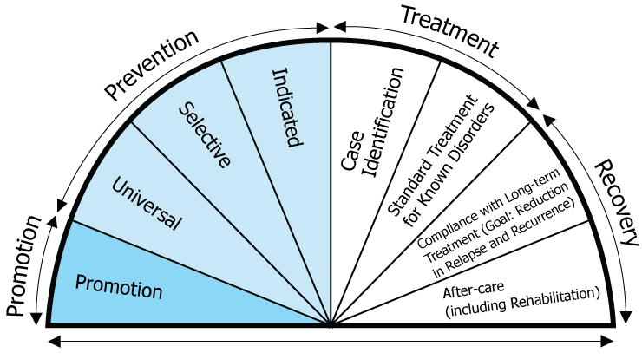
Universal Screening

Slide 19
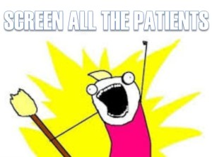

Slide 20
Why Universal Screening?
We have a BIG problem in the United States.
The Acute Care Model (traditional treatment and recovery supports) are not as effective as the Chronic Care Model (Sarah Wattenberg, Senior Advisor for Drug Policy, White House Office of National Drug Control Policy, , March 13, 2016, SBIRT Grantee Conference, Maryland).
The effects of substances on people’s lives such as exacerbating illnesses, costs to the individual as well as society, time spent to address the problems, the toll on relationships and society begin before addiction occurs

Slide 21
Why Is SBIRT Important?
Unhealthy and unsafe alcohol and drug use are major preventable public health problems resulting in more than 100,000 deaths each year.
The costs to society are more than $600 billion annually.
Effects of unhealthy and unsafe alcohol and drug use have far-reaching implications for the individual, family, workplace, community, and the health care system.
SAMSHA, (2015)

Slide 22
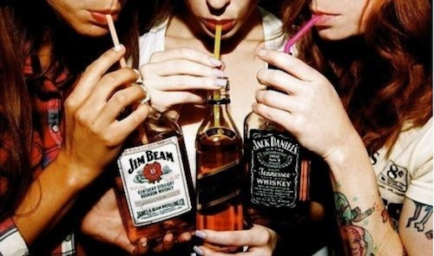
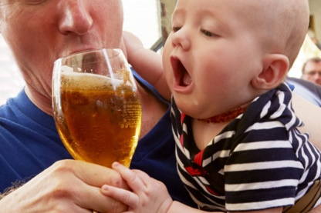
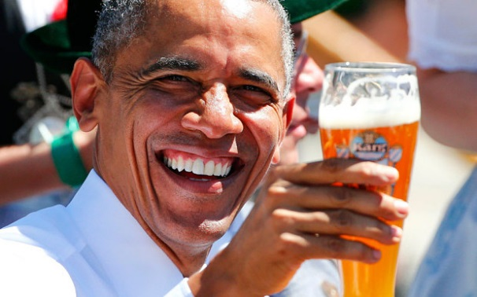
Alcohol:
What is moderate drinking?
Most Americans overestimate what “moderate drinking” is
Binge drinking negates the cardiac benefit of moderate drinking

Slide 23
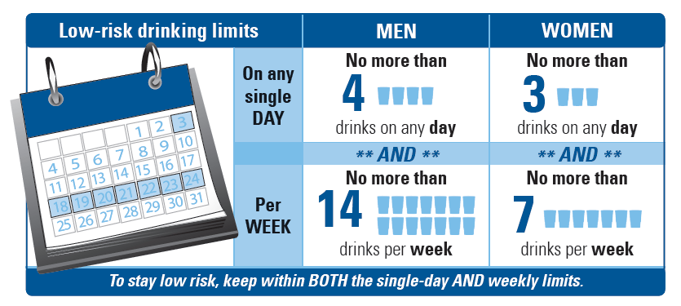
At-Risk Drinking
“binge drinking”
National Institute on Alcohol Abuse and Alcoholism. “Rethinking Drinking,” 2010.
MMWR 2012:61:14-19.
Notes:
Maybe separate out epidemiology to slide AFTER audience response slide

Slide 24
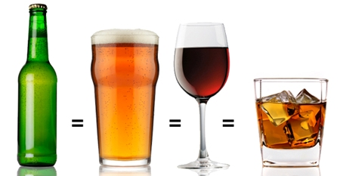
What is a Standard Drink?
12 oz
Beer
8-9 oz
Malt
Liquor
5 oz
Wine
1.5 oz/
1 shot
liquor
Beer:
12 oz = 1
16 oz = 1 1/3
22 oz = 2
40 oz = 3 1/3
Malt
Liquor:
12 oz = 1 1/2
16 oz = 2
22 oz = 2 1/2
40 oz = 4 1/2
Wine:
5 oz = 1
750 ml bottle = 5
Liquor:
1.5 oz shot = 1
Mixed drink = 1 or more
Pint = 8 1/2
Fifth = 17
~5% ~7 % ~12% ~40%
The percent of “pure” alcohol expressed here
as alcohol/volume varies by beverage.
NIAAA, 2009
http://pubs.niaaa.nih.gov/publications/RethinkingDrinking/Rethinking_Drinking.pdf
Notes:
Beware of microbrews and pints

Slide 25
4%
Dependent
24%
At Risk
37%
Low Risk
35%
No Risk

Slide 26
Harms Related to Hazardous
Alcohol and Substance Use
Increased risk for:
Injury/trauma
Criminal justice involvement
Social problems
Mental health consequences (e.g., anxiety, depression)
Increased absenteeism and accidents in the workplace

Slide 27
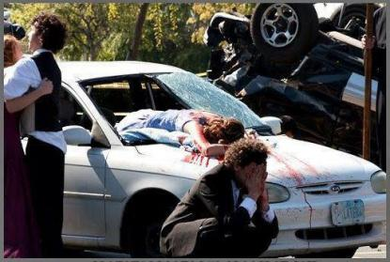
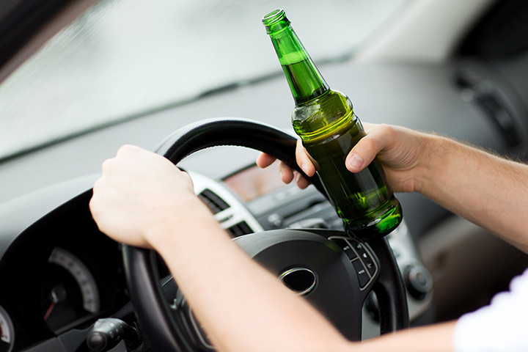
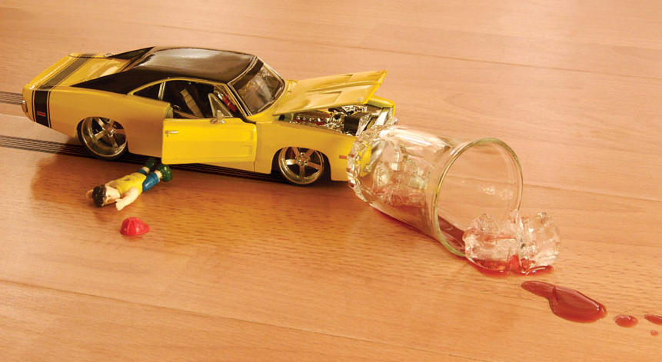
Unfortunately, these kinds of experiences remain too commonplace
Over 10,000 deaths/year
$51 billion in total costs/year

Slide 28

What problems do you notice when people binge drink?

Slide 29
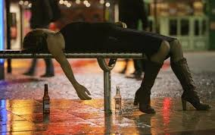
Binge Drinking:
A GREATER cause of harm/death
Other substance use
Alcohol use disorders
Liver disease
Impaired physical health
Impaired mental health
Impaired cognition/ADL’s
Obesity/overweight
DUI’s
Injuries (intentional & unintentional)
Miller, David, March 14, 2016, SBIRT Faculty Training
School problems
Unsafe sex/STD’s
Unintended pregnancy
Sexual victimization

Slide 30
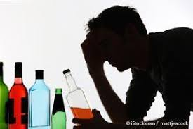
Binge Drinking Increases DUI Risk
Over 10% of binge drinkers report driving within 2 hours of their most recent binge
Almost half of alcohol-impaired driving involves persons who are not heavy drinkers, based on average daily consumption
1 in 3 college binge drinkers (2.1 million students) report driving under the influence
        Naimi et al 2009; Flowers et al, 2008; http://www.collegedrinkingprevention.gov/
Notes:
Exact figure is 11.9%

Slide 31
Other Risks of Exceeding Daily Drinking Limits (College Students)
Unsafe sex: 400,000 had unprotected sex (1:15); 100,000 too drunk to give consent
Sexual abuse: 70,000 victims of sexual assault
Academic problems: 25% of college binge drinkers report negative academic consequences (1:4)
        http://www.collegedrinkingprevention.gov/

Slide 32

What has been your experience?
How much of a problem is alcohol/drug use among your clients?
  Not a problem at all
  A small problem
  A moderate problem
  A large problem

Slide 33
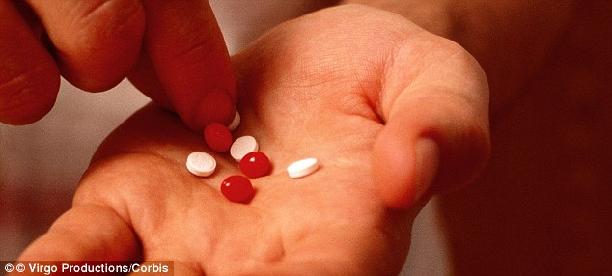
What has been your experience?
How difficult is it for your organization to impact substance use in clients?
  Not at all difficult
  Moderately difficult
  Very difficult
  Impossible

Slide 34
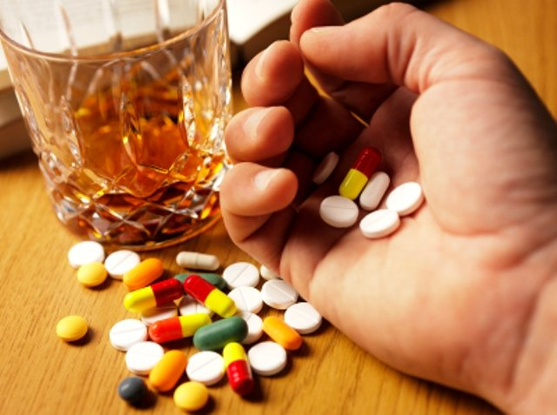
What has been your experience?
What is the greatest problem facing your organization today related to substance use issues?
Binge drinking
Alcohol addiction
Prescription pain medication abuse
Illegal drug abuse
Notes:
a

Slide 35
Current Substance Use Trends
44% of adult population binge drinks
Greatest # of people using marijuana- 22.2million people
4.3 million people use pain medications
As of 2014, 17 million have an alcohol use disorder
Since 2000, increase in drug overdoses by 137% with 200% increase in overdose deaths of opioid abuse
2014, upward trend in initiating heroin use and overdose deaths
(Kimberly Johnson, PhD, Director, SAMHSA, March 12, 2016, SBIRT Grantee Conference, Maryland).

Slide 36
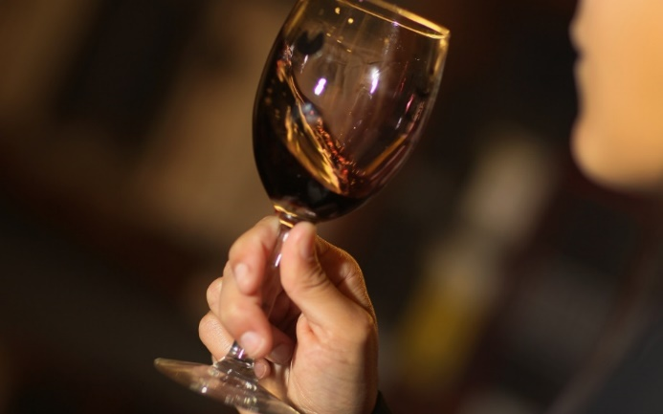
Terms used: Hazardous drinking, at-risk drinking, healthy alcohol limits, binge drinking, etc.
“At-risk”
Alcoholic

Slide 37
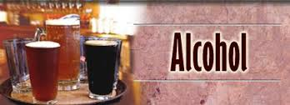
Alcohol & Teens
Alcohol is by far the drug of choice among youth (NIAAA, 2015).
1 in ____ children begin drinking by the end of 8th grade…Of them, half report being drunk (NIAAA, 2015).
Answer: 3
The average age at first drink is about ______, according to national surveys of 12- to 20-year-olds
Answer: 14
(Chen, C. M., Yi, H., & Faden, V. B. (2011). NIAAA trends in underage drinking in the United States, 1991–2009, Surveillance Report #91).

Slide 38
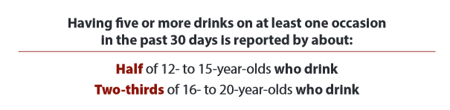
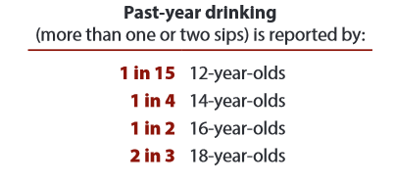
Binge Drinking & Teens
Binge drinking:
(students have reported having 5 or more drinks in a row in the past two weeks)
1 in 14 8th graders; 1 in 6 10th graders; 1 in 4 12th graders.
NIDA, 2016
Johnston, L. D., O’Malley, P. M., Bachman, J. G., & Schulenberg, J. E. (2011). Monitoring the Future national results on adolescent drug use: Overview of key findings, 2010. Ann Arbor: Institute for Social Research, The University of Michigan.

Slide 39
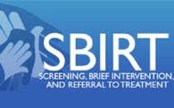
Uses of SBIRT
SBIRT can be used with people age 11 through adult, including the aging population
SBIRT can be used in a variety of settings
SBIRT can be used with alcohol, other drugs & other issues such as general health concerns

Slide 40
SBIRT Is a Highly Flexible Intervention
SBIRT Settings
Aging/Senior Services | Inpatient
Behavioral Health Clinic | Primary Care Clinic
Community Health Center | Psychiatric Clinic
Community Mental Health Center | School-Based/Student Health
Drug Abuse/Addiction Services | Trauma Centers/Trauma Units
Emergency Room | Urgent Care
Federally Qualified Health Center | Veterans Hospital
Homeless Facility | Other Agency Sites
Hospital

Slide 41
5 Basic Components of an
SBIRT System
Prescreening (1-2 question screen)
Screening (AUDIT / DAST; CRAFFT)
Clinician Intervention for all screen-positive clients
Referral as appropriate for clients with higher levels of risk or possibly dependent
Follow-up assessment/reinforcement at future visits

Slide 42

SBIRT Tools
AUDIT (Alcohol)
DAST (Drugs)
CRAFFT (Teens)
  Other tools screen for dependency only. Ex. CAGE is too broad for pre-screening or screening.

Slide 43
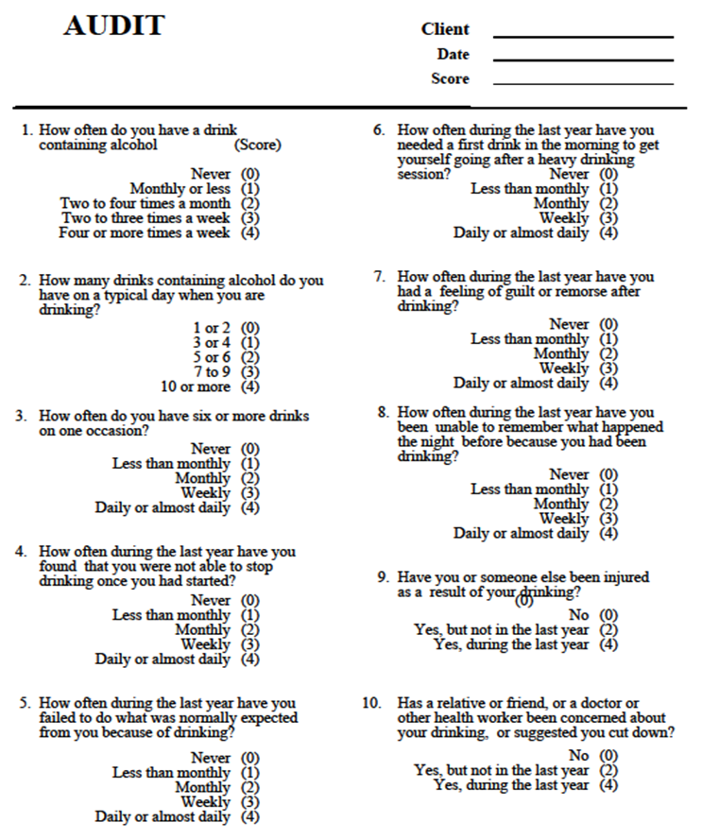
AUDIT Questionnaire
WHO, 1992

Slide 44
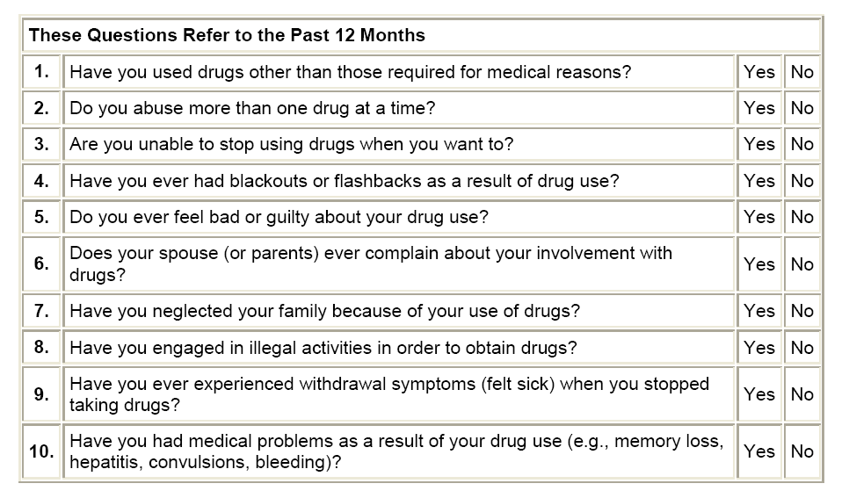
DAST(10) Questionnaire
Source: Yudko et al., 2007

Slide 45
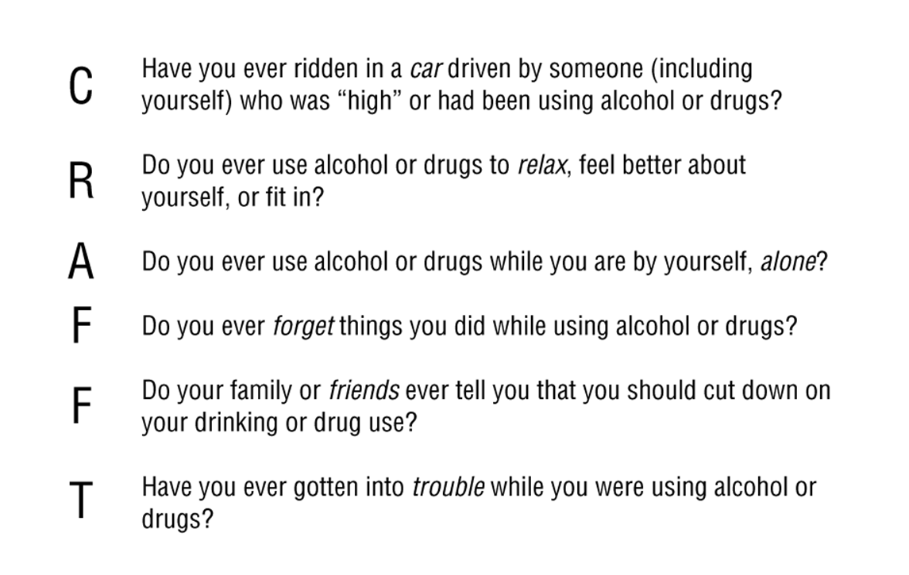
Prescreening/Screening for Adolescents: CRAFFT
Ask everyone

Slide 46
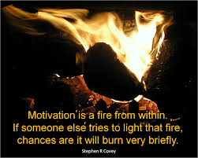
Motivational Interviewing…
The heart of SBIRT
MI SPIRIT
Core Skills:
  OARS
  REDS
Strategies:
  Readiness Rulers
  Decisional Balance
  Personalized Reflective Discussion

Slide 47

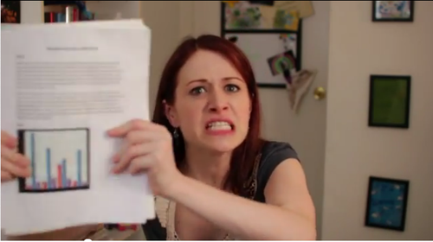
Research Shows
Brief Interventions―
Are low cost and effective
Are most effective among persons with less severe problems
“Brief interventions are feasible and highly effective components of an overall public health approach to reducing alcohol misuse.”
  (Whitlock et al., 2004, for U.S. Preventive Services Task Force)

Slide 48

Remember:
  SBIRT
Treatment
Faith is a significant factor in overall health
You don’t have to use SBIRT perfectly to have an impact on someone’s life!

Slide 49
SBIRT & Faith
Faith and Spirituality Integrated SBIRT Network
The Mission of the Faith & Spirituality Integrated SBIRT Network is to provide SBIRT training that helps allied health professionals engage in culturally competent clinical practice by integrating faith and spirituality during behavior change discussions with clients and patients in various health care settings.
Partner Universities
Partner Sites
Hospital Chaplains, Clergy, Department of MH

Slide 50
SBIRT & Faith continued
Contact information:
The Faith & Spirituality Integrated SBIRT Network
918 E. Alosta Ave.
Azusa, CA 91702
626-815-6000 ext. 2417
Email: healthpsychlab@apu.edu
  http://www.sbirtfaithandspirituality.org/www/lms/default.aspx
University of Alabama, AL-SBIRT
  Integrated Health Care Implementation
  EMS, Fire & Rescue, Chaplains

Slide 51

SBIRT In Your Practice?
Where are you currently practicing?
Do you already screen for substance use, not just abuse?
Do you have an opportunity to reach out to people?
How would a reduction or elimination of substance use help people in their relationship with God and with others?
What questions or comments do you have about SBIRT?

Slide 52
Reimbursement www.samhsa.gove/sbirt/coding-reimbursement
Payer | Code | Description | Fee Schedule
Commercial Insurance | CPT 99408 CPT 99409 | Alcohol and/or substance abuse structured screening and brief intervention services; 15 to 30 minutes Alcohol and/or substance abuse structured screening and brief intervention services; greater than 30 minutes | $33.41 $65.51
Medicare | G0396 G0397 | Alcohol and/or substance abuse structured screening and brief intervention services; 15 to 30 minutes Alcohol and/or substance abuse structured screening and brief intervention services; greater than 30 minutes | $29.42 $57.69
Medicaid | H0049 H0050 | Alcohol and/or drug screening Alcohol and/or drug screening, brief intervention, per 15 minutes | $24.00 $48.00

Slide 53
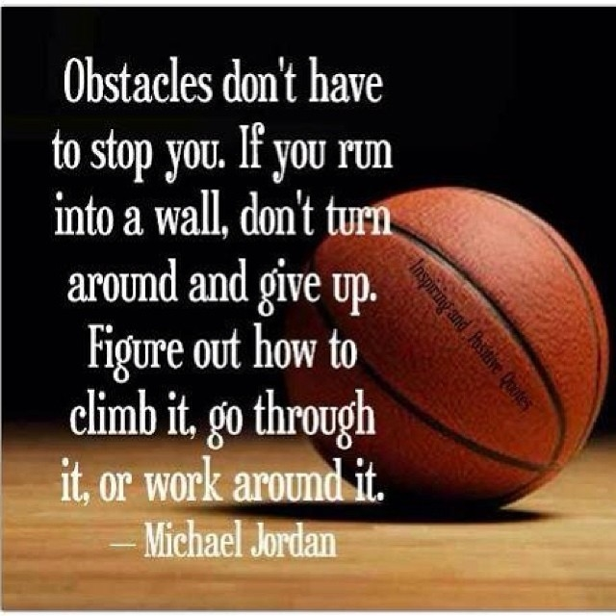
What obstacles do you see?

Slide 54


Slide 55

Information &
Training Resources
-ncsbirt.org
-ireta.org/category/sbirt
-https://www.samhsa.gov/sbirt
-http://www.marylandsbirt.org
-http://sbirt.vermont.gov
-http://www.sbirtoregon.org
-ihhs.appstate.edu/sbirt

Slide 56
Resources
Acheampong, A., Lasopa, S., Striley, C., & Cottler, L. (2016). Gender differences in the association between religion/spirituality and simultaneous polysubstance use (SPU). Journal of Religious Health, 55, 1574-1584.
Arnold, R., Avants, S., Margolin, A., & Marcotte, D. (2002). Patient attitudes concerning the inclusion of spirituality into addiction treatment. Journal of Substance Abuse Treatment, 23(4), 319-326. doi:10.1016/s0740-5472(02)00282-9
Brome, D. R., Owens, M. D., Allen, K., & Vevaina, T. (2000). An examination of spirituality among African American women in recovery from substance abuse. Journal of Black Psychology, 26(4), 470-486. doi:10.1177/0095798400026004008
Cheney, A., Curran, G., Booth, B., Sullivan, S., Stewart, K., & Borders, T. (2014). The religious and spiritual dimensions of cutting down and stopping cocaine use: A qualitative exploration among African Americans in the south. Journal of Drug Issues, 44(1), 94-113.
Davis, M. (2014). Religious and non-religious components in substance abuse treatment: A comparative analysis of faith-based and secular interventions. Journal of Social Work, 14(3), 243-259.

Slide 57
Continued…
Green, L. L., Fullilove, M. T., & Fullilove, R. E. (1998). Stories of spiritual awakening: The nature of spirituality in recovery. Journal of Substance Abuse Treatment, 15(4), 325-331. doi:10.1016/S0740-5472(97)00211-0
Gorsuch, R. L. (1995). Religious aspects of substance abuse and recovery. Journal of Social Issues, 51(2), 65-83. doi:10.1111/j.1540-4560.1995.tb01324.x
Hester, R. D. (2002). Spirituality and faith-based organizations: Their role in substance abuse treatment. Administration and Policy in Mental Health and Mental Health Services Research, 30(2), 173-178. doi: 10.1023/A:1022589303010
Kim-Spoon, J., Farley, J., Holmes, C., Longo, G., & McCullough, M. (2014). Processes linking parents’ and adolescents’ religiousness and adolescent substance use: Monitoring and self-control. Journal of Youth and Adolescence. 43. 745-756.
Lund, Pekka. (2016). Christianity in narratives of recovery from substance abuse. Pastoral Psychology. 65, 351-368.
Marks, L. (2005). Religion and bio-psycho- social health: A review and conceptual model. Journal of Religion and Health, 44(2), 173-186. doi:10.1007/s10943-005-2775-z

Slide 58
Continued…
Matthews, D. A. (1998). Religious commitment and health status: A review of the research and implications for family medicine. Archives of Family Medicine, 7(2), 118-124. doi:10.1001/archfami.7.2.118
Neff, J. A., Shorkey, C. T., & Windsor, L. C. (2006). Contrasting faith-based and traditional substance abuse treatment programs. Journal of Substance Abuse Treatment, 30(1), 49-61. doi:10.1016/j.jsat.2005.10.001
Pardini, D. A., Plante, T. G., Sherman, A., & Stump, J. E. (2000). Religious faith and spirituality in substance abuse recovery. Journal of Substance Abuse Treatment, 19(4), 347-354. doi:10.1016/s0740-5472(00)00125-2
Piedmont, R. L. (2004). Spiritual transcendence as a predictor of psychosocial outcome from an outpatient substance abuse program. Psychology of Addictive Behaviors, 18(3), 213-222. doi:10.1037/0893-164x.18.3.213
Wang, M., Wong, Y.J., Nyutu, P., Spears, A., and Nichols III, W., (2016). Suicide protective factors in outpatient substance abuse patients: Religious faith and family support. The International Journal for the Psychology of Religion. 26(4), 370-381.

Slide 59
Annette Ward, LCSW, LCAS
Appalachian State University
Mt. Vernon Baptist Church Counseling Ministry
wardja1@appstate.edu

