Slide 1
Opioid Use in Pregnancy: An Evidence-Based Approach
Cayce Watson, LAPSW, MAC cayce.watson@lipscomb.edu Lipscomb University
April Mallory, LCSW, MAC amallor3@utk.edu University of Tennessee College of Social Work

Slide 2
Workshop Learning Objectives
Discuss the scope of opioid use among women and risks during pregnancy, including NAS.
Utilize a case example to illustrate potential treatment conflicts for practitioners when using MAT with pregnant clients.
Describe evidence-based points of intervention at both the individual and community practice levels.

Slide 3
Overview of Opioids
Opioids are a class of drugs historically used as painkillers.
They have great potential for misuse. Repeated use of opioids greatly increases the risk of developing an opioid use disorder.
Prescription Opioids: doctors prescribe for pain relief, but they are frequently diverted for improper use.
In the 2013 & 2014 National Survey on Drug Use and Health (NSDUH), 50.5% of people who misused prescription painkillers got them from a friend or relative for free, and 22.1% got them from a doctor.
Consistent use of opioids results in increased tolerance (needing more for the same result) & the person may not be able to maintain the source for the drugs. This can cause them to turn to the black market for these drugs & even switch from prescription drugs to cheaper & more risky substitutes like heroin. (“Opioids,” 2016)

Slide 4

The Scope of the Epidemic
According to the National Survey on Drug Use and Health (NSDUH) in 2014:
4.3 million Americans engaged in non-medical use of prescription painkillers in the last month.
Approximately 1.9 million Americans met criteria for prescription painkillers use disorder based on their use in the past year.
1.4 million people used prescription painkillers non-medically for the first time in the past year.
The average age for prescription painkiller first-time use was 21.2 in the past year.
Admissions to treatment for primary pain reliever use increased in 2012 to 972K from low-mid-700s in previous years
Though non-medical use in young people (18-25) has declined 2002-2013, it is still the second most prevalent illicit use category and significantly more than other categories of prescription abuse
(Center for Behavioral Health Statistics and Quality, 2015)

Slide 5
What changed?
Sales of prescription opioids nearly quadrupled from 1999 to 2014. (“Injury Prevention,” 2016)
  Possible causes: increased marketing, change in prescribing habit from use for acute pain to use for chronic pain, cultural change to focus on pain as the 5th vital sign
Primary care providers now account for about half of the pain prescriptions in the US
Prescribing variability region to region (“Injury Prevention,” 2016)
Pain medications began being prescribed to younger people. According to Fortuna, et al., rates “nearly doubled from 1994-2007.” (American Society of Addiction Medicine, 2016)
Notes:
Objective 1
Get numbers on admissions for tx, rx by region (TDH chart from 2014 or 15) for local

Slide 6

Opioid Use & Women
A rising problem for women of reproductive age with 7 out of 10 drug related overdose deaths including some form of prescription painkiller (CDC, 2013).
Females are more likely to receive opioid prescriptions for issues like chronic pain and they tend to develop drug dependency faster than their male counterparts (Salter, Ridley, & Cumings, 2015).
Prescribing disparities exist among women living in poverty. 39% of women on Medicaid filled an opioid prescription at a pharmacy compared to 28% of women with private insurance (CDC, 2015).
TEDS Report 2014 shows data from admissions. More women were admitted to treatment for prescription painkiller use than men (19% v. 12%)
Overdose deaths among women due to the use of prescription opioids has increased since 2007, and has surpassed deaths from motor vehicle-related accidents; with a “5-fold increase between 1999 and 2010, totaling 47,935 during that period” (CDC, 2013, SAMHSA, 2016).
Notes:
Objective one
Get numbers on admissions for tx, rx by region (TDH chart from 2014 or 15)
http://www.samhsa.gov/data/sites/default/files/sr077-gender-differences-2014.pdf
Substance Abuse and Mental Health Services Administration, Results from the 2013 National Survey on Drug Use and Health: Summary of National Findings, NSDUH Series H-48, HHS Publication No. (SMA) 14-4863. Rockville, MD: Substance Abuse and Mental Health Services Administration, 2014.

Slide 7
Women of reproductive age who filled an opioid prescription
2008-2012
(Patrick, 2016) and (CDC, 2015)
Notes:
This bill does reflect the commendable goal of addressing the drastic increase in NAS
This bill criminalizes addiction, which we know is a complex disease that deserves public health approach to treatment.
There are major discrepancies in opioid prescribing, with more women are prescribed opioids than men.
Women from lower socioeconomic groups are also prescribed more of these highly addicted substances than women from higher SES groups, at a rate that is 39% higher.

Slide 8
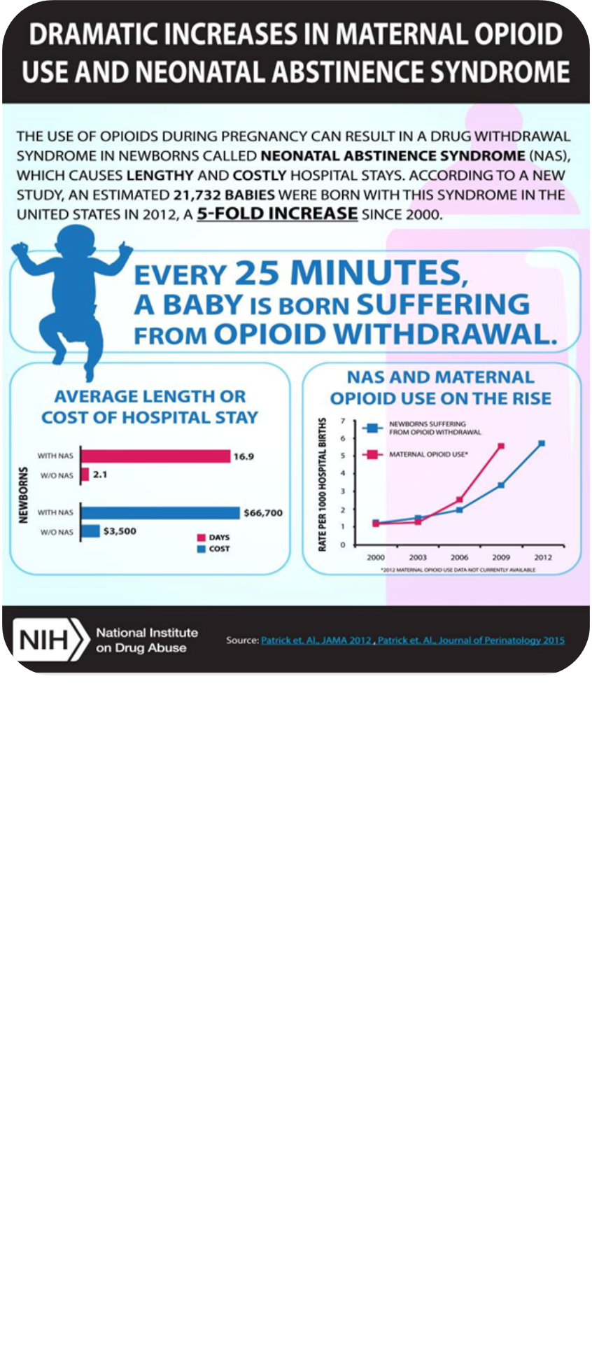
Opioid Use & Pregnancy
Includes the use of heroin and/or the misuse of prescription opioid medications (ACOG, 2012).
The concern is neonatal withdrawal and the “addicted baby” however this term is misleading and stigmatizing. Addiction is described as a set of compulsive behaviors that continue despite adverse consequences while the withdrawal symptoms in newborns are associated with evidence of only physiological dependence (Newman, 2013).
On average, between 50-60 percent of opioid-exposed infants will experience NAS and require some form of pharmacological intervention (Salter et al., 2015 & ASTHO, 2014).
The current standard of care includes the use of medication-assisted therapy (ACOG, 2012).
Practitioners disagree with treatment options; this creates conflicts among providers and community resources, leading to improper/incomplete care for mothers and babies, including pregnant women being treated with non-therapeutic levels of medication to limit exposure to the fetus (Jones, et al, 2008).
Notes:
“Withdrawal from opioid use during pregnancy is associated with poor neonatal outcomes, including early preterm birth or fetal demise, and with higher relapse rates among women; robust evidence has demonstrated that maintenance therapy during pregnancy can improve outcomes.

Slide 9
The Rationale for Opioid-assisted Therapy During Pregnancy
2005 – 2010, NIH and NIDA sponsored a multi-site national study concerning opioid use among pregnant women.
  Prevent Opioid withdrawal or symptoms
  Provide MAT for stabilization
  Mitigate euphoria and desire/craving to use illicit opiates and other drugs, while stabilizing the environment for the fetus and limiting exposure to illicit drugs (Jones, et. al., 2008).
“Prevent complications of illicit opioid use and narcotic withdrawal, encourage prenatal care and drug treatment, reduce criminal activity, and avoid risks to the patient of associating with a drug culture. . . Neonatal abstinence syndrome is an expected and treatable condition that follows prenatal exposure to opioid agonists and requires collaboration with the pediatric care team” (ACOG, 2014).
Women are able to shift focus to healing, relationships, preparing to parent, however a crucial component of psychosocial interventions and support are needed in addition to the pharmacological interventions for sustained success (Jones, et al., 2008).

Slide 10

Medication-Assisted Therapy (MAT)
Pregnant women who stop using opioids and relapse have increased risk of overdose (SAMHSA, 2016).
MAT or Medication Assisted Therapy is considered best practice (ACOG, 2012), but should include both medication and behavioral therapies (SAMSHA, 2014).
Methadone has been used for decades to treat opioid dependency and multiple studies prove it to be a safe option during pregnancy, however one risk includes NAS (SAMHSA, 2008).
Another treatment option for women is buprenorphine, which acts on the same receptors as morphine and heroin. Buprenorphine is prescribed by approved and specially trained physicians in an office setting which leads to increased patient compliance and reduced stigma. However, this drug has not been studied as extensively in pregnant women long-term and, as such, may require additional informed consent (ACOG, 2012 & SAMSHA 2008).
Unfortunate stigma associated with MAT (enabling drug use, substituting, not true recovery)
Notes:
Opioid agonist or agonist-antagonist combination medication is introduced to create a steady-state, avoiding the intoxication-withdrawal cycle (methadone, buprenorphine, or buprenorphine-naloxone combinations).
Medication-Assisted Therapy is a standard evidence-based treatment for opioid dependence. Of course, opioid use during pregnancy – including MAT, prescription opioid use for pain, or non-medical opioid use – can put infants at risk of neonatal abstinence syndrome (NAS). However, NAS is both expected and treatable, and evidence has shown that it does not lead to long-term complications. Because of superior outcomes associated with MAT compared with withdrawal, ACOG continues to recommend use of MAT as the standard of care during pregnancy for women with opioid use disorders” (ACOG, 2016).

Slide 11
Methadone Buprenorphine
Reduces fluctuations in maternal serum opioid levels, so it protects a fetus from repeated withdrawal episodes (TIP, 43, 2015).
Induction monitoring, if prior stabilization (remain, Withdrawal overlaps with pregnancy, split dosing later in pregnancy, continued during labor and delivery, require 70% more meds post delivery, discuss stress and dose reduction if overmedicated (Jones, et al., 2008).
There is “no compelling evidence” that maternal dose predicts symptoms of NAS, thus higher doses are recommended because they are related to illicit substance use, compliance with prenatal care, prolonged gestation, and improved growth of the infant (TIP, 43, 2015).
Infants exposed are likely have shorter treatment stays and less medication to treat the symptoms of NAS compared to infants exposed to methadone (Jones, et al., 2010).
Subutex (buprenorphine) or Suboxone (buprenorphine + naloxone)less sedation; Less acute withdrawal; possible to hold dose during labor, require less additional opioids post delivery (Jones, et al., 2008).
Produces similar outcomes with less severe NAS. No significant adverse maternal or neonatal outcomes related to the use of buprenorphine + naloxone have been reported (Debelak, Morrone, O’ Grady, & Jones, 2013 & ACOG 2014).
Notes:
here have been case studies associating such morbidities as stillbirth, fetal distress, and premature delivery with detoxification from methadone (Jones, et, al 2008).
2010 study the buprenorphine-exposed neonates required, on average, 89% less morphine to treat neonatal abstinence syndrome, a 43% shorter hospital stay, and a 58% shorter duration of medical treatment for neonatal abstinence syndrome. These results support the use of buprenorphine as a potential first-line medication for pregnant opioid-dependent women who are new to treatment. (AGOG, 2014).
Methadone and buprenorphine are classified as Pregnancy Category C5 drugs by the FDA, well-controlled studies of how these drugs affect pregnant women
are lacking. (SAMHSA, 2016). With both combination with alcohol of benzos can be fatal)

Slide 12
Emerging Research: Detox as a Choice
Bell Study: (2016)
4 methods: acute detoxification of incarcerated patients; inpatient detoxification with intense outpatient follow-up management; inpatient detoxification without intense outpatient follow-up management; and slow outpatient buprenorphine detoxification
“600 patients have been reported to detoxify from opiates during pregnancy with no report of fetal harm related to the process. These data highly suggest that detoxification of opiate-addicted pregnant patients is not harmful. The rate of neonatal abstinence syndrome is high but primarily when no continued long-term follow-up occurs.”
“Whether this treatment management should become common practice in obstetrics will take further study as to whether detoxification/long- term behavioral health programs can be universally developed, implemented, and funded.”

Slide 13
Redefining our Approach to Clients:
Choice: Clients’ readiness for change; worker uses clients’ capacities and provides options and encourages self-efficacy.
    Empowerment: Increase one’s capacity to take control of her situation by “meeting the client where the client is”
Dialogue and Collaboration: Based on empathy and inclusion- relationship is central to trust and the vehicle for change.
Redefine Successful Outcomes: Measuring and affirming positive outcomes as – any reduction in risky behaviors or use, and not by total abstinence. Emphasizes incremental change and “in a hierarchy with the more feasible options at one end (e.g., measures to keep people healthy) and less feasible but desirable options at the other end.”
Dignity and Worth: Harm Reduction avoids the stigma associated with drug use, approaches clients with compassion and without judgment

Slide 14

Bigler (2005) states: Personhood stands above moral judgments regarding risky or socially negative behaviors. A person is not left to suffer simply because the experience, the disease, or the harm is a natural consequence of her/his own behavioral choices. (p. 76)
“Seeking obstetric-gynecologic care should not expose a woman to criminal or civil penalties, such as incarceration, involuntary commitment, loss of custody of her children, or loss of housing. These approaches treat addiction as a moral failing” (ACOG, 2011).
Social workers should advocate for coordinated community intervention focused not only on the health of the newborn but the dignity and worth of the pregnant woman. This can be achieved through interagency collaboration with social service providers, women’s health providers, and pediatric care providers (Watson & Mallory, 2017).
Notes:
Move away from a moral model of understanding complex individual and social problems within the macro context.

Slide 15
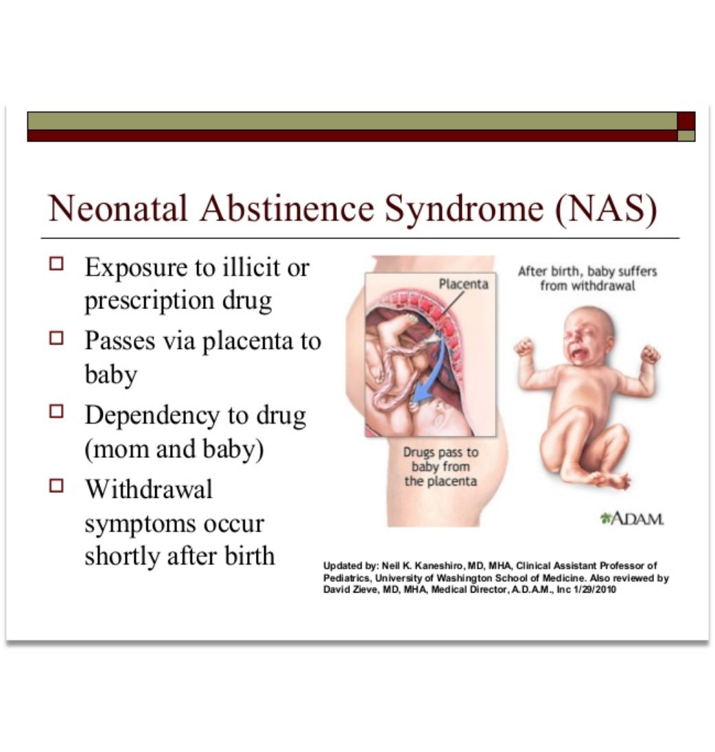
Among hospital related stays for substance use, 60% were related to NAS with one-fourth involving opioids (Finger et al., 2015, & SAMHSA, 2016).
NAS is a result of fetal exposure to certain drugs, primarily opioids, and manifests as clinical symptoms in newborns with withdrawal. Symptoms may include uncoordinated sucking reflexes leading to poor feeding, neurological excitability, gastrointestinal dysfunction, and a high-pitched cry (ASTHO, 2014).
While NAS is not ideal, it may pose less harm to a pregnant mother and her baby than detoxification or the behaviors associated with high-risk drug use such as frequent physical withdrawal, exposure to infectious disease, tainted street drugs, criminal activity, or violence.
NAS develops in “55-94% of drug-exposed infants (University of Iowa Children’s Hospital, 2013).

Slide 16
Finnegan Score: Determines Treatment
Symptoms are influenced by a variety of factors, including the type of opioid, when the mother uses during pregnancy and when she engages in the treatment system, genetic factors, and exposure to other substances (smoking) (SAMHSA, 2016).
The Finnegan Score is a measure of 21 symptoms that are most frequently observed in opiate-exposed infants in three categories:
CENTRAL NERVOUS SYSTEM METABOLIC GASTROINTESTINAL
high pitched cry (continuous) sweating sucking
sleep after feeding fever feeding
hyperactive reflexes yawning regurgitation
tremors mottling loose stools
muscle tone/jerks/convulsions nasal stuffiness
The score indicates the degree of severity and monitors changes over frequent re-evaluations.
Initial scoring is 2 hours post delivery and typically done every 4. A total of 3 scorings of 24 or greater prompts intervention. (The Indiana NAS Task Force uses a standard of “2 or 3 Finnegan scores of 24 or greater” to define NAS)
Sources: Finnegan CP. Neonatal abstinence. In: Nelson NM, ed. Current therapy in neonatal-perinatal medicine. Toronto/Philadelphia: Decker: 1985: 264-6.
NAS Task Force Response to SB408. Retrieved from http://www.in.gov/laboroflove/files/Neonatal_Abstinence_Syndrome_Report_Final_Report.pdf
Notes:
Do you want to clarify in that first paragraph that dose of agonist is not an influencing factor?
This was developed in the 1970s and has become controversial. Some believe that the method in which the score is calculated (separated from mom, in NICU) actually increases the score. Many medical centers have implemented a modified version of the Finnegan into their policies and procedures, due to research supporting skin-to-skin contact, breastfeeding, etc, as helpful for NAS symptoms.

Slide 17
NAS Treatment
Non-Pharmacological Standards
Pharmacological treatment
includes relieving infant symptoms and supporting maternal bonding and may include the following:
Swaddling,
rocking,
reduced stimuli in environment (light & noise),
breast feeding (may reduce need for intervention)
bottle feed or pacifier in between to assist with sucking reflex, and
rooming together
(SAMHSA, 2016 & University of Iowa Children’s Hospital, 2013).
primarily intended to relieve NAS symptoms and its associated complications, such as fever, weight loss, and seizures” (SAMHSA, 2016).
This may be morphine as first line of treatment or methadone followed by tapering off schedule based on symptoms (University of Iowa Children’s Hospital, 2013).
In a 2010 study, infants with NAS required less therapy and shorter hospital stays when roomed with their mother on a postnatal unit than when admitted to a traditional neonatal care unit (Saiki, Lee, Hannam, & Greenough, 2010).

Slide 18
Case Study: Ann
What suggestions do you have to improve the system of care for pregnant women on medication assisted therapy?
What organizational and community-based policies are barriers in your community?
Watson, C. M., & Mallory, A. (2017). The criminalization of addiction in pregnancy: Is this what justice looks like? The New Social Worker Magazine.

Slide 19

Barriers and Treatment Issues
Access to treatment; long-term detox
Access to Long-Acting Reversible Contraception
Stability of insurance markets, gov’t funding of treatment programs
Availability of family-centered, residential treatment for pregnant women
Housing resources often have policies prohibiting admission of clients on MAT & pregnant clients
30-day Transition off insurance is inadequate for tapered detox or completing primary treatment
Affordability of MAT without insurance coverage
Access to MAT provider
Transportation to frequent appointments, distant clinics, etc.
Fear of arrest, stigma, incarceration, or DCS referral
Notes:
Cayce
Not all providers have up to date knowledge about LARC; not all state Medicaid programs cover it;

Slide 20
Evidence-Based Points of Intervention

Slide 21
Treatment Interventions
Promote comprehensive medication-assisted therapy (MAT) which includes: prenatal care, individual & group therapy, resource allocation, psychosocial support, parent-skills training, & family education. Expand access to MAT by advocating for Medicaid coverage & increasing provider capacity.
Expand access to family-centered, residential substance abuse treatment. This is part of the SAMHSA Pregnant & Postpartum Women Initiative (PPW).
Expand training on screening (SBIRT) for substance use & addiction in pregnancy, as well as reproductive justice among social service providers, medical students, OBGYNs, & pediatric nurses & physicians
Assist & encourage smoking reduction for pregnant patients. Cigarette smoking increases the incidence of NAS (Patrick, et al., 2015)
Standardized scoring & interventions for NAS in hospitals. This reduces length of treatment & length of stay (Patrick, 2014)
Notes:
Increase in access to MAT (recent legislation & SAMHSA rule change increased the number of patients each provider can serve)

Slide 22
Policy Interventions
Educate elected officials & policy makers on treatment options & advocate for fair policies that preserve the relationship between mothers & babies by promoting bonding & attachment & discouraging separation
Continue Medicaid coverage for at least one year post delivery to ensure completion of treatment plan & continuity of care.
Increase access to long-acting reversible contraception (LARC) (see TN county health departments Primary Prevention Initiative in which Sevier County recorded a 92% reduction in NAS nine months after implementing PPI for more information)
Continue vigorous opposition to fetal assault laws & advocacy for clients at the macro level
Reduce stigma through education about MAT & NAS
Additional research into detoxing during pregnancy and development of evidence-based detoxification programs (see Bell, et al, 2016)
Notes:
Increase in access to MAT (recent legislation & SAMHSA rule change increased the number of patients each provider can serve)

Slide 23
Presentation References

Slide 24
American Congress of Obstetricians and Gynecologists. (2012). Opioid Abuse, Dependence, and Addiction in Pregnancy. Committee Opinion No. 524. 19:1070–6.
American Congress of Obstetricians and Gynecologists. (2011). Substance Abuse Reporting and Pregnancy: The Role of the Obstetrician–Gynecologist. Committee Opinion No. 473. 117:200–1.
American College of Obstetricians and Gynecologists. (2016) Statement on Opioid Use During Pregnancy retrieved from: http://www.acog.org/About- ACOG/News-Room/Statements/2016/ACOG-Statement-on-Opioid-Use-During-Pregnancy
American Society of Addiction Medicine. (2016). Opioid Addiction 2016 Facts & Figures.
Association of State and Territorial Health Officials. (2014). Neonatal Abstinence Syndrome: How States Can Help Advance the Knowledge Base for Primary Prevention and Best Practices of Care. [PDF Document]. Retrieved from: http://www.astho.org/prevention/nas-neonatal-abstinence-report/
Bell J, Towers CV, Hennessy MD, et al. Detoxification from opiate drugs during pregnancy. Am J Obstet Gynecol 2016;215:374.e1-6.
Bigler, M. (2005). Harm Reduction as a Practice and Prevention Model for Social Work. Journal of Baccalaureate Social Work, 10 (2), 70-86.
Center for Behavioral Health Statistics and Quality. (2015). Behavioral health trends in the United States: Results from the 2014 National Survey on Drug Use and Health (HHS Publication No. SMA 15-4927, NSDUH Series H-50). Retrieved from http://www.samhsa.gov/data/
Centers for Disease Control and Prevention. (2015). Press Release: Opioid Painkillers Widely Prescribed Among Reproductive Age Women. Retrieved from: http://www.cdc.gov/media/releases/2015/p0122-pregnancy-opioids.html
Centers for Disease Control and Prevention. (2013). Prescription Painkiller Overdose Infographic. Retrieved from: http://www.cdc.gov/vitalsigns/prescriptionpainkilleroverdoses/infographic.html
Debelak, K, Morrone, WR, O’Grady, KE, and Jones, HE. Buprenorphine + naloxone in the treatment of opioid dependence during pregnancy-initial patient care and outcome data. American Journal of Addiction, 2013 May-June; 22(3):252-4. doi: 10.1111/j.1521-0391.2012.12005.x.
Fingar, K.R., Stocks, C., Weiss, A.J., & Owens, P.L. (2015). Neonatal and maternal hospital stays related to substance use, 2006–2012. HCUP Statistical Brief #193. Agency for Healthcare Research and Quality, Rockville, MD. Retrieved from http://hcup-us.ahrq.gov/reports/statbriefs/sb193-Neonatal- Maternal-Hospitalizations-Substance-Use.pdf
Finnegan CP. Neonatal abstinence. In: Nelson NM, ed. Current therapy in neonatal-perinatal medicine. Toronto/Philadelphia: Decker: 1985: 264-6.
Notes:
This is not complete yet

Slide 25
Identifying Neonatal Abstinence Syndrome (NAS) and Treatment Guidelines, 2013 PDF University of Iowa Children’s Hospital Retrieved from https://www.uichildrens.org/uploadedFiles/UIChildrens/Health_Professionals/Iowa_Neonatology_Handbook/Pharmacology/Neonatal%20Abstinence%20Sy ndrome%20Treatment%20Guidelines%20Feb2013%20revision.pdf
Injury Prevention & Control: Opioid Overdose. (2016, March 16). Retrieved from http://www.cdc.gov/drugoverdose/data/prescribing.html
Jones, H., Martin, P., Heil, S., Kaltenbach, K., et al. (2008). Treatment of Opioid Dependent Pregnant Women: Clinical and Research Issues. Journal of Substance Abuse Treatment (35), 245-259.
Jones, H. E., Kaltenbach, K., Heil, S., Stine, S. M., Coyle, M. G., Arria, A. M., O’Grady, K., Selby, P., Martin, P., & Fischer, G. (2010). Neonatal abstinence syndrome after methadone or buprenorphine exposure. New England Journal of Medicine, 363, 2320–2331
National Association of Social Workers. (2013). NASW Standards for Social Work Practice with Clients with Substance Use Disorders. [PDF Document]. Retrieved from http://www.socialworkers.org/practice/standards/naswatodstatndards.pdf
National Association of Social Workers. (2013). A Social Work Perspective on Drug Policy Reform Public Health Approach. [PDF Document]. Retrieved from http://www.naswdc.org/advocacy/DrugReformWP.pdf
Newman, Robert. (2013). Open Letter to the Media and Policy Makers Regarding Alarmist and Inaccurate Reporting on Prescription Opioid Use by Pregnant Women. [PDF Document]. Retrieved from: http://advocatesforpregnantwomen.org/Opioid%20Open%20Letter%20-%20March%202013%20- %20FINAL.pdf
Opioids. (2016, February 23). Retrieved from http://www.samhsa.gov/atod/opioids
Saiki, T., Lee, S., Hannam, S., & Greenough, A. (2010) Neonatal abstinence syndrome –postnatal ward vs neonatal management European Journal of Pediatrics 169:95–98
Salter, M. Ridley, N., & Cumings, B. (2015). Tennessee Association of Alcohol, Drug, and Other Addiction Services White Paper on Implementation of Chapter 820 Opportunities to Address Pregnancy, Drug Use and the Law. [PDF Document]. Retrieved from: http://taadas.org/TAADAS%20White%20Paper%202015.pdf
Segal, Elizabeth, (2010). Social Welfare Policy and Social Programs A Values Perspective 2nd edition Brooks/Cole
Substance Abuse and Mental Health Services Administration Center for Substance Abuse Treatment. (2008). Medication-Assisted Treatment for Opioid Addiction in Opioid Treatment Programs. Treatment Improvement Protocol (TIP) Series 43. HHS Publication No. (SMA) 12-4214
Substance Abuse and Mental Health Services Administration, Advancing the Care of Pregnant and Parenting Women With Opioid Use Disorder and Their Infants: A Foundation for Clinical Guidance, Rockville, MD: Substance Abuse and Mental Health Services Administration, 2016.
Substance Abuse and Mental Health Services Administration. A Collaborative Approach to the Treatment of Pregnant Women with Opioid Use Disorders. HHS Publication No. (SMA) 16-4978. Rockville, MD: Substance Abuse and Mental Health Services Administration, 2016. Available at: http://store.samhsa.gov/
Terplan, M., Kennedy-Hendricks, A., & Chisolm, M. (2015). Prenatal Substance Use: Exploring Assumptions of Maternal Unfitness. Substance Abuse: Research and Treatment 9 (S2) 1-4.

