Slide 1




Thinking outside of the box reaching inner city children
Desiree Davis, Ph.D. msw, lmsw, lcsw, acsw

Slide 2
If a person can define you, they will confine you.
Frank W. Hale, Jr.

Slide 3

Our Mission
Because of our love and devotion to Jesus Christ, the Berean Seventh-day Adventist Church is committed to continually train and equip the membership to meet the changing needs of the community and proclaim the everlasting gospel; thus leading people to a lasting relationship with Jesus Christ.

Slide 4
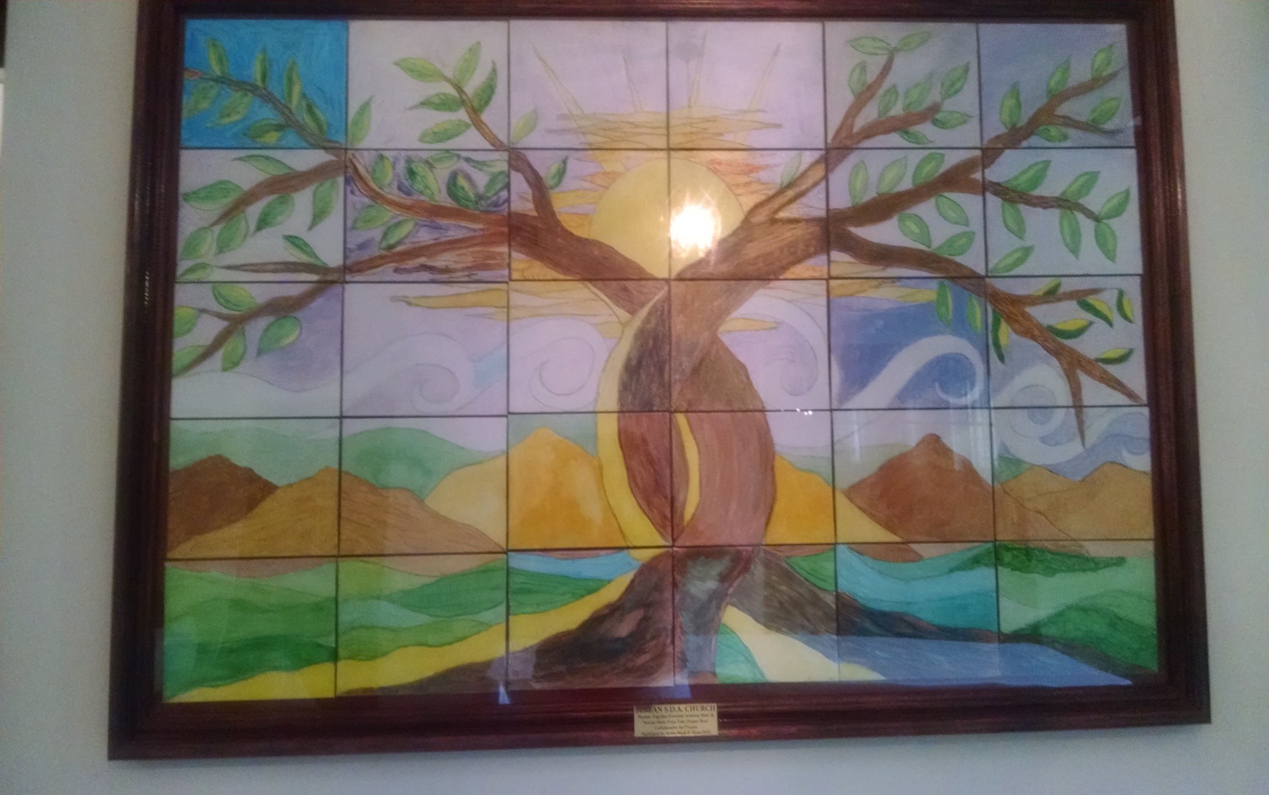
Our Togetherness

Slide 5
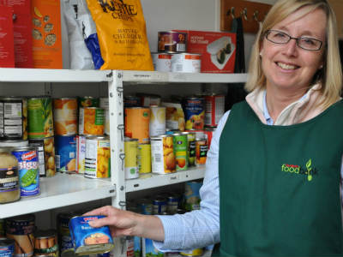
History of Community Involvement
Community Center- GED classes, Computer classes, counseling
Food Pantry – Food twice a month, clothing, hair cuts
Job Fairs/Hair cuts
Vegetarian/vegan cooking classes
Spa Day
Walk-a-thons
Visit sick & shut in
Nursing Home ministry
Drum Corp
Etiquette classes for teens in the community

Slide 6



Children Categories At Our Church
Children whose parents are members of our church
Children from the neighborhood
Children whose parents who grew up in our church but are no longer attending
Children whose parents who grew up in our church who attend sometimes
Children whose relatives attend our church

Slide 7

Theoretical Framework
CAR – children at risk is a concept that “views children as whole, complex human beings who actively participate in their own development, who grow in context, and although vulnerable, possess the capacity to be agents of God, regardless of age, status, or gender” (Greener, 2016, p.159).

Slide 8


Literature Review
Mercer (2005) contends that “every child always exists in multiple and often competeing communities exercising formative, shaping influences on the child’s identity” (p.174).
Children should be apart of all facets of the church activities (Csinos, Jennings, Mclaren, &Yust, 2010).
Crosby, Smith, & Frederick (2015) discuss the importance of children ministry workers listening attentively to children in order to validate them.
.

Slide 9
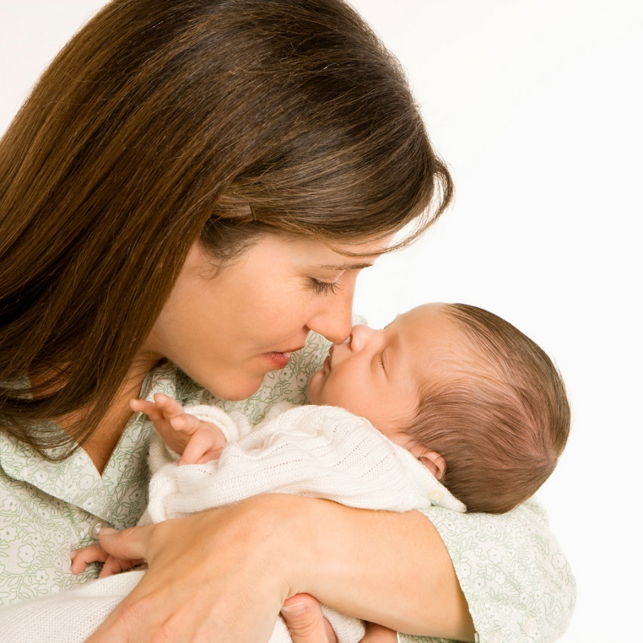

The Real Faces Of Poverty
Feminization of Poverty
Juvenilization of Poverty

Slide 10
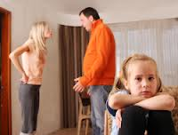
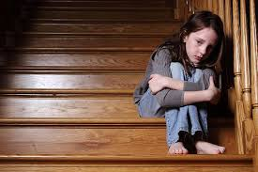
Barriers For Children At Risk
Meet children where they are on the journey.
Make sure the gospel is not presented as the “white child’s religion” (Padilla, 1985: 1-2).
Childhood has many critical periods for the formation of life achievements. They cannot wait until home is a perfect place with all the resources available. The church must fill that gap by presenting with a “whole gospel response” that provides help when needed, that demonstrates God’s love and genuine care (Mott, 2011).

Slide 11
Rapport Building through Vacation Bible School
Go door to door two by two.
Provided flyers with information in the surrounding neighborhood & other nearby low income locations – Monroe Circle & Laurel Court.
Met interested parents/children in their homes and had them complete informed consent, medical consent, & transportation forms.
Provided a time to return to collect paperwork and answer questions.
Arranged a pick up time for the children.
Step 3 Become a Link
Step 2 Share information
Step 1 Introduce self

Slide 12
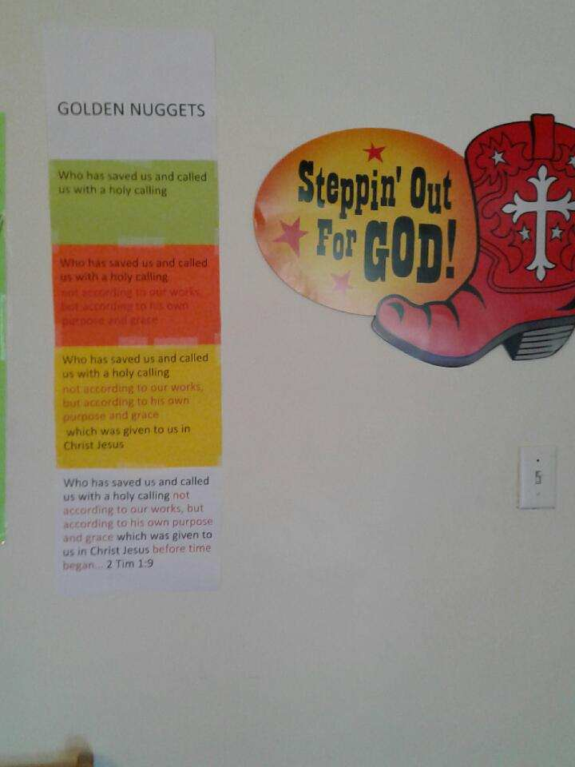
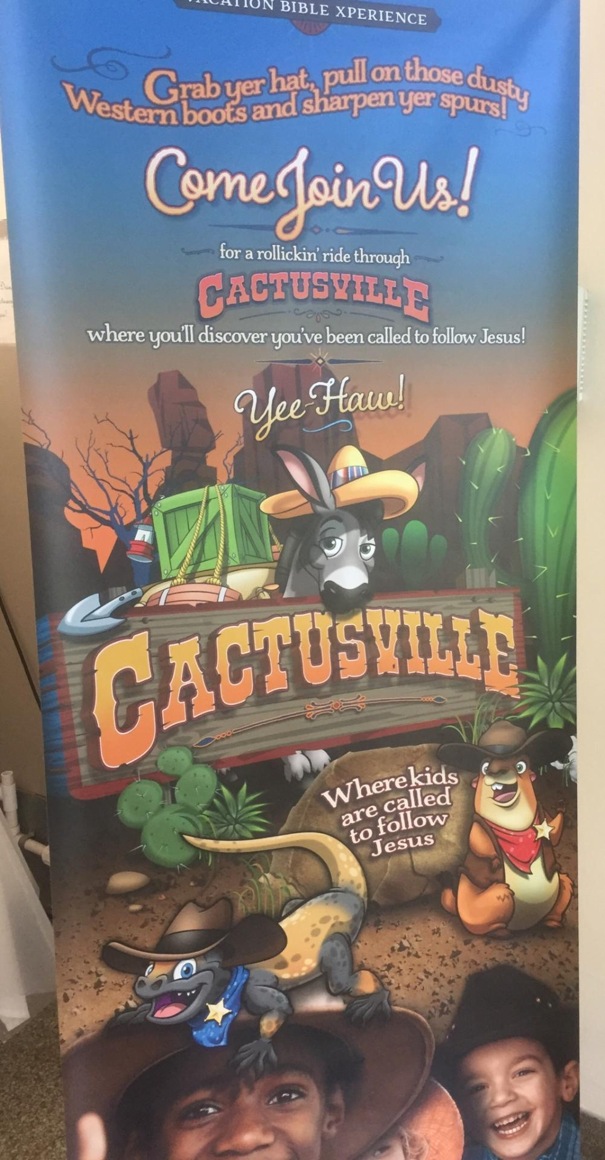
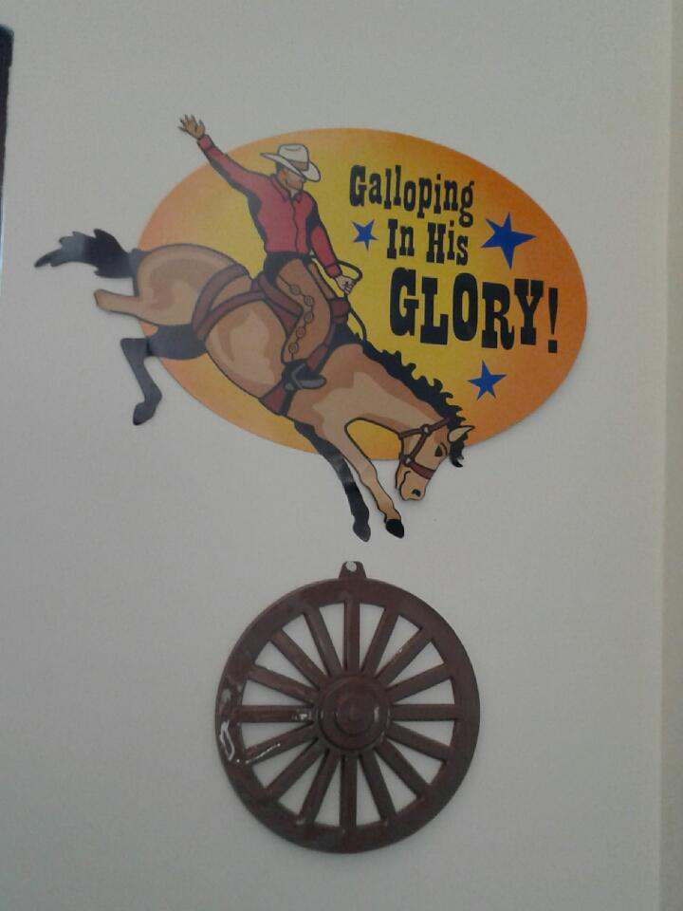
Vacation bible school

Slide 13
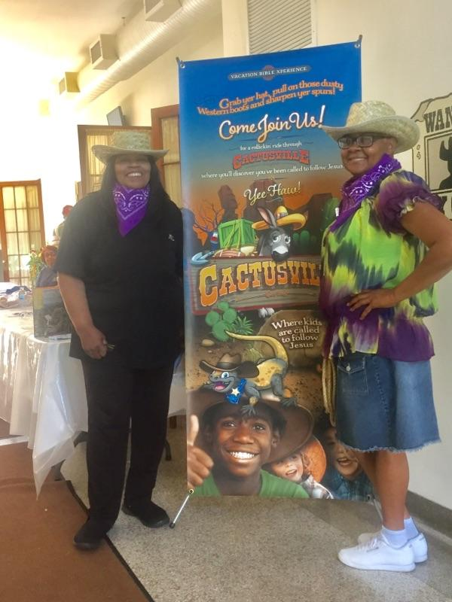
Our response
Teachers established a relationship with parents.
Teachers/SS Secretary provided transportation to children.
A member became a caregiver at church and in the home. This connection would become vital to the nurturance, relationship, and stability of children in the home and at church.
She also provided transportation for the children.
Other members became caregivers for children while at church and also providing transportation for them.

Slide 14
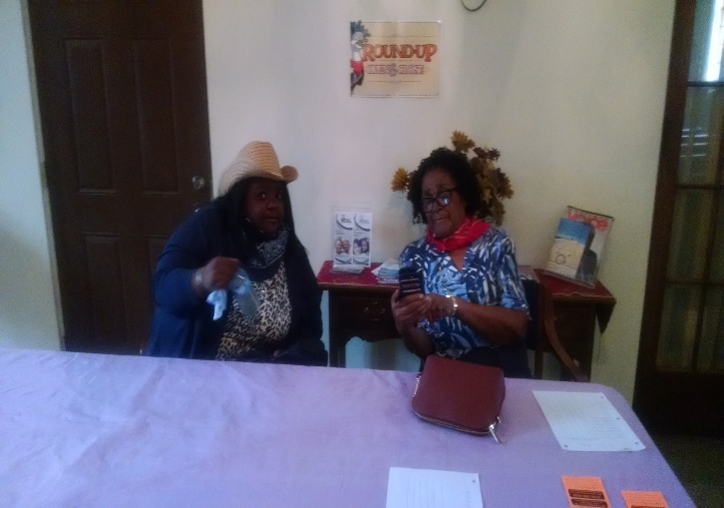
Rapport Enhancement
Children & neighbors become acquainted with members.
Outreach turns into a ministry that may lead to deeper relationships with members from the church.
Children becoming acquainted with Jesus and wanting to learn more about Him and be involved with church.

Slide 15
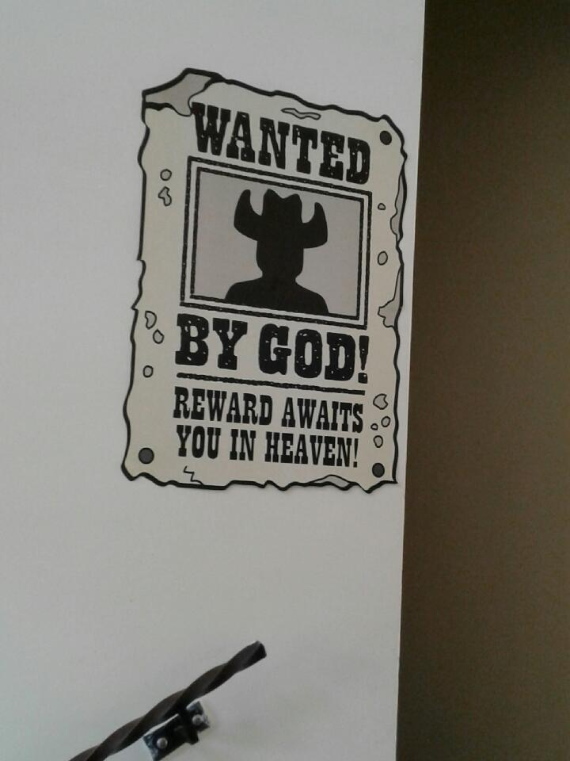
Trouble in the camp
Parents needed a break
Children sent to VBS without informed consent
Children had to be a certain age

Slide 16
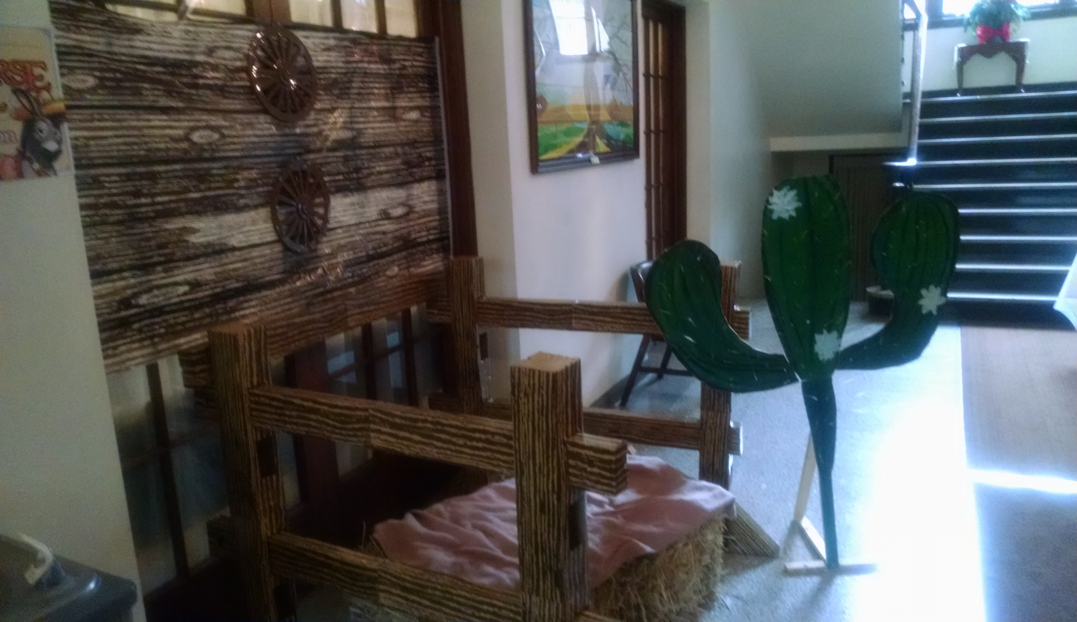
Photo Booth

Slide 17

Considering our options
Logistics
Responsibility
Providing Transportation for children to and from church.
Provided weekly breakfast for the children because they had not eaten before being picked up for church.
Having a main contact person with for the parent.
Being consistent with responsibility.
Being responsible for children throughout both of services.
Having backup care with children when primary teacher is tired.

Slide 18
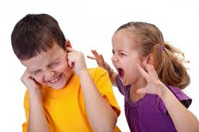
Challenges we Faced
Children with multiple problems
Behavioral
Financial
Family

Slide 19


Approaches We Used
Strengths Based Perspective
Person-in-Enviroment
Cognitive Behavior Therapy
Be real
Be Consistent
Be available
CORE BELIEFS

Slide 20
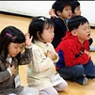


Ways We Use To Involve Our Children
Involved children in ministry by having them read scripture during their classes & during church, give prayer, and read the mission story.

Slide 21
Lessons We Learned
Be committed to the ministry that God has given you to do.
There will be bumps and challenges along the way.
Be attentive to the frontline workers. Consider needs they may have along with those who you are ministering too.

Slide 22
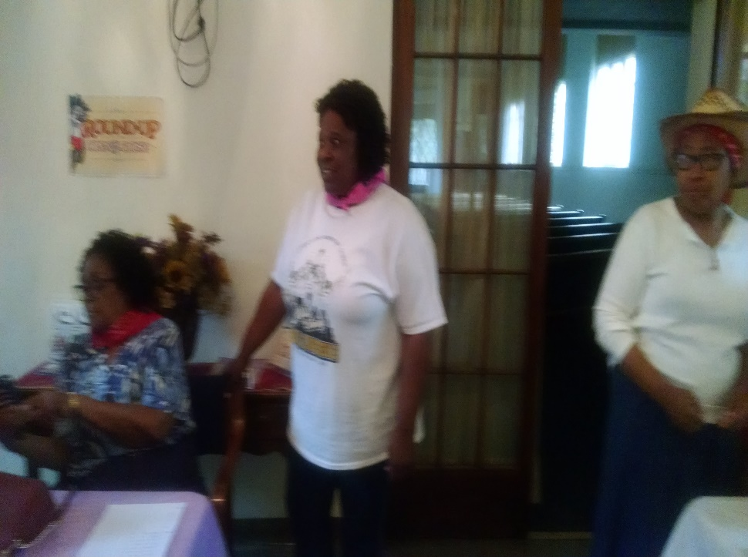
Children Ministry Leaders must be united
Value in being united in our work with our children.
It fortified our commitment to be the best and persevere through difficulties.
Solid program outcomes such as VBS, Craft program, Adventurers program.

Slide 23

What I do
Weekly breakfast for all the children.
Snacks are provided by teacher.
Gifts for attendance.
Children assist with tasks in the classroom.
Children like to sit with the teacher sometimes.
Special programs for children.
Socials for the children.
Lunch is provided by the church each week.

Slide 24
Strategies to involve leaders & Members
Pray and seek God’s guidance in all plans.
Programs are planned & advertised.
Programs are promoted in the Sabbath School Council, then the Church Board, and then the Church.
Volunteers are enlisted.
Sell the idea during church service with an announcement and also place all announcements in the bulletin.
Move forward.

Slide 25
Strategies for your outreach ministry
Ask God to show you what to do.
Look for specific needs in your church community.
Be willing to try something new.
Use your talents & gifts to bless those who are less fortunate.
Use all members young & old to assist in the outreach ministry.
Start simple.

Slide 26

At the end of the Day
Heaven is our home!

Slide 27
References
Crosby, R., Smith, E., Frederick, T. (2015). The Kid-Friendly Church: What Makes Children Feel Loved, Valued, And Part of A Supportive Church Community. The Journal of Family and Community Ministries, 28 (1), 87 -108
Csinos,D.M.,Jennings, D.L.,McLaren,B.D.and Yust,K.M.(2010). Where are the children? Family and Community Ministries, 23(4),10-21.
Greener,S.H. (2016). Children-at-risk and the whole Gospel:Integral mission to for and with vulnerable agents of God. Transformation,33(3), 159-170.
Mercer, J.A. (2005). Welcoming Children: A Practical Theology of Childhood. St. Louis, MO: Chalice Press.
Mott, S. (2011). Biblical Ethics and Social Change. Oxford: Oxford University Press.
Padilla, CR (1985). Mission between the Times. Grand Rapids, MI: Eerdmans Publishing Company.

