Slide 1
Individual Development Accounts through Local Congregations
Terry A. Wolfer, MSW, PhD. and Janessa Steele, MSW Candidate
University of South Carolina College of Social Work

Slide 2
What are Individual Development Accounts (IDAs)?

Slide 3
What are Individual Development Accounts (IDAs)?
Matched savings accounts
Match rates from 1:1 to 8:1
Help participants save for assets
Includes financial education

Slide 4
Addressing Poverty
For many people in poverty, a lack of assets—a home, education, or transportation—"poses a more significant barrier to upward mobility than their yearly income. . . . Wealth (in the form of capital and property) is a fundamental fault line of social stratification” (Shapiro & Wolff, 2001, p. 13)

Slide 5
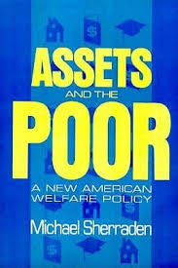
History of IDAs
Assets and the Poor by Michael Sherraden (1991)
Wide international use:
  UK, Korea and Singapore have automatic enrollment
  Youth development in sub-Saharan Africa

Slide 6
American Dream Demonstration
2,364 participants in fourteen states
Run by CFED (Prosperity Now) and monitored by CSD
First large-scale study of IDAs in the U.S. (1997-2003)
Survey respondents N = 298

Slide 7
American Dream Demonstration (cont.)
As result of their participation:
  60% were more likely to make educational plans for their children
  59% more likely to work or stay employed
  73% more likely to improve their housing (Sherraden, 2002, p. 6)

Slide 8
American Dream Demonstration (cont.)
As result of their participation:
  93% strongly agree or agree they are more confident about the future
  84% more economically secure
  85% more in control of their lives (Sherraden, 2002, p. 6)

Slide 9
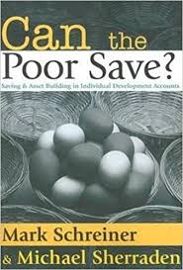

Slide 10
. . . Why, yes.

Slide 11
IDA Outcomes
“Low-income children who have just $500 in college savings are three times more likely to graduate from college” (CFED, 2017, ¶1)
Some success of IDA programs attributed to psychological factors, e.g., hope that savings and asset accumulation are achievable goals (Corporation for Economic Development, 2017; Kim, Sherraden, Huang & Clancy, 2015; Mason, Nam, Clancy, Kim & Loke, 2009; Shanks, 2014; Stevens, 2009).

Slide 12
IDA Outcomes (cont.)
SEED study on CDAs in Oklahoma found positive economic and psychological effects for parents AND children; perception that college is within reach (Mason et. al., 2009)
Ten-year studies show increased educational attainment for males; asset accumulation associated with decreased depression (Grinstein-Weiss et. al., 2013; Rohe et al., 2016)

Slide 13
IDA Outcomes (cont.)
“Assets provide people with a stake in society and produce psychological and social benefits for individuals, e.g., increased future orientation and aspirations, personal efficacy and self-esteem, and social connectedness. These life opportunities are then internalized and shape individual behavior” (Ssewamala, 2005, p. 5)

Slide 14
IDA Outcomes (cont.)
“Rather than focusing on what low-income people do not have, IDAs build upon people’s hard work, discipline, and financial assets in order to help them acquire even more behavioral and financial assets so that they can be self-sufficient. This leads to intergenerational economic stability in families, which in turn strengthens the entire communities in which these families reside” (Chalmers Center, 2008, ¶4)

Slide 15
IDAs for Christians in Social Work
Strengths perspective
Faith values
Need for smaller, simplified programs and focus on lower income participants
Just alternative to predatory lending
Considerations for people with disabilities, homelessness, domestic violence, etc.

Slide 16
Funding
Assets for Independence Act enacted in 1998
Often cited grantmaker for IDA programs
Notes:
Let’s talk about a significant consideration for IDA implementation that makes congregational resources all the more important.

Slide 17
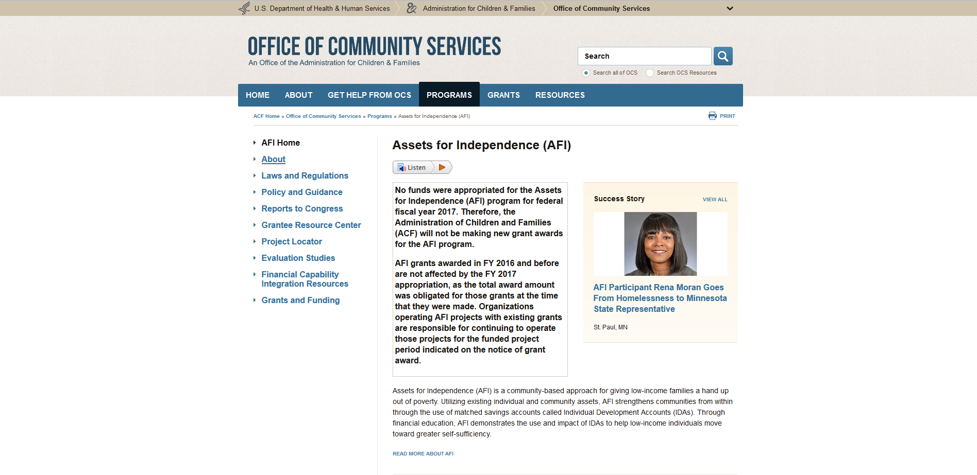

Slide 18
Congregational Tithing as Support Strategy
Means for congregations to implement IDA programs
“This work also connects to the faith-based tradition of community economic development and the call by the faith community to address economic injustice. . . . The congregation and faith community is an asset that is already working, and can be developed to help families and communities build their own assets” (Boddie & Thirupathy, 2005, p. 2).

Slide 19
Congregational Tithing (cont.)
“According to studies on congregational activities . . . few congregations work to develop the assets of families and communities. Instead, most congregations provide charity-based services like food and clothing ministries, rather than asset-based strategies like business incubation and job training” (Boddie & Thirupathy, 2005, p. 16).
Notes:
(Hodgkinson, Weitzman et al., 1993; Chaves & Tsitsos, 2001; Cnaan & Boddie, 2001; Cnaan, Boddie et al., 2002)

Slide 20
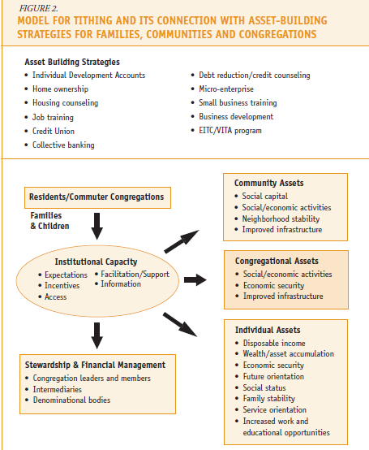
Notes:
Note that Boddie & Thirupathy have a free resource for congregations to use as they determine how to incorporate an asset-building focus for ministry.

Slide 21
Other funding sources
Included on flashdrive: example of a proposal to your church and resource with list of funding options

Slide 22
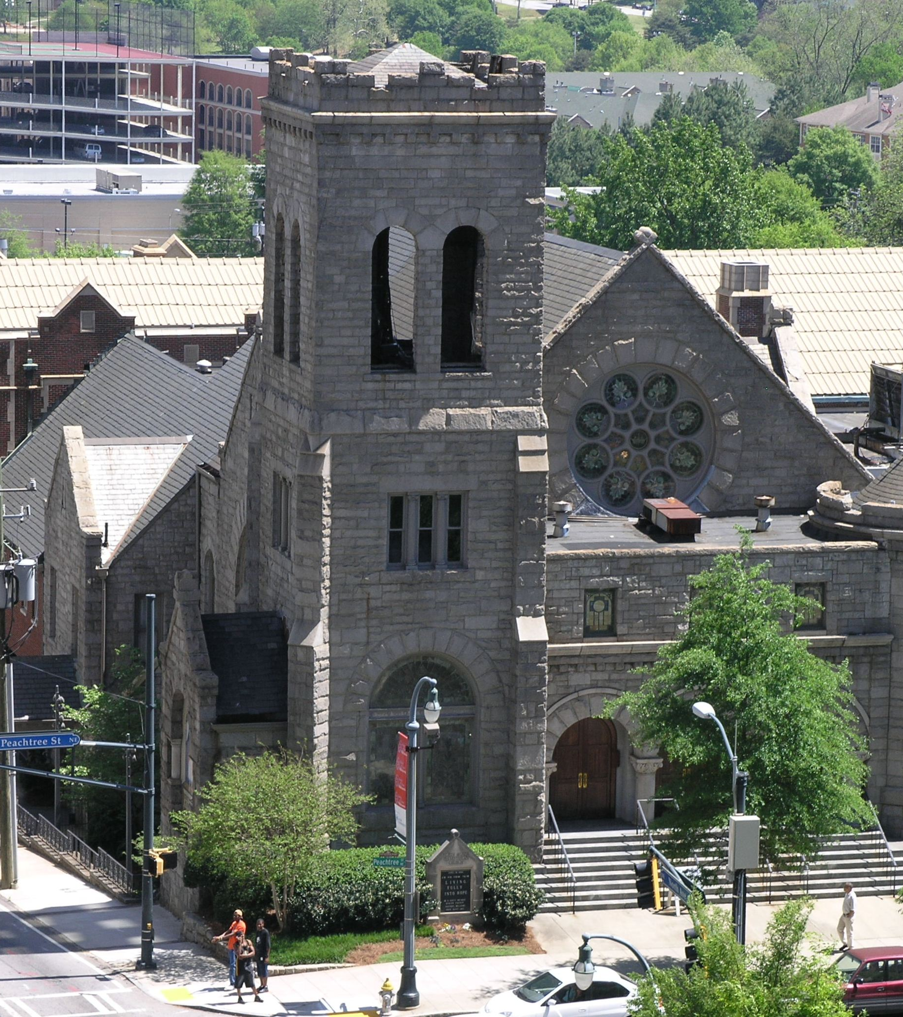
North Avenue Presbyterian Church: A case study
“[IDAs] struck a chord right away. We had lots of programs for people who were materially poor, but nothing that could help someone move the poverty needle in a real way” – Matt Seadore, Director of Missions and Outreach
Used financial literacy course to connect people with the program
In 3 years: 5 completed and 3 in process
Notes:
Note: few publications on churches doing this. Why? Perhaps because the model hasn’t seemed accessible or because of banking issues? Connect to church’s mission.

Slide 23
Case Study (cont.)
Small committee, allies
Eligibility: family income <200% of federal poverty level
Assets to increase net worth or employability (e.g., home improvement, CDL license, truck, laptop)
1:1 match up to $1000

Slide 24
Case Study (cont.)
80% of participants had no formal banking relationship when began financial education
$150 matching incentive for opening a savings account; each matched savings participant used their account to save for their asset
Banking practices
Terminology of Matched Savings

Slide 25
Case Study (cont.)
“From my vantage point, it’s sort of a win-win-win. It takes what people in the church naturally want to do and gives them a system and a way to do it. But the person in matched savings feels they have done it themselves, and they have” — Matt Seadore, Director of Missions and Outreach

Slide 26
Participant Perspective
“Always came up short. . . . I took a Dave Ramsey course, but he wasn’t talking to people like me”
Saved for a truck: at 59, the first vehicle he has ever owned
“I'm feeling financially stable right now. If I didn't get another dime for the next six months, I could pay every bill I have”
Now an ally for others in the program, and considering certification as a financial literacy facilitator
Notes:
Social connection and hope aspects

Slide 27
Participant Perspective (cont.)
“It put me in a beautiful, socially connected environment. What I don't know, somebody in my surroundings knows and don't have any problem assisting me. I got support around me. A person that gets socially connected, who is socially economically hit hard, it makes such a difference. If the church introduced this, decides to get on board, it don't only help those who socially economically like myself, it helps anyone who has any problems budgeting and saving to see a whole new picture. It meets you right where you are” — Participant & Ally

Slide 28
Small Group Brainstorming
Imagine starting a matched savings/IDA program at your own congregation
Congregational Asset Mapping
Notes:
25 min.
Give participants 10 minutes to brainstorm in their own groups, and then provide time for discussion
Ask: What did you identify within your own congregation that might provide a basis for starting an IDA program? What did you learn from others? Do you foresee any barriers? How might you handle them?

Slide 29
Decisions for Starting an IDA Program
Funding (internal vs. external)
Eligibility (universal vs. targeted)
Asset management (529 vs. bank account vs. credit union partnership)
Specific assets (education vs. housing vs. business startup)
Population (youth vs. adults)
Withdrawals
What else?
Notes:
Identify several basic decisions that groups must make, and suggest some basic alternatives to kick off the discussion. Ask participants what other questions they might have if they were going to start their own program.
Biggers, p. 283– commonly partnered with local credit union
(i.e. no penalty from CEF; Biggers article)

Slide 30
More Resources & Toolkits
Electronic handouts: sample budget, proposal, and guidelines; mapping activity
White paper for Riverside Community Church
IDAs for Youth resource from CFED (2001)
RAISE Texas toolkit
Chalmers Center toolkit

Slide 31
References
Boddie, S., & Thirupathy, P. (2005). Way to give: A guide to connecting, giving, and asset building. Canada: The Annie E. Casey Foundation.
The Chalmers Center for Economic Development. (2008). A penny saved is a penny matched. Retrieved
from https://www.chalmers.org/news/entry/a-penny-saved-is-a-penny-matched.
Corporation for Economic Development. (2017). Children’s savings accounts (CSAs). Retrieved from http://cfed.org/programs/csa.
Grinstein-Weiss, M., Sherraden, M., Gale, W. G., Rohe, W. M., Schreiner, M., & Key, C. (2013). Long-term effects of individual development accounts on postsecondary education: Follow-up evidence from a randomized experiment. Economics of Education Review, 33, 58–68. https://doi.org/10.1016/j.econedurev.2012.12.007

Slide 32
References, Continued
Kim, Y., Sherraden, M., Huang, J., & Clancy, M. (2015). Child development accounts and parental educational expectations for young children: Early evidence from a statewide social experiment. Social Service Review, 89(1), 99–137.
Mason, L. R., Nam, Y., Clancy, M., Kim, Y., & Loke, V. (2009). Child development accounts and saving for children’s future: Do financial incentives matter? St. Louis, MO: Washington University.
Rohe, W. M., Key, C., Grinstein-Weiss, M., Schreiner, M., & Sherraden, M. (2016). The impacts of individual development accounts, assets, and debt on future orientation and psychological depression. Journal of Policy Practice, 16(1), 24–45. https://doi.org/10.1080/15588742.2015.1125329
Shanks, T. (2014). The promise of child development accounts: Current evidence and future directions. Community Investments, 26(2), 12-15.

Slide 33
References, Continued
Shapiro, T. M., & Wolff, E. N. (2001). Assets for the poor: The benefits of spreading asset ownership. New York: Russell Sage Foundation.
Sherraden, M. (1991). Assets and the poor. New York: M. E. Sharpes.
Sherraden, M. (2002). Individual development accounts: Summary of research. St. Louis, MO: Washington University.
Sherraden, M. (2007). Can the poor save? Saving and asset building in individual development accounts. New York: Routledge.
Ssewamala, F. M. (2005). Children development accounts in Africa: A pilot study. St. Louis, MO: Washington University.
Stevens, J. (2009). Child development accounts: Innovative plans build savings for youth, starting at birth. St. Louis Federal Reserve Bridges, Spring 2009, 1-3.

Slide 34
Questions?

Slide 35
Thank You!
Terry A. Wolfer, PhD
terry.wolfer@sc.edu
Janessa Steele, MSW Candidate
janessa@email.sc.edu
College of Social Work
University of South Carolina

