Slide 1
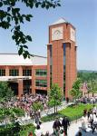
Moving from Safe Spaces to Brave Spaces:
Faith Based Social Justice
Sonyia Richardson MSW, LCSW
Vanessa Drew-Branch Ed.D., LSW
University of North Carolina Charlotte
NACSW National Conference
Charlotte, NC
November 3, 2017
The University of North Carolina at Charlotte

Slide 2
Workshop Objectives
Participants will:
Understand the difference between safe space and brave space.
Learn strategies for engaging in faith based social action aligned with values.
Learn practical strategies for shifting from creating space spaces to creating and maintaining brave spaces.

Slide 3
How do you manage discussions regarding the socio-political environment?
Avoid discussions
Initiate controlled discussions that consider comfort level of group
C. Welcome discussion but tread lightly
D. Welcome full, open discussion without reservation or without fear of consequences

Slide 4
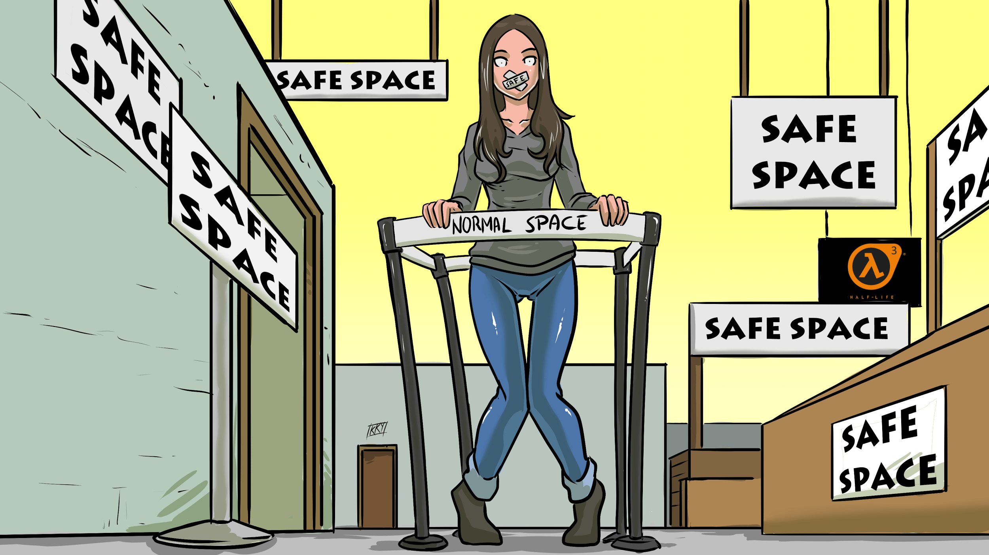
Are you building this...

Slide 5

Or this...

Slide 6

Faith Based Social Justice
Deliberate, faithful, and competent action by people of faith on behalf of or for marginalized or oppressed populations. This action is not dependent on outcomes but based on obedience and sacrifice.
Faithfulness
Competence
Sherwood (2017)

Slide 7
Advocacy Scriptures
““Speak up for those who cannot speak for themselves, for the rights of all who are destitute. Speak up and judge fairly; defend the rights of the poor and needy.” -Proverbs 31:8-9
“Learn to do right; seek justice. Defend the oppressed. Take up the cause of the fatherless; plead the case of the widow.” -Isaiah 1:17
“This is what the LORD says: Do what is just and right. Rescue from the hand of his oppressor the one who has been robbed. Do no wrong or violence to the alien, the fatherless or the widow, and do not shed innocent blood in this place.” -Jeremiah 22:3
“The King will reply, ‘Truly I tell you, whatever you did for one of the least of these brothers and sisters of mine, you did for me.’” -Matthew 25:40
“We who are strong ought to bear with the failings of the weak and not to please ourselves.” -Romans 15:1
“Carry each other’s burdens, and in this way you will fulfill the law of Christ.” -Galatians 6:2
Faithfulness
Competence

Slide 8
Forms of Advocacy
Instrumental: Holding systems accountable (lobbying, letter writing, peaceful marches)
Educational: Educating individuals, families, colleagues, society (committee work, group work, awareness events)
Practical: engaged in action (running for political office, volunteering)
(McLaughlin, 2009)

Slide 9
Moving from Safe to Brave
How do you define “safety”?
Who is entitled to “safety”
How can the concept of “safety” halt social justice discourse?

Slide 10
Moving from Safe to Brave
What is a “Safe Space”?
“An environment where everyone feels comfortable expressing themselves and participating fully, without fear of attack, ridicule, or denial of experience” (National Coalition for Dialogue & Deliberation, n.d.)
Safe Space allows for neutrality.

Slide 11
Moving from Safe to Brave
What is a “Brave Space”?
…anger, hostility, frustration, and pain are characteristics that are not to be avoided under the banner of safety.… They are attributes that are to be recognized in order to engage in a process that is creative enough to establish new forms of social existence, where both parties are transformed. (Leonardo & Porter, 2010, p. 149)
Brave Space is a Transformative Space

Slide 12
Tips and Strategies for Shifting to Brave Spaces
Develop “Space Rules”
Integrate NASW Code of Ethics, faith, and competence within decision making
Make sure to wrap up discussion with final lessons
Only “fix” discomfort out of obedience to discernment

Slide 13
Tips and Strategies for Shifting to Brave Spaces
4) Affirm everyone in the space
5) Encourage authenticity and transparency
6) Advocate from faith based social justice perspective
7) Model bravery for participants through appropriate professional disclosure

Slide 14
Holding Tensions
Set rules for discussion
Allow full range of emotions
Identify intended outcome
Engage in brief dialogue
Identify lessons learned

Slide 15
Contact
Vanessa Drew-Branch Ed.D., LSW
University of North Carolina Charlotte, School of Social Work
Lecturer
Phone: 704-687-7940
vdrew@uncc.edu
Sonyia Richardson MSW, LCSW
University of North Carolina Charlotte
Lecturer, Doctoral Student
Phone: 704-687-7935
srichardson@uncc.edu

Slide 16
References
Leonardo, Z. & Porter, R..(2010). Pedagogy of fear: Toward a Fanonian theory of safety in race dialogue. Race Ethnicity and Education, 13(2), 139 — 157.
McLaughlin, A. (2009). Clinical social workers: Advocates for social justice. Advances in Social Work, 10(1), 51-68.
National Coalition for Dialogue & Deliberation. (n.d.) Safe space. Retrieved from http://ncdd.org/rc/glossary#S
Sherwood, D. A. (2017). Christianity and social work practice with LGBTQ clients: Dealing competently, ethically, and faithfully with hard issues. Social Work and Christianity, 44(1), 3-10.

