Slide 1
Designing Diversity in
Death Education
Jana Donahoe, LCSW, Ph.D.
Assistant Professor of Social Work
Delta State University
NACSW Conference November 4, 2017
Special Thanks: Kelsa Powell, Brittany Smart, & Sarah Freeman
Senior DSU BSW Students

Slide 2

Session Goals
After the session, participants should be able to:
Understand and assess death anxiety
Understand the ethical and critical components of death education
Design ethically, culturally, and spiritually sensitive death education programs for client systems in diverse population groups
Feel more prepared to use death education with diverse populations in social practice and education
Use death education as a means of ethical/professional self-care and for anxiety reduction re: death as a part of life

Slide 3

Session Justifications
This session is important because:
Death is a fact of life
Death is encountered by all of us in our personal and professional lives
Culturally and spiritually sensitive death education is needed to:
1) Help us overcome our fears of death
2) Give us a sense of power/control over certain aspects of death and dying
Prepare us to use death education with diverse population groups
Enable us to use death education for self-care and client care

Slide 4

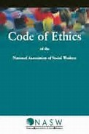
NASW Code of Ethics
All six values (Service, Social Justice, the Dignity and Worth of All People, the Importance of Human Relationships, Integrity, and Competence) all must be applied with Death Education.
Relevant Code Sections to Death Education:
1.01 Commitment to Clients
1.02 Self-Determination
1.03 Informed Consent
1.04 Competence
1.05 Cultural Competence and Social Diversity

Slide 5
NASW Code of Ethics
1.01 Commitment to Clients
Social workers’ primary responsibility is to promote the well-being of clients. In general, clients’ interests are primary. However, social workers’ responsibility to the larger society or specific legal obligations may on limited occasions supersede the loyalty owed clients, and clients should be so advised. (Examples include when a social worker is required by law to report that a client has abused a child or has threatened to harm self or others.)
1.02 Self-Determination
Social workers respect and promote the right of clients to self-determination and assist clients in their efforts to identify and clarify their goals. Social workers may limit clients’ right to self-determination when, in the social workers’ professional judgment, clients’ actions or potential actions pose a serious, foreseeable, and imminent risk to themselves or others.

Slide 6
NASW Code of Ethics
1.03 Informed Consent
(a) Social workers should provide services to clients only in the context of a professional relationship based, when appropriate, on valid informed consent. Social workers should use clear and understandable language to inform clients of the purpose of the services, risks related to the services, limits to services because of the requirements of a third-party payer, relevant costs, reasonable alternatives, clients’ right to refuse or withdraw consent, and the time frame covered by the consent. Social workers should provide clients with an opportunity to ask questions.

Slide 7
NASW Code of Ethics
1.04 Competence
(a) Social workers should provide services and represent themselves as competent only within the boundaries of their education, training, license, certification, consultation received, supervised experience, or other relevant professional experience.
(b) Social workers should provide services in substantive areas or use intervention techniques or approaches that are new to them only after engaging in appropriate study, training, consultation, and supervision from people who are competent in those interventions or techniques.
(c) When generally recognized standards do not exist with respect to an emerging area of practice, social workers should exercise careful judgment and take responsible steps (including appropriate education, research, training, consultation, and supervision) to ensure the competence of their work and to protect clients from harm.

Slide 8
NASW Code of Ethics
1.05 Cultural Competence and Social Diversity
(a) Social workers should understand culture and its function in human behavior and society, recognizing the strengths that exist in all cultures.
(b) Social workers should have a knowledge base of their clients’ cultures and be able to demonstrate competence in the provision of services that are sensitive to clients’ cultures and to differences among people and cultural groups.
(c) Social workers should obtain education about and seek to understand the nature of social diversity and oppression with respect to race, ethnicity, national origin, color, sex, sexual orientation, gender identity or expression, age, marital status, political belief, religion, immigration status, and mental or physical disability.

Slide 9
NASW Code of Ethics
Relevant Code Sections to Death Education:
4.01(b) Competence—…Social workers should critically examine and keep current with emerging knowledge relevant to social work….
4.02 Discrimination—Social workers should not practice, condone, facilitate, or collaborate with any form of discrimination on the basis of race, ethnicity, national origin, color, sex, sexual orientation, age, marital status, political belief, religion, or mental or physical disability.
4.03 Private Conduct—social workers should not permit their private conduct to interfere with their ability to fulfil their professional responsibilities.

Slide 10
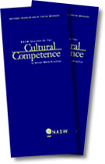
NASW Standards Relevant to
Death Education & Counseling
Standard 3. Assessment
Social workers shall assess clients and include comprehensive information to develop interventions and treatment planning.
Standard 4. Intervention/Treatment Planning Social workers shall incorporate assessments in developing and implementing intervention plans that enhance the clients’ abilities and decisions in palliative and end of life care.
Standard 5. Attitude/Self-Awareness
Social workers in palliative and end of life care shall demonstrate an attitude of compassion and sensitivity to clients, respecting clients’ rights to self-determination and dignity. Social workers shall be aware of their own beliefs, values, and feelings and how their personal self may influence their practice.

Slide 11
NASW Standards
Standard 9. Cultural Competence
Social workers shall have, and shall continue to develop, specialized knowledge and understanding about history, traditions, values, and family systems as they relate to palliative and end of life care within different groups. Social workers shall be knowledgeable about, and act in accordance with, the NASW Standards for Cultural Competence in Social Work Practice (NASW, 2004).
National Association of Social Workers. (2015). Standards for cultural competence in social work practice.
Washington, DC: NASW Press.
National Association of Social Workers. (2004). Standards for palliative and end-of-life care.
Washington, DC: NASW Press.

Slide 12

Theoretical Framework
Terror Management Theory
(Pyszcynski, Greenberg, & Solomon, 1997, 1999)
Addresses the issue of why people engage in certain behaviors to achieve certain psychological states based on their deeply rooted concerns about mortality (Arndt & Vess, 2008).
Is the theory that we all want to live but know we will die since death is unavoidable; but the thought of death produces conflict and fear which we manage using cultural and religious beliefs and rituals that provide meaning and value to us about death (Greenberg, Pyszcznski, & Solomon, 1991).

Slide 13
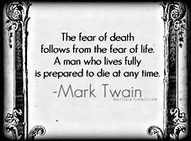
Ethical Fear Reduction
Since sustaining our faith and cultural views and maintaining a sense of worth reduce our fears and help us manage our deaths; therefore, it seems logical that death education that is spiritually and culturally, personally and practically relevant for dying patients would reduce their fears and provide them with a sense of control over the inevitability of death.

Slide 14

Reasons People fear Death per
Terror Management Theory
Death is unavoidable and certain for everyone.
The body is prone to disease, disability, and death.
So much about death is unknown.
Death is everywhere--its always in the news.

Slide 15
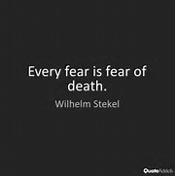
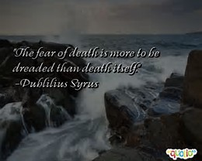

Death Anxiety
Death Anxiety is the morbid, abnormal or persistent fear of one's own death or the process of his/her dying. It is sometimes called thanatophobia. This is different from necrophobia which is a specific fear of dead or dying persons and/or things. Symptoms are similar to other anxiety disorders. We will discuss specific symptoms in other slides.

Slide 16

Causes of Death Anxiety (DA)
Early exposure to death without resolution
Traumatic Experiences (also relates to PTSD)
Observation of trauma (even from media sources such as TV, movies, horror shows or houses)
Exposure to/proximity/anticipation of death situations
Multiple losses with complicated grief
Unresolved loss and grief, especially with attachment figures

Slide 17
Causes of Death Anxiety (DA) (continued)
Obsessive thinking/worrying about death
Co-existing mental illness/anxiety disorders
Low self-esteem/failure
Unresolved relational and spiritual issues (guilt, shame, regret…)
Substance use/abuse/misuse or withdrawal
Medication side-effects
Co-occurrence with certain medical diagnoses (heart disease, cancer, COPD….) especially if the disease is terminal

Slide 18

Self-Assessment Exercise:
Are you afraid to die?
Research suggests that professionals who exhibit symptoms of death anxiety may unknowingly show their anxiety in their behavior with client systems. Fear and anxiety can be “contagious” in that when others sense fear in a person, they become fearful as well (Arndt & Vess, 2008).
Therefore, self-awareness and proactive self-assessment are needed so when death and dying are encountered in practice, social workers are better able to manage their emotions and assist the client system more professionally.

Slide 19

Self-Assessment: Templer Death Anxiety Scale
Purpose: To measure death anxiety
Author: Donald Templar
Description: 15 item instrument that is designed to measure respondents’ anxiety about death
It includes a broad range of items and concerns about death
It is reliable and valid for most population groups (Good internal consistency rate; test-retest correlation of .83; good concurrent validity)
Permission was granted for use in the IRB-approved and
exempted DSU Death Education Project.
The Templer Death Anxiety Scale. (2007).

Slide 20
The Templer Death Anxiety Scale (DAS) Pretest
If a statement is true or mostly true as applied to you, write “True”
If a statement is false or mostly false as applied to you, write “False”
1. I am very much afraid to die.
2. The thought of death seldom enters my mind.
3. It doesn’t make me nervous when people talk about death.
4. I dread to think about having to have a operation.
5. I am not afraid at all to die.
6. I am not particularly afraid of getting cancer.
7. The thought of death never bothers me.

Slide 21
The Templer Death Anxiety Scale (DAS) Pretest
True or False?
8. I am often distressed by the way time flies so very rapidly.
9. I fear dying a painful death.
10. The subject of life after death troubles me greatly.
11. I am really scared of having a heart attack.
12. I often think about how short life really is.
13. I shudder when I hear people talking about a World War III.
14. The sight of a dead body is horrifying to me.
15. I feel that the future holds nothing for me to fear.

Slide 22

Templer Death Anxiety Scale Answers--
Give yourself 1 point if your answer matches these:
If your answer does not match, give yourself a zero=0
1=True
2=False
3=False
4=True
5=False
6=False
7=False
8=True
9=True
10=True
11=True
12=True
13=True
14=True
15=False

Slide 23
Templer Death Anxiety Scale Scoring
Assign a score of One (1) for each item answered correctly using the previous slide’s answers
Total the score
The higher the score the higher the anxiety level of the respondent:
High Death Anxiety = 11-15
Moderate Death Anxiety = 5-10
Low Death Anxiety = below 4

Slide 24

DSM V Criteria
Marked fear or anxiety about a specific object or situation
The phobic object or situation almost always provokes immediate fear or anxiety
The phobic object is actively avoided or endured with intense fear or anxiety
The fear or anxiety is out of proportion to the actual danger posed by the specific object or situation and to the sociocultural context
The fear, anxiety or avoidance is persistent, typically lasting for 6 months or more
American Psychiatric Association. (2013).

Slide 25
DSM Criteria (continued)
The fear, anxiety or avoidance causes clinically significant distress or impairment in social, occupational, or other important areas of functioning
The disturbance is not better explained by symptoms of another mental disorder, including fear, anxiety, or avoidance of situations associated with panic-like symptoms or other incapacitating symptoms (as in agoraphobia); objects or situations related to obsessions (as in OCD); reminders of traumatic events (as in PTSD); separation from home or attachment figures (as in S.A.D.); or social situations (as in social anxiety disorder).
American Psychiatric Association. (2013). Specific Phobia. In Diagnostic and Statistical Manual, 5th ed.: DSM -5™
(pp. 189-190; 197-202). Washington, DC: American Psychiatric Association Publishing.

Slide 26
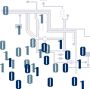

DSM 5 Coding
300.29 (F40.248) Situational OR (F40.248 specific phobia situational)
OR
300.29 (F40.298) Other
Coding Note: when more than one phobic stimulus is present, code all ICD-1-CM codes that apply.
Codes 300.29 (F40.228) Natural Environment [phobia] or 300.29 (F40.233) Fear of Injury may also apply.
American Psychiatric Association. (2013). Specific Phobia. In Diagnostic and Statistical Manual, 5th ed.: DSM -5™ (pp. 189-190; 97-
202). Washington, DC: American Psychiatric Association Publishing.

Slide 27


Multi-Dimensional Assessment for Death Education
Key Assessment Areas of Client System in Addition to Regular Assessment: (Client, family, extended family, significant others, community…)
Death Anxiety of Client System Cultural Beliefs, Customs, Rituals and Preferences about Death
Religious and Spiritual Beliefs, Customs, Rituals and Preferences about Death
Care and Quality of Life Options (Pain Management, Nursing Home, Hospital, Hospice/Palliative Care Inpatient or In-Home)
Death History of Client System: Traumatic Experiences re: Death

Slide 28
Multi-Dimensional Assessment for Death Education
Continued:
Key Assessment Areas of Client System in Addition to Regular Assessment: (Client, family, extended family, significant others, community…)
Life Stories, Personal Legacy Wishes—Generativity Issues
End-of-Life Scenarios and Wishes—Life Support, Organ Donation, Memorial Services, Burial/Cremation,
Advanced Directives (Wills, Estates, DNRs, Living Wills, 5 Wishes, HIPPA Release, Durable Power of Attorney Health care, etc.)

Slide 29

Death Anxiety in Relation to Death Education
Goals of Death Education:
Good Death as opposed to Bad Death
Normal Grieving Processes
Consistency with Client’s Wishes and Needs
Prerequisites for Good Death:
Self-Awareness about Mortality
Acceptance (as opposed to denial) of Death’s Reality
Control over Death Anxiety (from using DA interventions)
Peace

Slide 30


Interventions for Death Anxiety
Death Education and Awareness: #1 Rx
Cognitive/Behavioral Therapies
Talk Therapies
Relaxation Therapies
Systematic Desensitization/Exposure Therapy (in some cases—this may make it worse)
Protocol Therapies for Generalized Anxiety Disorder, Panic Disorder, OCD, PTSD if relevant including medication like antidepressants
Coping Skills/Development of Self-Esteem
Reassurance
Social and spiritual support
Combinations of the above therapies
(Cavanaugh & Blanchard-Fields,2011, pp. 506-057).

Slide 31

Death Education
Death Education (DE) is “a whole range of activities and experiences related to death. It may include helping someone to understand their feelings about death, dying, and bereavement as well as promoting the best possible quality of life for all concerned” (Kemp, 2014, p. 8).
Kemp, A.R. (2014). Death, dying, and bereavement in a changing world. New York: Routledge.

Slide 32
Death Education
Death Education combines factual information about the dying and death processes with issues aimed at reducing fear and anxiety and increase sensitivity and empathy for those who are dying.
Death Education Programs vary widely and may include disciplines and topics involving philosophy, art, religion, spirituality, medicine, drama, literature, music, or other death-specific content.
Programs should reflect the diversity of participants.
Research indicates that Death Education lowers death anxiety for people of all ages, religions, races.
From Cavanaugh & Blanchard-Fields, 2011, pp. 507-508.

Slide 33


Key Components of Death Education:
Didactic: imparts the knowledge, values, and skills beneficial to client or student learning through direct teaching methods such as discussion, lectures, handouts, textbook readings, etc. (Kemp, 2014, p. 8).
Teachable Moments: Naturally occurring moments when someone is open to learning about death in a meaningful way because of current real-life experiences with it.

Slide 34

Key Components of Death Education
Experiential: involves the use of engaging activities to enhance learning including assignments that engage students in movies, art, music about death, role-plays, death and funeral simulations, interactive discussions, support/focus groups, funeral attendance, completing death certificates and advanced directives forms, writing personal obituaries and bucket lists, planning personal funeral services, visiting nursing homes, hospices, and funeral homes, etc.
These activities are designed to evoke feelings and change attitudes, increase awareness of personal mortality, increase empathy for those who are in the end-of-life process, as well as to provide a sense of control over an otherwise uncontrollable life process
(Kemp, 2014, p. 8; ADEC, 2017).

Slide 35

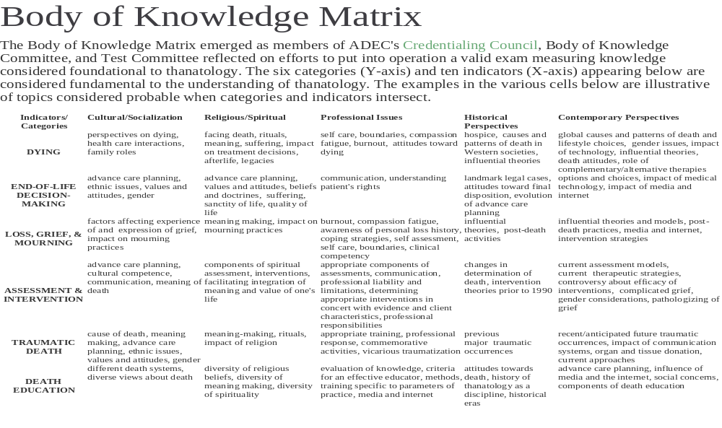
Association for Death Education and Counseling

Slide 36
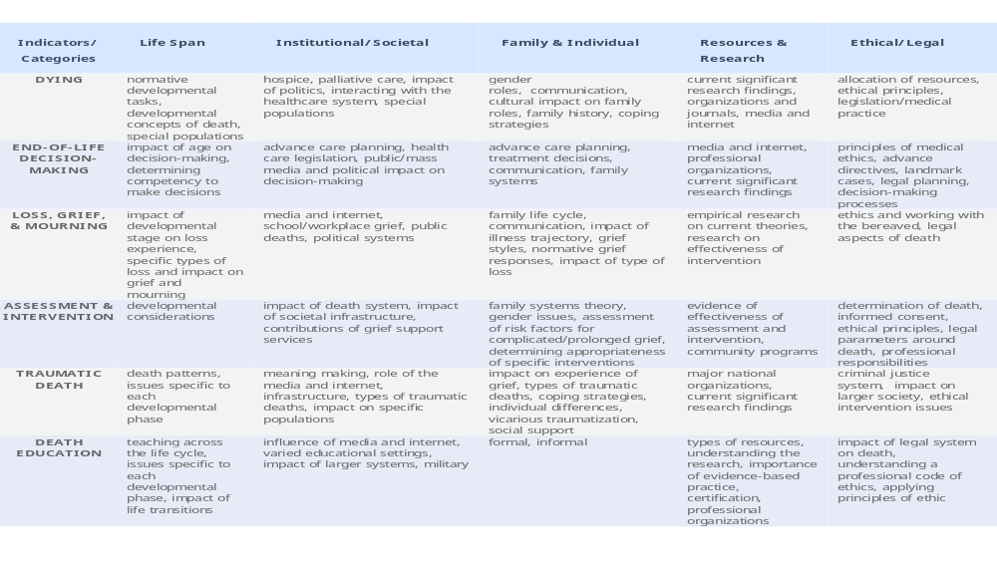
Association for Death Education and Counseling’s Matrix Continued

Slide 37

Exercises for Self-Awareness re: Mortality
Writing your own obituary
Planning your own memorial and burial services
Asking yourself: “Could my death occur right now or very soon?” “What can I do to help make my death more acceptable to me and my family?”
Writing down specific personal feelings and fears associated with death and how those can be addressed.
Note: These activities also enhance feelings of power and control over death and foster acceptance of mortality.
From Koestenbaum, 1976 in Cavanaugh & Blanchard-Fields, 2011, pp. 506-507.

Slide 38
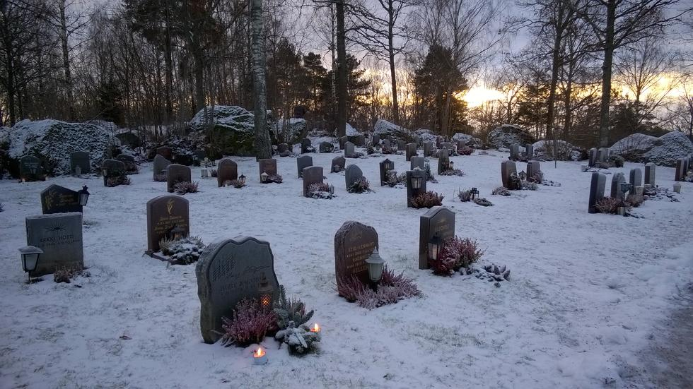
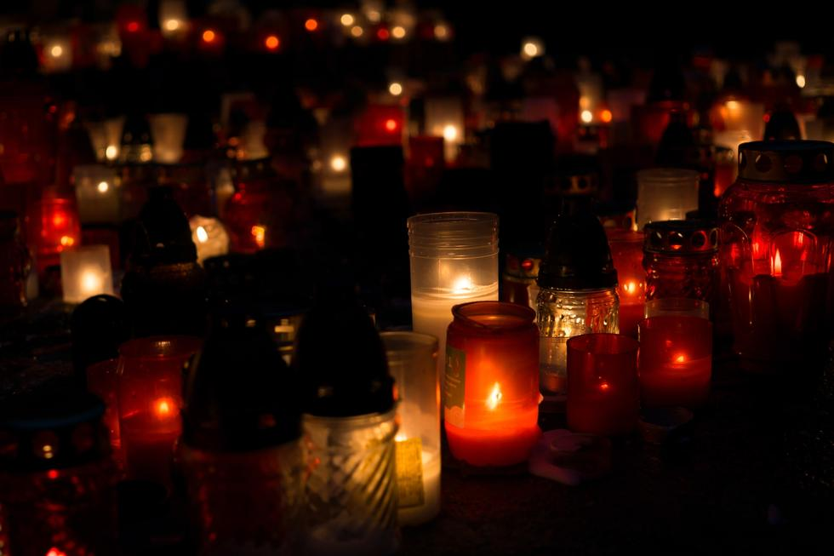
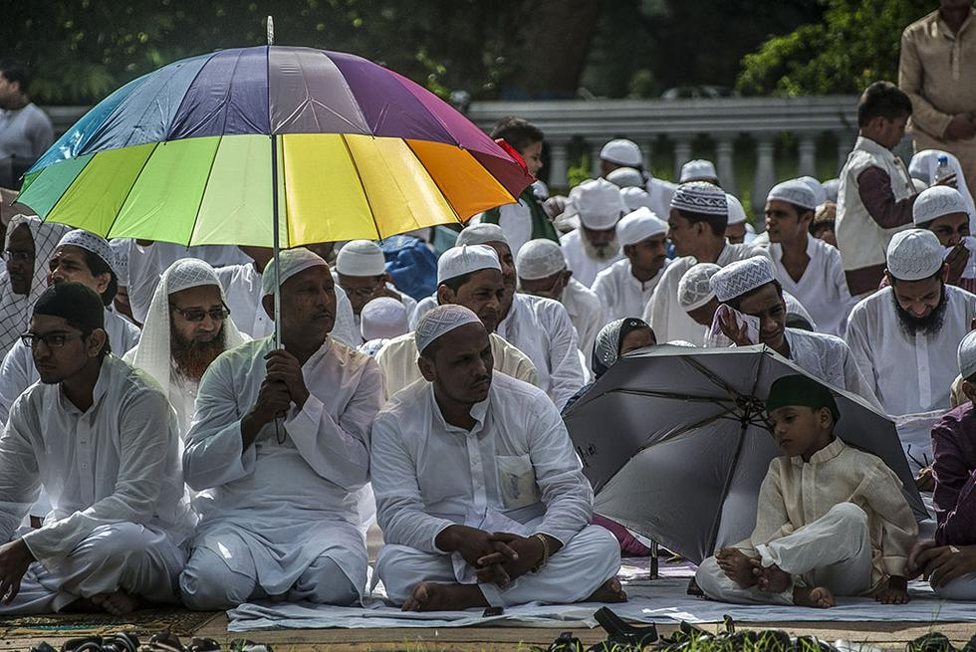
Designing Diversity in Death Education
Age-Appropriate
Culturally Sensitive and Relevant
Spiritually Sensitive and Relevant
Educational
Practical
Meaningful
Interactive
Holistic—involving the whole person and client system

Slide 39

Example of Death Education Programs (DEPs)
Children
Older Adults
People of the Islamic Faith
People of the Hindu Faith
People of the Christian Faith

Slide 40

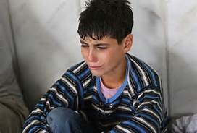
Death Education with Children—Kelsa Powell, DSU BSW Student
Do Children think about death?
Is death considered normal to a child?
Lets talk!
Notes:
1. Most children (even really young) do think about death, and there are multiple sources of evidence to prove it.
2. When asked about death do children see it as normal? Do they understand what death really means? It has been found that until the age of five, children don’t understand death.

Slide 41
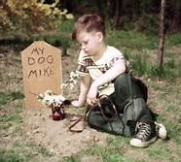
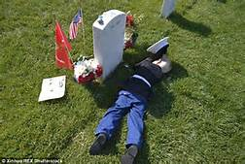
How do children see death?
Burials and Funerals
Children have many different ways of viewing a burial or funeral
Burying their first pet fish
Viewing the individual as “asleep”
Notes:
Some children have grown up to be scared by funerals and what they mean. Children can remember seeing or touching the cold lifeless body and this leaves them fearful of death.
Some children have mentioned that their first memory of death is burying their first pet in the yard with their parents and that it meant goodbye.
Some kids have been quoted to see a dead body and say “they won’t wake up”
These memories have been found to have left the child fearful of their own death.

Slide 42
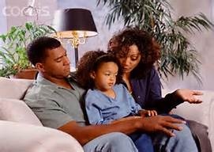

How Do We Reduce the Fear?
Depends on Age and Developmental Level
Didactic Methods
Provide Support
Talk about It
Share Memories
Explain the Stages of Grief
Discussing Moving Forward after Loss
Notes:
Death education programs can be formulated to help a younger population group.
While some may think that a bucket-list should only be used for adults who have many things they want to accomplish before passing, that is not always the case. We can use a bucket-list to help children to cope with death, and it may even be more effective. Children should have a long life expectancy, but for some that is not the case. For children who are terminally ill, getting to see a wish come true can be very beneficial for them. We see how well this works with the Make-A- Wish program.
When a child is dealing with death one of the main things that we can do to help them is support them. When supporting a child there are other options that can be beneficial aside from talking to them. We can use play therapy and let the child play or color and learn their emotions through their actions.
One of our main problems in dealing with death and children is their level of understanding. It is important to prepare children for the stages of grief by explaining it in a way they can understand. Children need to be told that its okay to be angry, that they are allowed to be upset, and that what they are going through does not make them “abnormal”.
Due to children being young it is important that we ensure their ability to move forward after death. Part of accepting death should be to know that they can move forward after a traumatic situation. In practice we can help with this by teaching children coping skills.

Slide 43


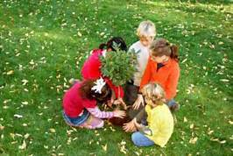
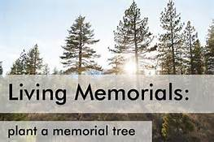
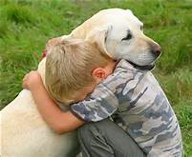
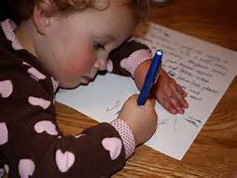
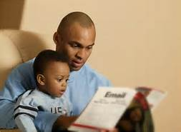
Experiential Methods:
Art
Music
Play
Pets
Movies
Games
Letters, Books
Bucket-Lists
Memorials

Slide 44
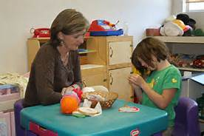
Considerations for DEPs with Children
Age
Maturity
Spiritual Awareness
Interest in Learning/Talking about Loss
Need
Culture
Find and Use Teachable Moments

Slide 45
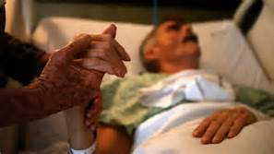
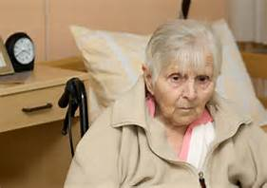
Death Education with Older Adults —
Kelsa Powell DSU BSW Student
Should we consider it normal?
Are older adults fearful of death?

Slide 46


Do older adults see death differently?
Burials and Funerals
End of Life Expenses
Personal Legacies
Notes:
Older adults have a better understanding of death. They have all witnessed it multiple times in life. They know when they see a dead body what it actually means and that they wont see that person again in this life.
Due to their understanding of death, older adults form more worries towards the end of life. End of life expenses may begin to bother these individuals and they may worry about becoming a burden to their families
Older adults may also begin to worry about their personal legacies at this point. It is important to many individuals how they are remembered when they are gone. At this point it is important for us to remember in practice to support them in remembering their life and listen to their stories.

Slide 47

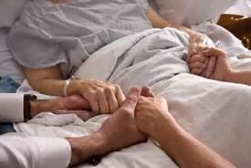
How do we reduce anxiety towards the end of life?
Palliative Care
Personal wishes
Stages of Death
Bucket List
Notes:
One of the main things that we can do for older adults in this stage of life is palliative care. This alone can help reduce the fear of dying alone or in pain.
We can help older adults with personal wishes. These wishes can start at funeral arrangements and go all the way to advanced directives. Helping older adults handle these things can help reduce their fear of leaving a burden on their family.
One thing we can do with older adults is discuss with them the stages of death. It is normal at the stage of life to be in denial of the end of life. Some older adults feel as if they haven't achieved everything they wanted and its not their time yet. We can begin with them in that stage of senial and support them through the following stages.
A bucket list can be beneficial for older adults. As I mentioned earlier, this point in life for many older adults becomes a time of regret. Regretting time wasted or wishing they had been able to do something can cause death anxiety. Giving these individuals the opportunnity to accomplish things before their passing time can relieve that anxiety greatly.

Slide 48
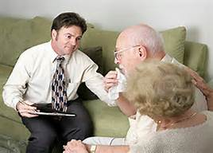
Considerations for DEP with Older Adults
Cognitive Ability
Need and Interest
Spiritual and Cultural Factors
Family Support
Generativity

Slide 49
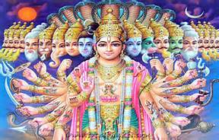
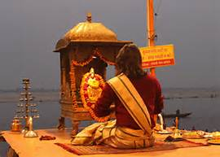
Death Education with People of the Hindu Faith
—Sarah Freeman DSU BSW Student
India- birthplace of Hinduism
Polytheistic---worship many gods
Atman- “soul”
Realizing one’s true nature
Maya
Samsara
Moska
Brahman
(Kemp, 2014; Dees, 2001)

Slide 50
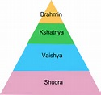
Hindu Cultural Issues
Dharma
Caste system: Brahmin, Kshaatriyas, Vaishayas, Shudras, untouchables
Four divisions in the life cycle: student, householder, recluse or retirement, ascetic
  (Kemp, 2014; Dees, 2001)

Slide 51
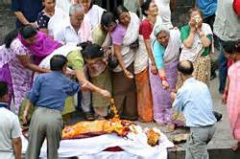

Last Rites Tradition
Within 12 hours of death
Feet facing south- direction of death
People present at death read sacred verses
Lamp is lit near dying person
  (Kemp, 2014; Dees, 2001)

Slide 52
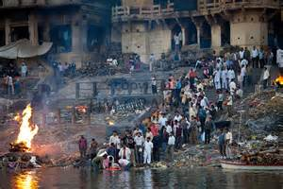
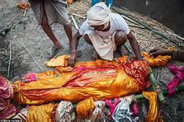
Hindu Burial Traditions
Chief mourner
Wrap body
  men: unbleached white cloth
  women: orange, red, or gold cloth
Burning ghat
Varanasi- Khasi
Procession through town
Cremation ceremony conclusion
(Kemp, 2014; Dees, 2001)

Slide 53
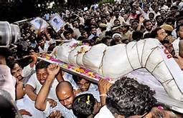
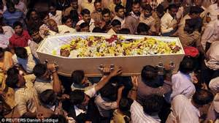
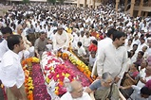


Hindu Burial Ceremony
Chief mourner
Wrap body
  men: unbleached white cloth
  women: orange, red, or gold cloth
Burning ghat
Varanasi- Khasi
Procession through town
Cremation ceremony conclusion
(Kemp, 2014; Dees, 2001)

Slide 54
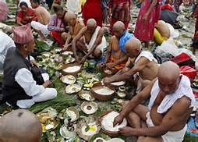
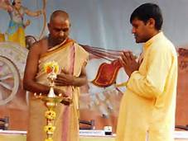
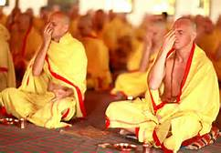
Hindu Afterlife Beliefs
Family- unclean- 10 days
Special ceremonies
Special diet
The soul of deceased’s new body is formed
  10 days
Shraddha ceremony
  (Kemp, 2014; Dees, 2001)

Slide 55
Cultural and Religious Considerations for DEPS with Hindus
The body preparation process is extremely important. Make sure that all cultural and religious rituals are satisfied. The body must be properly washed, shrouded in white or colored cloth, and positioned properly.
Public ceremonial burning of the body or ceremonial cremation is a common Hindu burial tradition.
Special diets and ceremonies accompany the death and bereavement processes.
Post-burial religious rituals and customs should be included in bereavement planning for the family.
(Kemp, 2014; Dees, 2001)

Slide 56
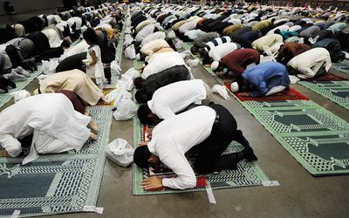
Death Education with People of the Islamic Faith
—Brittany Smart, DSU BSW Student
Preached by the Prophet Muhammad, who appeared in Mecca 1,400 years ago
They believe in only one God-Allah
Guidelines:
  Believe in Prophet Muhammad
  Believe there is a day of judgment and a life after death
  Pray five times a day
  Commit to fasting
  Go on a pilgrimage to Mecca
  Fight for the sake of Allah
  (Kemp, 2014; Dees, 2001; Gilanshah, 1997)

Slide 57

Religious Beliefs
Believe in the Koran
Prohibit slavery, prostitution, drinking, gambling, robbery, and adultery
Emphasize charity and places a great importance on education
Family life is very important
Those who follow the Koran are said to have a happy and healthy life now and in the afterlife
(Kemp, 2014; Dees, 2001; Gilanshah, 1997)

Slide 58

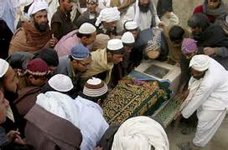
Afterlife Beliefs
They believe that death is a return to God
For believers of this faith, the afterworld is beautiful but for the nonbelievers, it is ugly
Dreams determine their afterworld experiences
They will see those who have passed on when they enter the afterlife
They will watch over their families when they enter the afterlife
They also will make family visits to the families
The funeral ceremony will prepare the dead person for the day of judgment
(Kemp, 2014; Dees, 2001; Gilanshah, 1997)

Slide 59

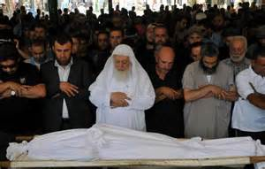
Death Rituals
A close relative must be with the dying person at all times
During this time, they are reading the Koran to the dying person
Both Satan and angels will be close by
When the person dies, immediate actions take place:
  Turn the body to face toward Mecca
  Close the body’s eyes and mouth
  Straighten both legs and stretch both hands by the sides
  Announce the death immediately to all friends and relatives
  Hasten to bathe the body and cover/shroud it with white cotton using specific methods
(Kemp, 2014; Dees, 2001; Gilanshah, 1997)

Slide 60
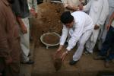
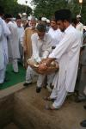
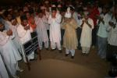
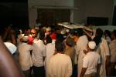

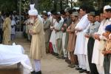
Burial Ceremonies
Four people place the corners of a bier (table or platform) on their shoulders
They must repeat “Allah Akbar” which means “God is Great”
The grave should face Mecca and the burial is to take place from sunrise to sunset on the day of death or on the following day
There is crying and praying and sometimes fainting during the ceremony
The funeral is both depressing and expressive
(Kemp, 2014; Dees, 2001; Gilanshah, 1997)

Slide 61
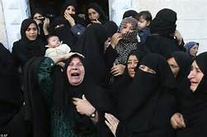
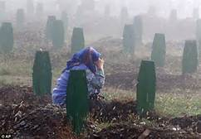
Post Burial Ceremonies
Everyone goes to the family’s home for a meal and stays for the rest of the day and close relatives stay the entire week
They are to be social for the entire week and not left alone
Day 3 after burial- a several hour ceremony is held in the mosque to pray
Day 7 after burial- a prepared stone will be placed to cover the grave and fresh flowers are placed
Day 40- They gather in the cemetery to pray from the Koran
Up until 40 days, everyone is required to wear black
One year after burial- a ceremony is held to pray and remember deceased
(Kemp, 2014; Rees, 2001; Gilanshah, 1997)

Slide 62
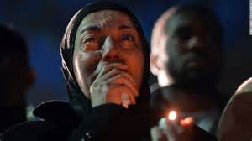
Cultural and Religious Considerations for DEPs
Praying and fasting may be included in the end-of-life scenario planning
Generativity/Legacy issues might involve education and charity with an emphasis on the preservation or enhancement of family life
Dreams may be significant as death draws near due to their interpretation of the afterlife
Their believe that they will watch over their families and make family visits when they enter the afterlife may provide comfort and hope for the dying person and the family and serve as a means of generativity/legacy.
The body preparation and burial processes is extremely important. Make sure that all cultural and religious rituals are satisfied. Someone will need to stay with the body and read the Koran. The body must be properly washed, shrouded in white cloth, and positioned properly. The burial will need similar preparations and its timing is critical to the Islamic faith.
Post-burial religious rituals and customs should be included in bereavement planning for the family.

Slide 63

Case Studies for Designing Diversity in DEPs
Joe is an 81 year-old African-American middle class Methodist preacher living in a rural Southern town. He and his small family are very involved in their local church and community and devoted to prayer, Bible study, and helping the poor. He has cancer and is ready to die, but wants a very simple service and burial. He is worried about how his wife will survive financially.
Betty is a wealthy, widowed Italian Catholic who immigrated to Chicago from Italy 50 years ago. She is 67. She attends mass and confession, but not regularly. She sometimes prays and takes communion but says it does not “do anything for her.” She is very afraid to die, but does not like to talk about it. She is more interested in her large extended family celebrating her pending death with good food, wine, and laughter at her family restaurant. She is worried that people will forget her and is especially worried that her two sons will not attend her wake and funeral get along as the estate is settled since they have not spoken to each other in 10 years. She wonders if her restaurant will survive.

Slide 64

Death Education for People of the Christian Faith—Audience
Consider Denomination, Beliefs, Customs, and Personal Practices
Assess Client System Needs and Wishes
Create culturally and spiritually relevant DEPs to enable a “good death” and prevent a “bad death.”
Which case is more likely to experience a “bad death” and which is more likely to experience a “good death?”
How can designing diversity in death education help both of these client systems reduce death anxiety so they experience better death and bereavement processes?

Slide 65
Is Death Education Effective?
Our 6 semester IRB-Approved Project with DSU BSW students
Level of Death Anxiety | Pretest Level of Death Anxiety | Posttest Level of Death Anxiety
Very High Death Anxiety (13-15) | 10 | 3
High Death Anxiety (10-12) | 29 | 14
Average death Anxiety (7-9) | 39 | 38
Low Death Anxiety (4-6) | 16 | 32
Very Low Death Anxiety (0-3) | 2 | 9
Total N: 96 | 96 | 96

Slide 66

Did this help decrease your death anxiety?
Take the posttest and find out. Note: it may take longer than 1 session. Reflection, doing some of the recommended activities, and completing death education designed just for you may help decrease your anxiety which is good for professional self-care.

Slide 67
The Templer Death Anxiety Scale Posttest
If a statement is true or mostly true as applied to you, write “True”
If a statement is false or mostly false as applied to you, write “False”
1. I am very much afraid to die.
2. The thought of death seldom enters my mind.
3. It doesn’t make me nervous when people talk about death.
4. I dread to think about having to have a operation.
5. I am not afraid at all to die.
6. I am not particularly afraid of getting cancer.
7. The thought of death never bothers me.

Slide 68
The Templer Death Anxiety Scale Posttest
8. I am often distressed by the way time flies so very rapidly.
9. I fear dying a painful death.
10. The subject of life after death troubles me greatly.
11. I am really scared of having a heart attack.
12. I often think about how short life really is.
13. I shudder when I hear people talking about a World War III.
14. The sight of a dead body is horrifying to me.
15. I feel that the future holds nothing for me to fear.

Slide 69
Templer Death Anxiety Scale Answers--
Give yourself 1 point if your answer matches these:
If your answer does not match, give yourself a zero=0
1=True
2=False
3=False
4=True
5=False
6=False
7=False
8=True
9=True
10=True
11=True
12=True
13=True
14=True
15=False

Slide 70
Templer Death Anxiety Scale Scoring
Assign a score of One (1) for each item answered correctly using the previous slide’s answers
Total the score
The higher the score the higher the anxiety level of the respondent:
High Death Anxiety = 11-15
Moderate Death Anxiety = 5-10
Low Death Anxiety = below 4

Slide 71


So Now What? How Will You Design Diversity in DEP with Diverse Populations?
Audience provides feedback
Areas of Consideration:
Self-Care/Awareness/Reflection
Diverse Ages
Diverse Population Groups
Spirituality
Cultural Sensitivity
Ethics
Assessment
Intervention

Slide 72
Session Goals: Accomplished?
After the session, participants should be able to:
Understand and assess death anxiety
Examine the ethical and critical components of death education
Design ethically, culturally, and spiritually sensitive death education programs for client systems in diverse population groups
Feel more prepared to use death education with diverse populations in social practice and education
Use death education as a means of ethical/professional self-care and for anxiety reduction

Slide 73

Questions

Slide 74
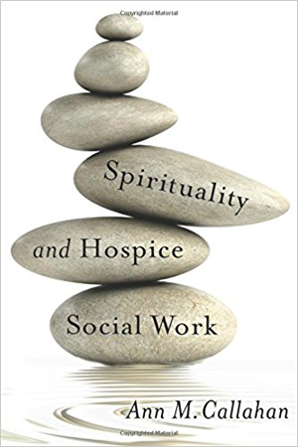
Resources
*Spiritual Diversity
*Spiritual Sensitivity
*Spiritual Competence
*Spiritual Assessment
  Spiritual Needs
  Spiritual Suffering
*Spiritual Care and Intervention
  Relational Spirituality
  Prayer
  Scripture
  Music
  Worship
  DEP
  Encouragement
  Advanced Directives
  Memorials

Slide 75

Resources
Association of Death Education and Counseling (ADEC)
NASW’s Standards on Palliative Care and End of Life Issues
National Hospice and Palliative Care Association

Slide 76

References
Abenogozar, M.C., Bueno, B., & Vega, J.L. (1999). Intervention on attitudes toward death along the
life-span. Educational Gerontology, 25, 435-447.
American Psychiatric Association. (2013). Specific Phobia. In Diagnostic and Statistical Manual, 5th ed.:
DSM -5™ (pp. 189-190; 197-202). Washington, DC: American Psychiatric Association
Publishing.
Arndt, J., & Vess, M. (2008). Tales from existential oceans: Terror Management Theory and how the
awareness of our mortality affects us all. Social and Personality Compass, 2, 909-928.
Callahan, A. (2017). Spirituality and hospice social work. New York: Columbia University Press.
Cavanaugh, J. C., & Blanchard-Fields, F. (2011). Adult development and aging. (6th ed.). Belmont, CA:
Wadsworth Group.
Gilanshah, F. (1997). Islamic customs regarding death. In D.P. Irish, K.F. Lundquist, & V.J. Nelsen (Eds.),
Ethnic variations in dying, death, and grief (pp. 137-146). Washington, DC: Tylor & Francis.
Kastenbaum, R. (2009). Death, society, and human experience. (10th ed.). New York: Macmillan.
Kemp, A.R. (2014). Death, dying, and bereavement in a changing world. New York: Routledge.
Koestenbaum, P. (1976). Is there an answer to death? Englewood Cliffs, NJ: Prentice-Hall.

Slide 77
References (Continued)
National Association of Social Workers. (2015). Standards for cultural competence in
social work practice. Washington, DC: NASW Press.
National Association of Social Workers. (2004). Standards for palliative and end-of-life
care. Washington, DC: NASW Press.
National Association of Social Workers. (1996). The Code of Ethics of the National
Association of Social Workers. Washington, DC: NASW Press.
Rees, D. (2001), Death and bereavement: The psychological, religious, and cultural
interfaces (2nd ed.). London: Whurr.
Solomon, S., Greenberg, J., & Pyszczynski, T. (1991). A terror management theory of social
behavior: The psychological functions of self-esteem and cultural worldviews.
Advances in Experimental Social Psychology, 24(93), 159-162.
The Templar Death Anxiety Scale. (2007). In Fischer, J., & Corcoran, K. (Eds.), Measures for
clinical practice and research: A sourcebook (4th ed., Vol. 2, pp. 827-828). New York: Oxford
University Press.

