Slide 1
Working Through Varying Professional Viewpoints on Controversial Issues”
NACSW Conference
Saturday November 4, 2017
Presenters:
Charles Seitz, Ph.D., M.S.W., LCSW- Department Chair, Social Work
Messiah College cseitz@messiah.edu
Michelle Dixon George, M.S.W., LCSW, BCD – Field Coordinator, Social Work
Messiah College mgeorge@messiah.edu
Jess Becker, B.S.W. student, Messiah College
Ally Bishop, B.S.W. student, Messiah College
Sara Gartner, B.S.W. student, Messiah College
Dakota Kelso, B.S.W. student, Messiah College

Slide 2
Abstract:
This discussion based workshop provides a framework for engaging in civil dialogue regarding controversial topics within social work professional organizations. Research related to the plurality of views on various topics will provide a foundation for identifying common ground and for working through the challenges where differences exist.

Slide 3
At the conclusion of this workshop, participants will be able to:
1. Discuss research related to areas of tension within social work professional organizations related to controversial topics including religion, political affiliation, abortion, infidelity and LGBTQ issues.
2. Utilize a framework to articulate commonalities with others presenting differing views and identify areas where a plurality of beliefs creates challenges to working together within the social work professional community.
3. Explore ways to provide a more cohesive social work voice within the larger society and identify a framework where future discussions within social work professional organizations can occur.

Slide 4
Our Goals…
Understand potential areas of tension related to controversial issues between different social work professional organizations.
Identify possible areas of alignment between professional organizations related to controversial issues.
Develop a framework where continuing dialog can occur between social workers having differing views on controversial issues.

Slide 5
Background for the presentation
This workshop will frame the issue through presenting research that has been conducted that reflects potential differing views within professional social work organizations on controversial issues.
The North American Association of Christians in Social Work (NACSW) membership was surveyed to provide insight on the extent of divergent views and to provide a framework for negotiating these challenges.
The National Association of Social Workers- PA (NASW-PA) was also surveyed using a similar questionnaire and the data was then compared.

Slide 6
Issues to consider prior to reviewing research data
There is limited research on this topic
There are limited instruments available to evaluate topic/ instruments used
were not assessed for validity/ reliability
Survey was primarily intended as a starting point for discussion
There is the possibility of overlap in participants (may have been potentially
surveyed twice)
Cannot specifically compare data between participant groups
There was a minor time lapse between surveys
Participant perception of survey purpose influenced both whether subjects
chose to complete the survey and the actual survey results
Qualitative date would need to be collected to achieve more clarity regarding
how values and beliefs impact practice
Potential issues related to collecting NASW data from only one state (NACSW
data was collected nationally). Potential for different data from other NASW
state chapters.

Slide 7
Participants
During the summer of 2014, in coordination with the NACSW, we conducted a national survey of NACSW (North American Association of Christians in Social Work) members related to how faith informs practice The survey was distributed via email to 978 NACSW members 123 participants completed the survey (12.5%) | In the Fall of 2014, in coordination with the NASW-PA Chapter, we sent a similar survey to NASW-PA members. It was distributed to members via email. The survey was distributed via email to A minimum of 2,904 members 213 participants completed the survey (7.3%)

Slide 8
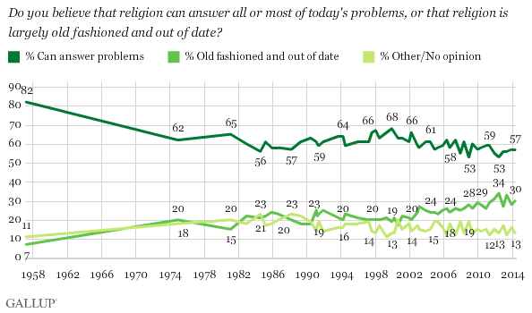
2014 - Fifty-seven percent of Americans say that religion can answer all or most of today's problems, while 30% say that religion is largely old fashioned and out of date. (2016 – 54% can answer problems/ 33% outdated) http://www.gallup.com/poll/1690/religion.aspx http://www.gallup.com/poll/171998/majority-says-religion-answer-today-problems.aspx

Slide 9
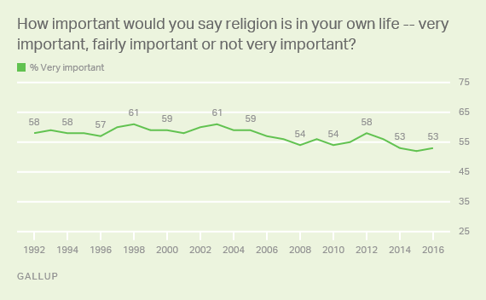
In 2016, 53% of Americans identify religion as very important in own life

Slide 10
What is your religious preference -- are you Protestant, Roman Catholic, Mormon, Jewish, Muslim, another religion or no religion? (2016 Gallop Poll) http://www.gallup.com/poll/1690/religion.aspx
What is your religious preference?
Protestant – 37%
Christian, nonspecific – 10%
Catholic – 22%
Jewish – 3%
Mormon – 2%
another religion – 5%
no religion? – 18%
No answer – 2%

Slide 11
Which of the following statements comes closest to describing your views about the Bible - 2017 http://www.gallup.com/poll/1690/religion.aspx
the Bible is the actual word of God and is to be taken literally, word for word – 24%
the Bible is the inspired word of God but not everything in it should be taken literally – 47%
the Bible is an ancient book of fables, legends, history, and moral precepts recorded by man – 26%

Slide 12
Demographics
Age of Participants (NACSW): 35 or under = 26% 36 to 55 = 37% 56 and older = 36%
Age of Participants (NASW- PA): 35 or under = 25% 36 to 55 = 32% 56 and older = 43%

Slide 13
Occupation of respondents
Occupation (NACSW): 50% either mental health worker or social work educator
Occupation (NASW): 42% either mental health worker or social work educator

Slide 14
NACSW - Please list numerically (rank in order) what you consider to be most important for arriving at a practice decision related to a controversial issue when working with a client. (Start with what you consider to be most important as number 1 to what you consider to be less important as number 10).
 | Top 1st responses | Top 2nd responses | Top 3rd responses
Professional Code of Ethics | 45 | 50 | (4^{th)}
Personal Faith Doctrine | 40 | 22 | (5^{th)}
State or Federal Regulations | 15 | (4^{th)} | 18
Agency Policy | (4^{th)} | 16 | 29
Consultation | (5^{th)} | (5^{th)} | 29
Other possibilities included research, industry standards, personal feelings, past experiences with clients etc.

Slide 15
Which of the following most closely represents your primary view on spirituality? (NASW)
I do not view myself as spiritual and my values and beliefs are not connected to a specific religion. | 8%
I do not view myself as spiritual but my values and beliefs are connected to a specific religion. | 3%
I view myself as spiritual but my values and beliefs are not connected to a specific religion. | 31%
I view myself as spiritual and my values and beliefs are connected to a specific religion. | 56%

Slide 16
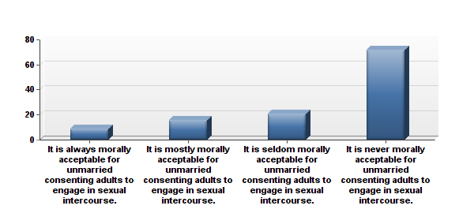
SURVEY QUESTION: This question addresses how you would address sexual relationships of non-married heterosexual adults within treatment situations.
NACSW
NASW

Slide 17
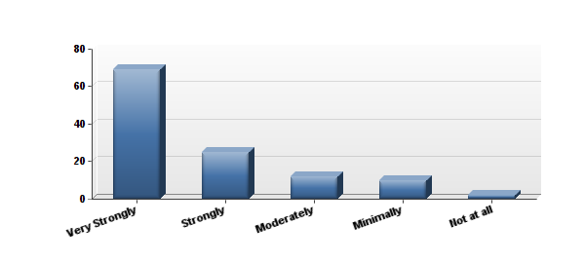
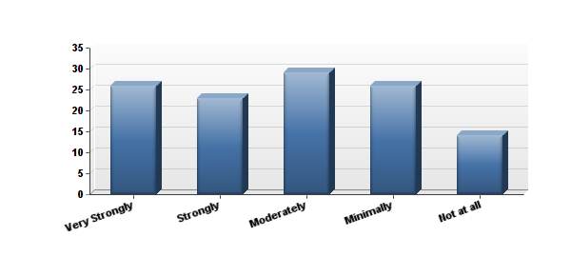
NACSW
79% = it is seldom or never morally acceptable for consenting non-married adults to engage in sexual intercourse
How strongly does your faith inform your response to the question above?
How strongly does your response to the question above impact your practice of social work?

Slide 18
NASW = 71% it is always or mostly always morally acceptable for unmarried heterosexual consenting adults to engage in sexual intercourse -

Slide 19
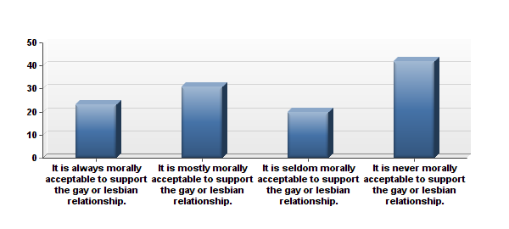
SURVEY QUESTION: When you are treating a gay or lesbian couple, which one of the following most closely reflects your response?
NACSW
NASW

Slide 20
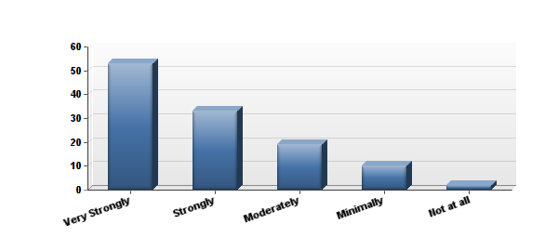
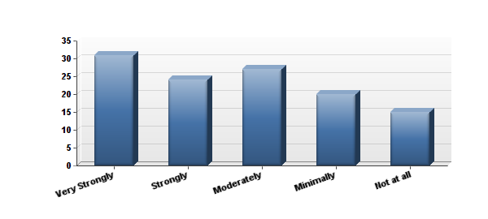
NACSW
53% = it is seldom or never morally acceptable to support the gay or lesbian relationship
How strongly does your faith inform your response to the question above?
How strongly does your response to the question above impact your practice of social work?

Slide 21
NASW
89% = it is mostly or always morally acceptable to support the gay or lesbian relationship

Slide 22
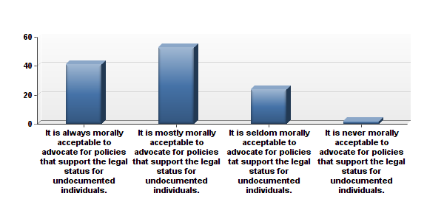
SURVEY QUESTION
Which one of the following most closely reflects your view of immigration policy within the practice of social work?
NACSW
NASW

Slide 23
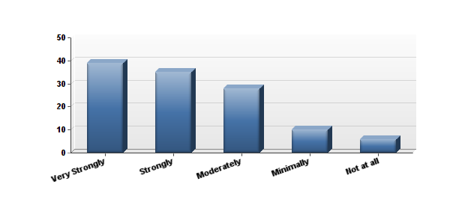
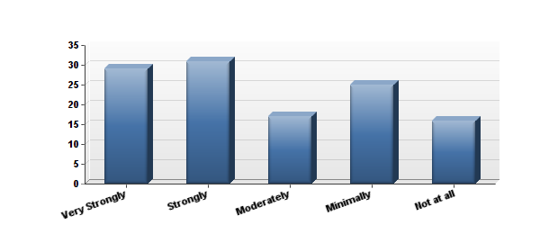
NACSW
78% = it is mostly or always morally acceptable to advocate toward legal status of undocumented individuals
How strongly does your faith inform your response to the question above?
How strongly does your response to the question above impact your practice of social work?

Slide 24
NASW
90% = it is mostly or always morally acceptable to advocate toward legal status of undocumented individuals

Slide 25
Respondent comments (similar comments from both participant groups)
Participants concerned about how the survey data would be used, concerned about motives behind survey
Participants noted research issues with the survey
Several participants wanted opportunity to explain answers
Some participants needed clarification on some questions
Some issues noted related to the repetitiveness of the questions or question wording
Participants appreciated opportunity address issues in both surveys
Some participants did not have experience in dealing with some issues in practice situations
Many participants wanted to express their own opinions related to how faith, ethics, and/or values impact practice.
Many individuals explained their answers (generally how they approached the survey and why they responded the way they did to specific questions)

Slide 26
Questions for Group Discussion
What did you find interesting related to the similarities and differences between the two survey groups? What are some possible explanations for similarities/ differences?
How could an awareness and understanding of the complexities of the issues (not simplifying) serve to enhance ethical, professional and competent social work practice?
How can we recognize and reconcile the differences in a way that best serves the profession and the needs of the individuals and communities served by social workers?
What roles can the NASW and the NACSW play in assisting members in navigating these tensions and challenges?
What recommendations do you have to continue an understanding related to how faith, beliefs and values impact practice?

Slide 27
References
Chamiec-Case, R. (2012). Ethically integrating faith and practice: Exploring how faith makes a difference for Christians in social work. In T. L. Scales & M. S. Kelly (Eds.), Christianity and Social Work: Readings on the integration of Christian faith and social work practice (4th ed.) (pp. 337-359). Botsford, CT: NACSW.
Council on Social Work Education. (2008). Education policy and accreditation standards. Retrieved from http://www.cswe.org/File.aspx?id=13780
Dessel, A., Bolen, R., and Shepardson, C. (2011). Can religious expression and sexual orientation affirmation coexists in social work: A critique of Hodge’s theoretical, theological, and conceptual frameworks. Journal of Social Work Education, 47(2), 213-234.
Gallop. (2017). Religion: Historical trends. Retrieved from http://www.gallup.com/poll/1690/religion.aspx
Healy, L. M. (2007). Universalism and cultural relativism in social work ethics. International Social Work, 50(11), 11-26.
Hodge, D. R. (2011). Toward a learning environment that supports diversity and difference: A response to Dessel, Bolen and Shepardson. Journal of Social Work Education, 47(2), 235-251
Shepardson. Journal of Social Work Education, 47(2), 235-251.
Sherwood, D. A. (2012b). The relationship between beliefs and values in social work practice: Worldviews make a difference. In T. L. Scales & M. S. Kelly (Eds.), Christianity and social work: Readings on the integration of Christian faith and social work practice (4th ed.) (pp. 85-103). Botsford, CT: NACSW.
Spano R. & Koenig, T. (2007). What is sacred when personal and professional values collide? Journal of Social Work Values and Ethics, 4(3). retrieved from http://www.socialworker.com/jswve/content/view/69/54/

Slide 28
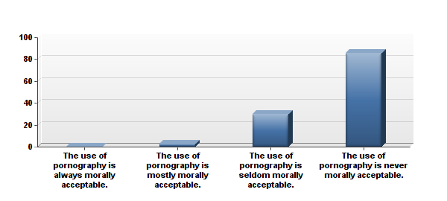
SURVEY QUESTION
Which one of the following most closely reflects your view of pornography as a treatment intervention when working with adults?
NACSW
NASW

Slide 29
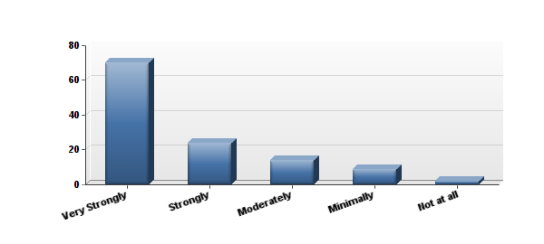
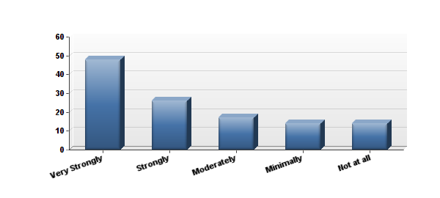
NACSW
97% = it is seldom or never morally acceptable to use pornography as a treatment technique
How strongly does your faith inform your response to the question above?
How strongly does your response to the question above impact your practice of social work?

Slide 30
NASW
77% = it is seldom or never morally acceptable to use pornography as a treatment technique

Slide 31
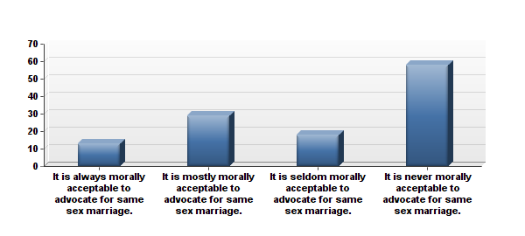
SURVEY QUESTION
Which one of the following most closely reflects your view of advocacy within your practice of social work?
NACSW
NASW

Slide 32
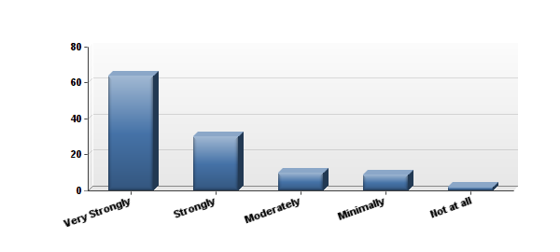
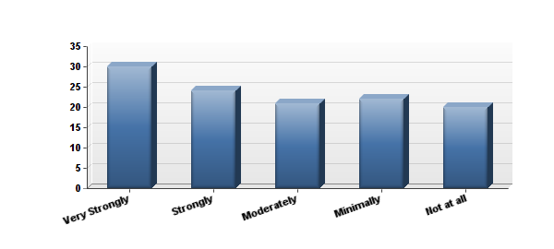
NACSW
64% = it is seldom or never morally acceptable to advocate for same sex marriage
How strongly does your faith inform your response to the question above?
How strongly does your response to the question above impact your practice of social work?

Slide 33
NASW
83% it is mostly or always morally acceptable to advocate for same sex marriage

Slide 34
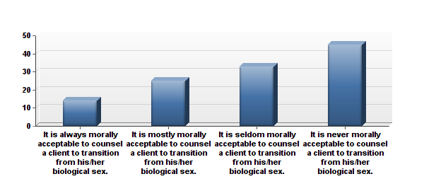
SURVEY QUESTION
Which one of the following most closely reflects your view of the treatment of transgender individuals?
NACSW
NASW

Slide 35
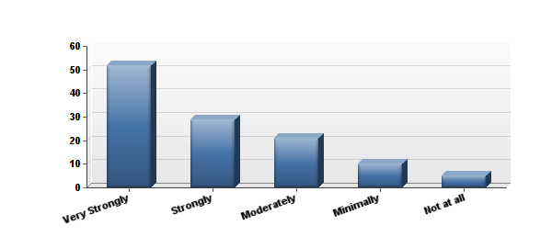
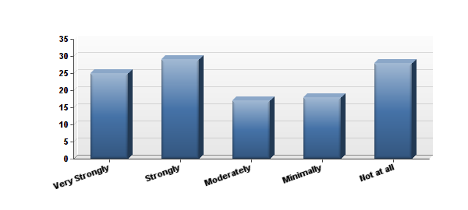
NACSW
69% = it is seldom or never morally acceptable to counsel to transition from his/her biological sex
How strongly does your faith inform your response to the question above?
How strongly does your response to the question above impact your practice of social work?

Slide 36
NASW
82% = it is mostly or always morally acceptable to counsel to transition from his/her biological sex

Slide 37
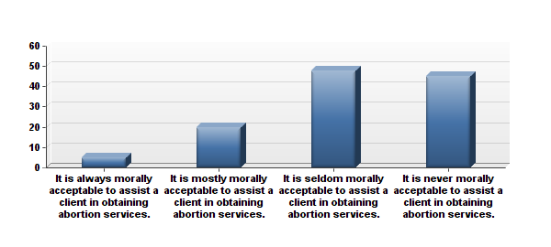
SURVEY QUESTION: Which one of the following most closely reflects your view of the issue of abortion?
NACSW
NASW

Slide 38
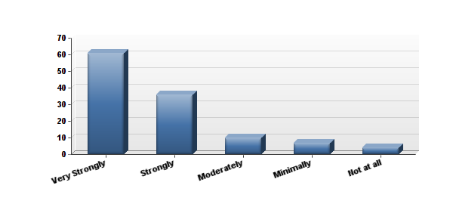
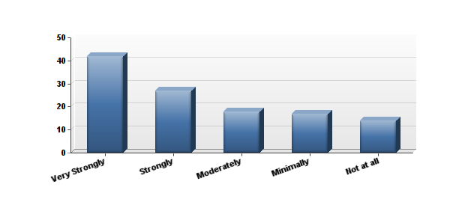
NACSW
69% = it is seldom or never morally acceptable to assist a client in obtaining abortion services
How strongly does your faith inform your response to the question above?
How strongly does your response to the question above impact your practice of social work?

Slide 39
NASW
71% = Always or mostly always morally acceptable to assist clients in obtaining abortion services

Slide 40
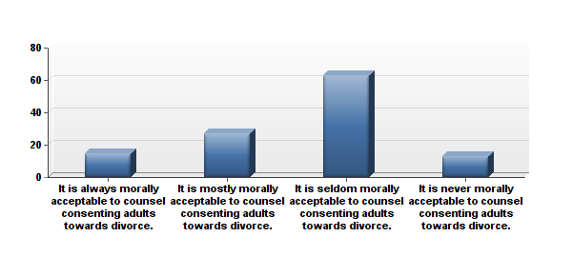
SURVEY QUESTION
When you are treating a couple who are considering divorce, which one of the following most closely reflects your response?
NACSW
NASW

Slide 41
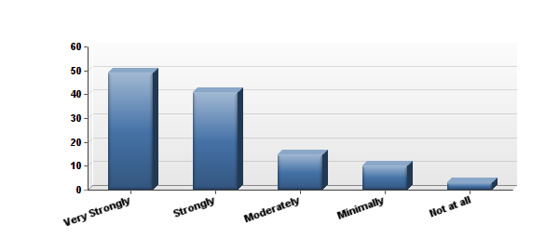
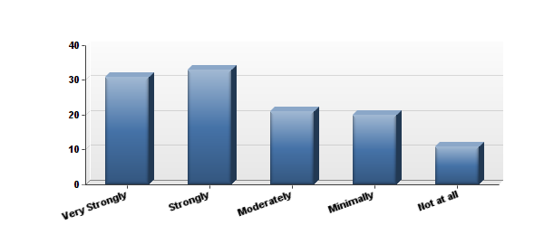
NACSW
64% = it is seldom or never morally acceptable to counsel toward divorce
How strongly does your faith inform your response to the question above?
How strongly does your response to the question above impact your practice of social work?

Slide 42
NASW
86% = it is mostly or always morally acceptable to counsel toward divorce

