Slide 1
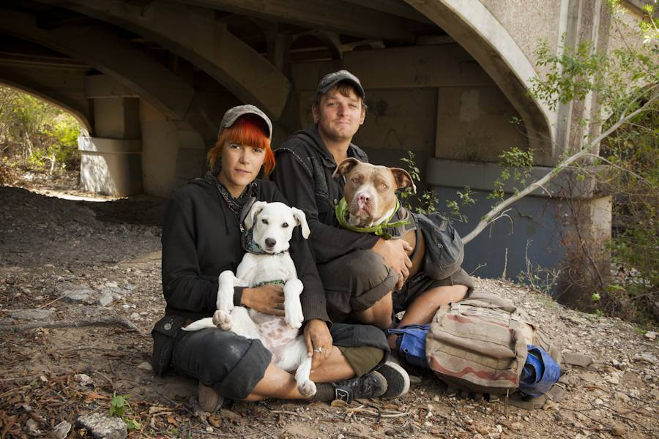















Homeless Adults with Companion Animals

Slide 2
Homeless Adults with Companion Animals
Sandi Harp, MSW
Dissertation Status at Walden University
Social Work Administration PhD Program
MSW from Florida State University
Subjective Meanings of Community Services: The Lived Experiences of Homeless Adults with Companion Animals

Slide 3
Homeless Adults with Companion Animals
My question…having lost so many people, things, relationships, and basic needs, why do homeless individuals seem to cling to their companion animals, at the expense of their own needs?
What is it about this pet (usually a dog) that causes them to forego shelter and assistance with food, physical health, mental health, and any other community service?
What may be a reason why homeless persons with a dog live unsheltered?

Slide 4
Homeless Adults with Companion Animals
What’s the Problem??
The 2017 U.S. government budgeted 60.2 billion dollars toward homelessness programs (U.S. HUD, 2017), but a large percentage may not have access because of agency pet restrictions. Services are under-utilized or forfeited altogether.
Fear of separation from a CA prevents many individuals from connecting to shelter, which leaves them vulnerable to weather, unsafe conditions, violence, and a lack of basic needs (Donley & Wright, 2012).

Slide 5
Homeless Adults with Companion Animals
Community Homeless Services:
Case management Physical Health
Food/Soup Kitchen Domestic Violence
Temporary Shelters Legal Services
Veteran’s Services Income Services (SSI, SSDI)
Educational Addiction Treatment
Vocational Housing
Mental Health Veterinarian Services
Some shelters such as The Bridge in Dallas provides wrap-around services including case management, food, temporary shelter, job training, mental/physical health services, legal services

Slide 6
Homeless Adults with Companion Animals
Very few temporary shelters (homeless or domestic violence) in America accommodate the person and their companion animal.
Miami
Phoenix
Riverside, CA
Dallas
Family Promise Shelters and Petco
Some reasons:
Other shelter guests allergic to dogs or fearful of them.
City codes
Lack of space for animals in the shelter

Slide 7
Homeless Adults with Companion Animals
https://youtu.be/keKvWdsuE4g
In 2016, 429,000 Americans were homeless (HUD, 2016)
Approximately 25 % of homeless Americans owns a pet (107,000) (Rhoades, Winetrobe, & Rice, 2015)
68% of American households own pets (American Pet Products)
Some causes of homelessness (Deck & Platt, 2015):
Systemic issues such as lack of affordable housing, fluctuating labor market, and poverty.
Intrinsic issues including mental illness, trauma, domestic violence, and substance abuse.

Slide 8
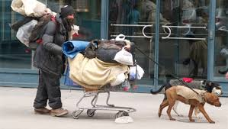

Homeless Adults with Companion Animals
Companion Animal = Pet; providing a satisfying psychological relationship that is reciprocal.
Possible Meanings of Companion Animals to the Homeless Owner:
Family Member
Protection
Friend
Social Ice Breaker
Reason to live
Reason to stay sober and safe
Proof of responsibility
Gap in Research: I have found no research that has explored their lived-meanings in reference to program/services utilization attempts and experiences.

Slide 9
Homeless Adults with Companion Animals
Homeless persons’ attachment to their pets is deeper than that of the American overall population (Hanrahan, 2013).
Why might a homeless individual choose their pet over receiving shelter or other services?

Slide 10
Homeless Adults with Companion Animals
Positive social change is anticipated by exploring the unique individual needs of homeless persons with CAs in relation to community programs and services.
Attachment Theory
(Bowlby, 1969 & 1980; Ainsworth, 1989)
Based on early childhood bonding with a primary caregiver, a type of attachment occurs: secure, ambivalent, anxious, avoidant, or disorganized, depending on the proximity of the caregiver, as well as nurturing of the infant (Schwartz, 2015).
Strange Situation

Slide 11
Homeless Adults with Companion Animals
Secure Attachment
Infant’s security in the presence of the primary caregiver.
Close proximity, secure base, & safe haven
Nurturing and meeting the infant’s needs

Slide 12
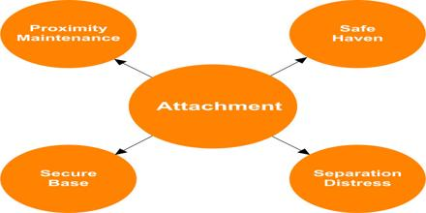
Homeless Adults with Companion Animals
Ainsworth stated that children with healthy proximity to their mother are more likely to have a secure base, and knowing their environment is safe provides a safe haven type of environment (Konok, et al., 2015).

Slide 13
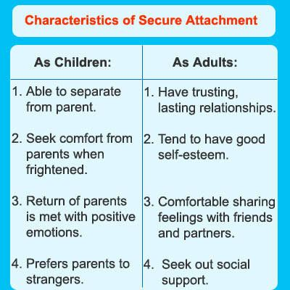
Homeless Adults with Companion Animals

Slide 14

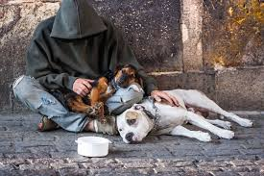





Homeless Adults with Companion Animals

Slide 15
Homeless Adults with Companion Animals
Insecure Attachment
Ambivalent
Avoidant
Infants’ unmet physical or emotional needs tends to translate into lack of trust and insecurity as adults (Joeng, Turner, Kim, Choi, Lee, & Kim, 2017).

Slide 16
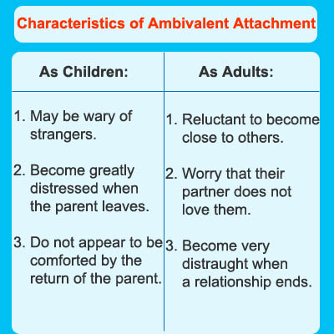
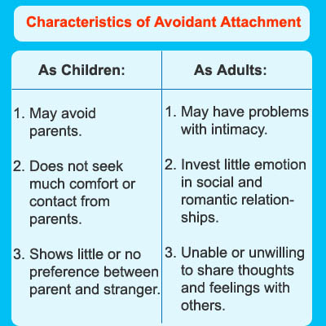


Homeless Adults with Companion Animals

Slide 17
Homeless Adults with Companion Animals
Evidence-Based Practices with Animals
Animal Assisted Interventions – is directed and/or delivered by a practitioner with specialized expertise and within the scope of practice of his/her profession. There are specific goals for each individual involved and the process is documented and evaluated.
Animal Assisted Therapy – a specially trained animal-¬handler team is an integral part of the treatment process; elderly, chronic and terminally ill, children, autism spectrum, and psychiatric patients. “AAT may be as good as interventions such as CBT” (Gonzalez-Ramirez & Hernandez, 2014, p. 311).

Slide 18
Homeless Adults with Companion Animals
Evidence-Based Practices with Animals
Including animals in social work practice is a holistic approach. No longer can we as social workers overlook “intrinsic anthropocentrism” of our work. (Hanrahan, 2013)
Emotional Support Animals – persons with anxiety and/or depression, college students, disasters, etc. (i.e. Las Vegas mass shootings)
PETS Act (post-Katrina) of 2006 – 67% of research participants said they would refuse to leave their home/pet if their pet was not allowed in a shelter.
Jails/Prisons (offender-led dog training programs) for dogs to be adopted.
Prisoners also train dogs as service dogs for veterans with PTSD. Additionally, the prisoners training dogs have fewer violations. https://youtu.be/5cnMjoqn-_s

Slide 19
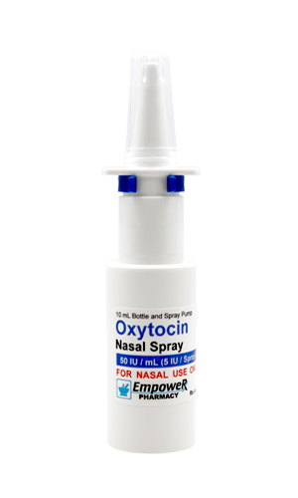














Homeless Adults with Companion Animals

Slide 20
Homeless Adults with Companion Animals
The attachment a human has with a CA has been positively correlated by the measurable increased level of oxytocin (OT) in both the human and their animal (Konok, et al., 2015).
Homelessness is considered a “toxic stressor,” that causes physical, psychological, and social challenges for homeless persons and challenges community service providers to address their needs (Murphy, et al., 2015, p. 268).
Pets may provide a buffer to the attachment challenges, however, inability to utilize community services may be a hindrance in getting basic needs met (Donley & Wright, 2012; Slatter, Lloyd, & King, 2012).

Slide 21
Homeless Adults with Companion Animals
Interactions with pets increases Oxytocin (bonding hormone), which is a physiological response found in the human and the animal during interactions.
Oxytocin is a neurochemical that decreases blood pressure, decreases heart rate, and lowers stress rates.
The excitement over the hormone began in the 1990s when researchers discovered that breastfeeding women are calmer in the face of exercise and psychosocial stress than bottle-feeding mothers.
As opposed to Cortisol’s “fight, flight, or freeze” responses, Oxytocin’s role is “tend and befriend.” (DeAngelis, 2008)

Slide 22
Homeless Adults with Companion Animals
When is Oxytocin produced?
Labor/Delivery
Breastfeeding (mom and baby)
Sexual Intimacy (husband and wife)
Petting Companion Animals (human and animal)
Oxytocin and Attachment
Early traumatic experiences appear to impair the development of the oxytocin system. Parents with a personal history of childhood abuse are less responsive to the prosocial effects of intranasal oxytocin. (Yates, 2013)

Slide 23
Homeless Adults with Companion Animals
For homeless adults struggling with safety and security that began in infancy, their companion animal (dog) may be the “lubricant” for perceived safety and their source of bonding.
Research is replete with studies regarding measurable physiological responses to attachment and stress in infancy with a corresponding attachment style throughout the lifespan (Bartz, Lydon, Kolevzon, Zaki, Hollander, Ludwig, & Bolger, 2015; Bernaerts, Prinsen, Berra, Bosmans, Steyaert, & Alaerts, 2017; Borgi & Cirulli, 2016; Eapen, Dadds, Barnett, Kohlhoff, Khan, Radom, & Solove, 2014; Ein-Dor & Hirschberger, 2016; Hurlemann & Scheele, 2016; Joeng, Turner, Kim, Choi, Lee, & Kim, 2017; Murphy, Steele, Bate, Nikitiades, Allman, Bonuck, Meissner, & Steele, 2015; Rockett & Carr, 2014). Infants’ unmet physical or emotional needs tends to translate into lack of trust and insecurity as adults (Joeng, Turner, Kim, Choi, Lee, & Kim, 2017).

Slide 24
Homeless Adults with Companion Animals
Homeless people attached to their pets have a stronger bond with their animals than pet-owners with secure housing .
Similarly, a dog owner experiences stress reduction when the dog is considered a safe haven.

Slide 25
Homeless Adults with Companion Animals
Subjective Meanings of Community Services: The Lived Experiences
Homeless Adults with Companion Animals
Closing the Loop:
Homeless Adults
Companion Animals
Community Services
Attachment

Slide 26
Homeless Adults with Companion Animals
Where to from here??
Face-to-face semi-structured interviews with homeless adults
temporarily staying at a pet-friendly shelter.
Examine transcripts for themes.
Phenomenological interpretations
Oral defense of my dissertation.
Advocacy at the macro-system level (based on perceived needs of the participants).
Share findings

Slide 27





Homeless Adults with Companion Animals
“The righteous care for the needs
of their animals…” Proverbs 12:10

