Slide 1
Interpersonal Violence
“What’s Love Got to Do With It?”

Slide 2
Incidence Among African American Emerging Young Adult Women
Among college students the National Intimate Partner and Sexual Violence Survey (NISVS) noted that almost half of female victims’ (47%) first experience of dating violence, by an intimate partner, occurred between the ages of 18 and 24 years (Black, Basile, Breiding, Smith, Walters, Merrick, & Stevens, 2011).
Black females experienced intimate partner violence at a rate 35% higher than that of white females, and about 22 times the rate of women of other races
Approximately 4 out of every 10 women of non-Hispanic Black (43.7%) have experienced rape, physical violence, and/or stalking by an intimate partner in their lifetime.

Slide 3
Incidence
Among the LGBTQ population of college students, West (2012) found that lesbian women experienced higher rates of IPV than gay men.
Females who were both perpetrators or victims of dating violence were either bisexual or lesbian (compared to heterosexuals).
The reported aggression of bisexuals was greater than or equal to the aggression of lesbian women and both groups were more aggressive than heterosexuals (Hughes, et al., 2010).
Associations also have been found between level of acculturation and sexual minority stress
Internalized homophobia and frequency of discrimination based on sexual orientation.

Slide 4
Associative Factors
The longer individuals have dated and the younger they started dating, the more abusive they tend to be.
Students’ lower household income and lower class standing were also related with the occurrences of physical dating violence.
Lack of economic resources and adjustment difficulties associated with less time at college could be the source for stress, thus increasing the occurrences of physical abuse among African American college students.
Some researchers posit that the stresses, strains, and oppression are factors that may contribute to African American men periodically losing their control (Taft et al., 2009).

Slide 5
Associative Factors
African American male students were more physically violent than African American female students.
This conclusion is also supported by earlier research which indicated that men who tend to hold traditional patriarchal views were more likely to support the use of violence against women than those with egalitarian gender role attitudes (Baker & Stith, 2008).
A history of repeated victimization appears to increase the likelihood of substance abuse.
Women who were both sexually and physically assaulted within the context of abusive relationships were more likely to report substance abuse.

Slide 6
Associative Factors
The image of the “Black superwoman” stereotype (Asbury, 1987; Bell & Mattis, 2000; Brice-Baker, 1994) may also heighten African American women's risk for and exposure to IPV.
“African American women as invulnerable, insensitive, stoic, and in need of control and domestication,”
Stereotype danger is the internalization of such ideas by African American women themselves.

Slide 7
StandUp! ManUp! Project
Violence Interruption Process – focused socio-culturally and based on Oakland Men’s Project
Liberation Theory
Didactic and experiential activities (i.e. Act Like a Man, Step Out of the Box, The Stand Up)
Utilized three male facilitators

Slide 8
STAND UP! SPEAK OUT!
(Violence Interruption Process, Hayden, 1996)
Violence is learned and can be unlearned.
Violence is interpersonal and institutional.
A person’s choice in areas of attitudes, actions, and values are made as the best perceived survival strategy at the time.
No one is safe until everyone is safe.
Information alone does not change attitudes.
We need to go through it before we can do it.
Change is a process, not an event.

Slide 9
Violence Interruption Process
Individuals come with respect for another’s humanity
In any group of people, there is tremendous healing power.
Our greatest resource is our community.
Each group targeted by oppression inevitably “internalizes” the mistreatment and the misinformation about itself
Liberation is the undoing of the effects of internalized oppression.
Tell the truth.
We are all connected.
There is no magic dust.

Slide 10
Outcomes
Presented to 406 students (Male:180 Female: 226 )
88% of male participants indicated they were glad they’d experienced the presentations
90% agreed that it brought new insights and stated they were inspired to action

Slide 11
Feedback/ Take Away
“The bystander is the third person involved (in DV)…” (Female)
“Stand up and speak out…it takes a community” (Male- Gaither Group)
“Society affects our understanding of abuse… our household affects our view of abuse” (Male- TRIO Group)
“Males staying in the box vs. jumping out of the box.” (Male – TRIO Group)
“Cheating is emotional abuse…and men should man up and speak…” (Female – TRIO Group)
“Jump out of the box…speak out when someone is wrong.” (Female)

Slide 12
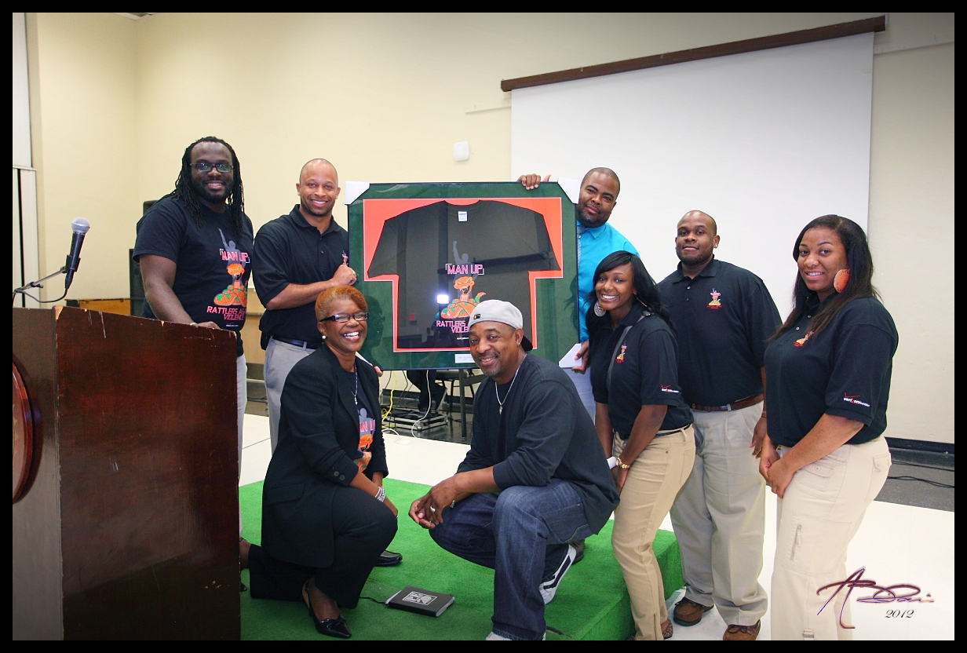
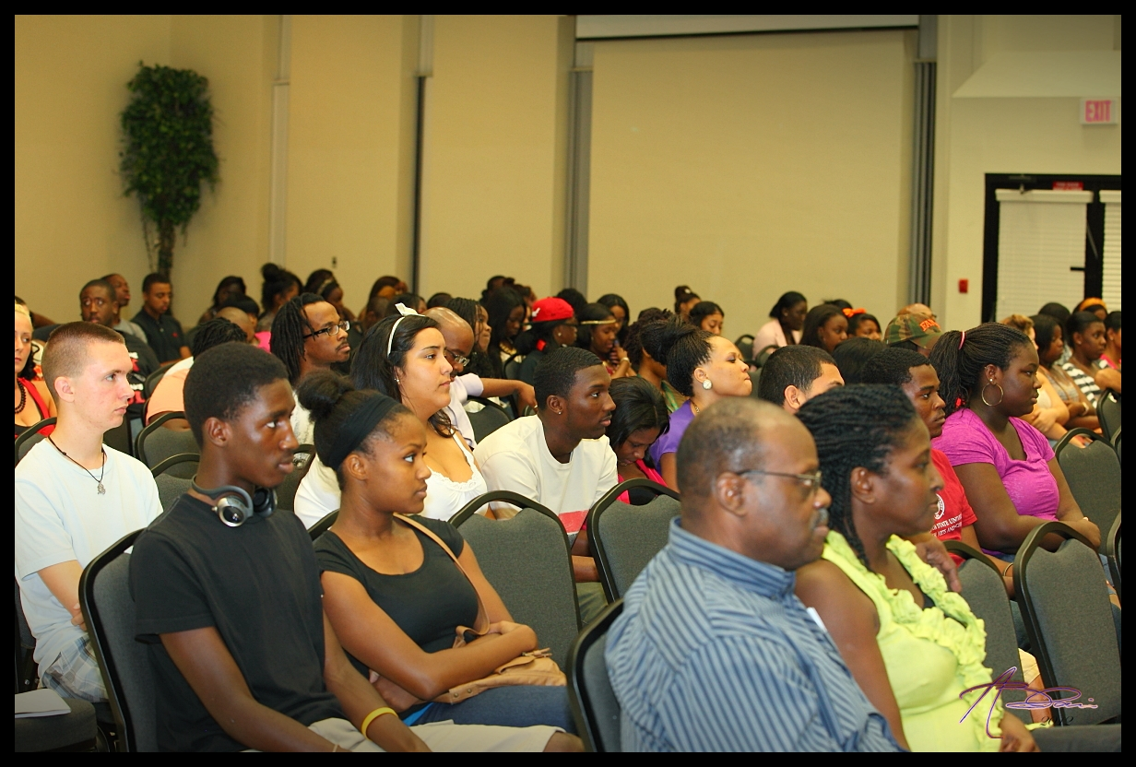
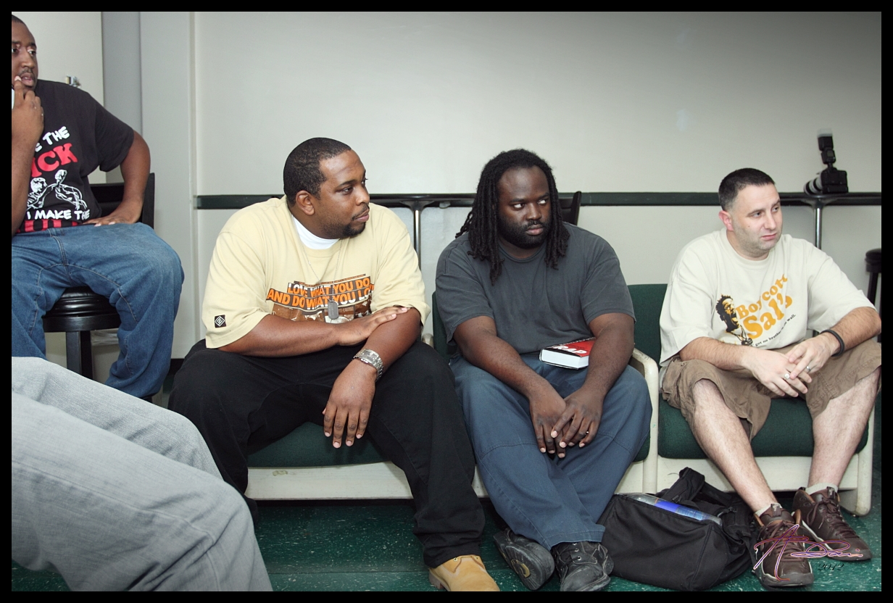
StandUp!

Slide 13
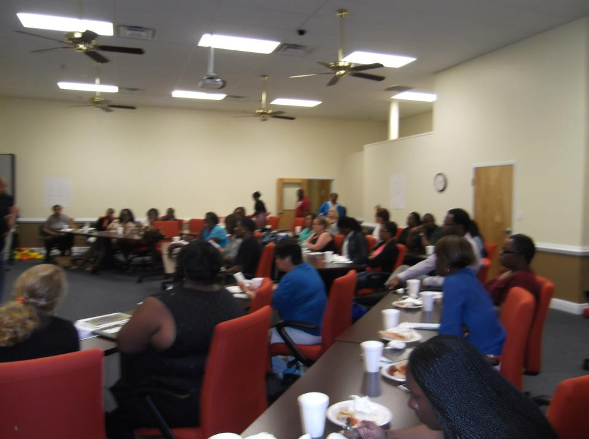
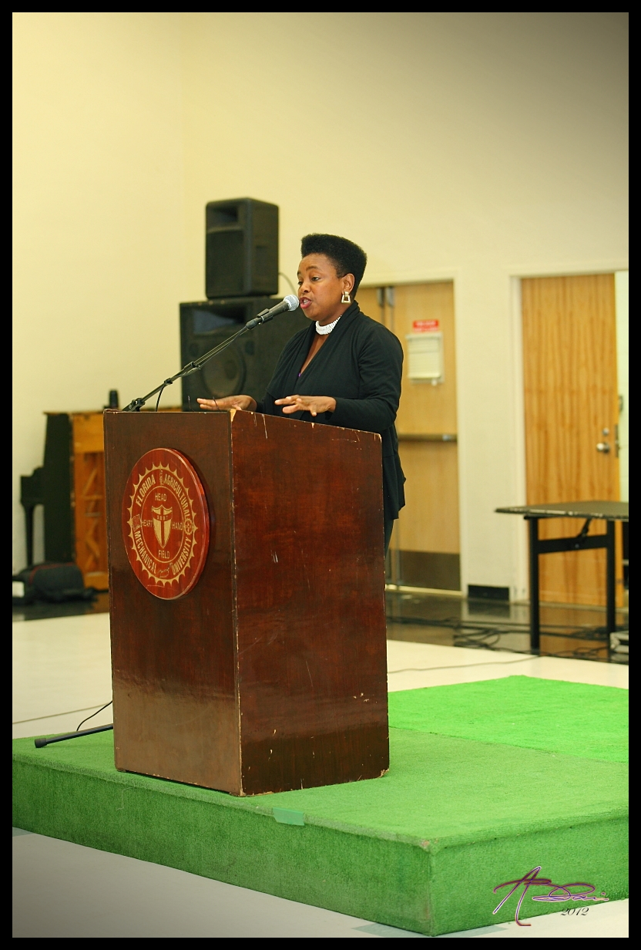
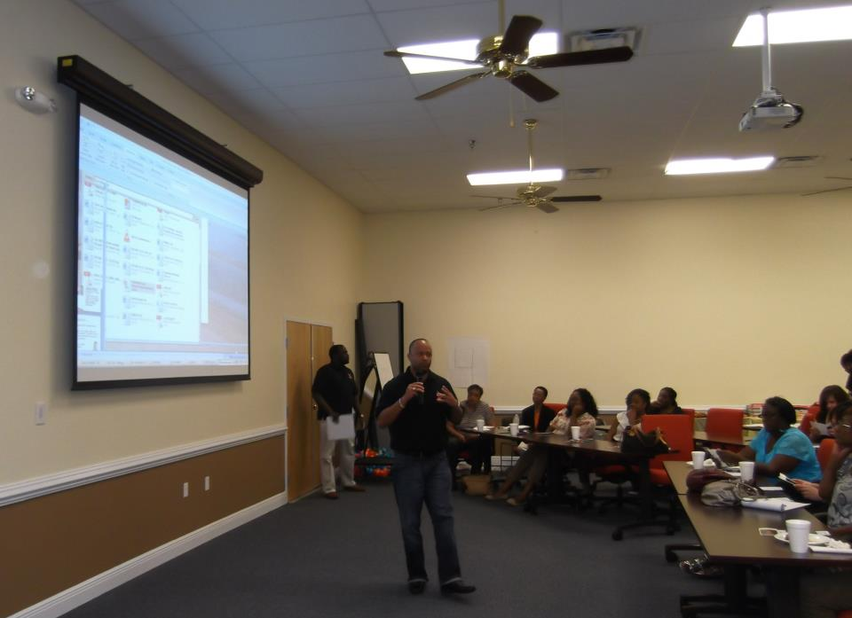

Slide 14

Contact
Dr. Wachell McKendrick
MSW Program Director
Department of Social Work
(850) 561-2251
wachell.mckendrick@famu.edu

