Slide 1
Integrating Faith and Practice
A professor and student view
Professor elke cox, MSW, LCSW, Liberty University
Michaela Frantz, BSW student, liberty university

Slide 2
Introductions and Overview
Integrating Spirituality Personally and Professionally
01
Integrating Spiritual Assessment
02
Integrating Spirituality in the Therapeutic Relationship
03

Slide 3
01:
Self-Care Exercise
What do you do for self-care?
What do you do specifically for spiritual self-care?

Slide 4
Assessing personal Self-care continued
Jesus as our model (John 15, Luke 5:16)
Self-care doesn’t end with us…
Asking for help reminds us of our own need (John 1)

Slide 5
Anchor Exercise:
HEALTHY MIND PLATTER BY DAN SEIGEL and Dr. David Rock http://www.drdansiegel.com/resources/healthy_mind_platter/
Focus time: close focus on tasks
Play time: spontaneous fun
Connecting time: relational time (in person if possible)
Physical time: exercise
Time in: quiet reflection
Down time: nonfocused, relaxation
Sleep time: consider how many hours

Slide 6
02: Utilizing Spiritual assessment tools:
In Practice and in the classroom
Spiritual Life maps
Genograms
Ecomaps
Culturagram
Spiritual Narrative

Slide 7
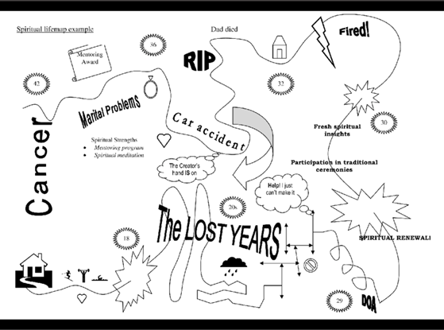
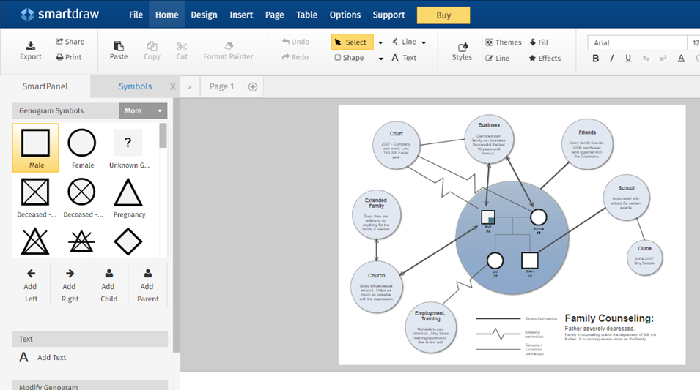

Life map ecomap
https://cloud.smartdraw.com/editor.aspx?templateId=9de5db8a-ad98-46a6-8690-eabcc807d9f2&noro=1

Slide 8
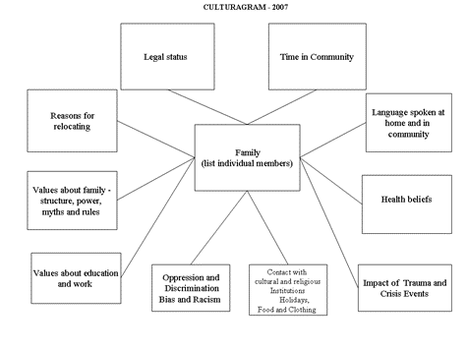
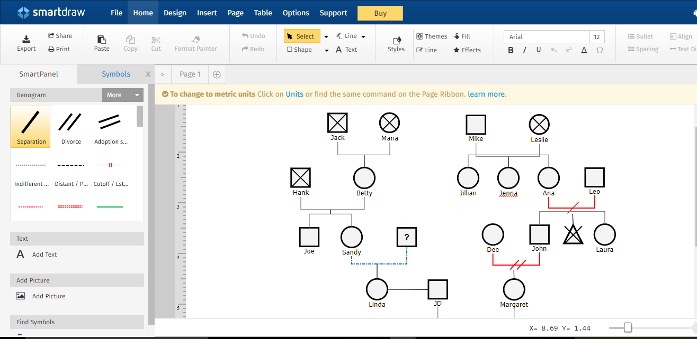

Genogram Culturagram
https://cloud.smartdraw.com/editor.aspx?templateId=867fc033-8041-469e-828d-b513711f36f7&noro=1

Slide 9
03: A Student’s perspective
Process and content relationship
Vulnerability and trust with classmates
Interviewing skills
Spiritual integration

Slide 10
Question and Answer Time

