Slide 1
Faith and Social Work
How in the World Do We Integrate
Faith and Social Work Education??
Sheri Duffy, LCSW
Louisiana College
Dean, School of Human Behavior
Associate Professor of Social Work
Nicole Johnson
Louisiana College
BSW Student

Slide 2
Louisiana College’s Mission
Provide liberal arts, professional, and graduate programs characterized by devotion to the preeminence of the Lord Jesus, allegiance to the authority of the Holy Scriptures, dedication to the academic excellence for the Glory of God, and commitment to change the world for Christ by the power of the Holy Spirit.

Slide 3
BSW Program mission
WE…
Prepare students to function compentently and effectively in a rapidly changing world.
Academically challenge our students within a nurturing Christian environment that offers an integration of faith and learning.
Advance students toward continued learning in all aspects of life with specialized emphasis on the professional application of generalist social work practice which includes its history and purpose.

Slide 4
Our Motto
Empower others through offering H.E.L.P and compassionate caring.
Hope to Every Living Person
Galatians 6:10
“Therefore as we have opportunity, let us do good to all people…”

Slide 5
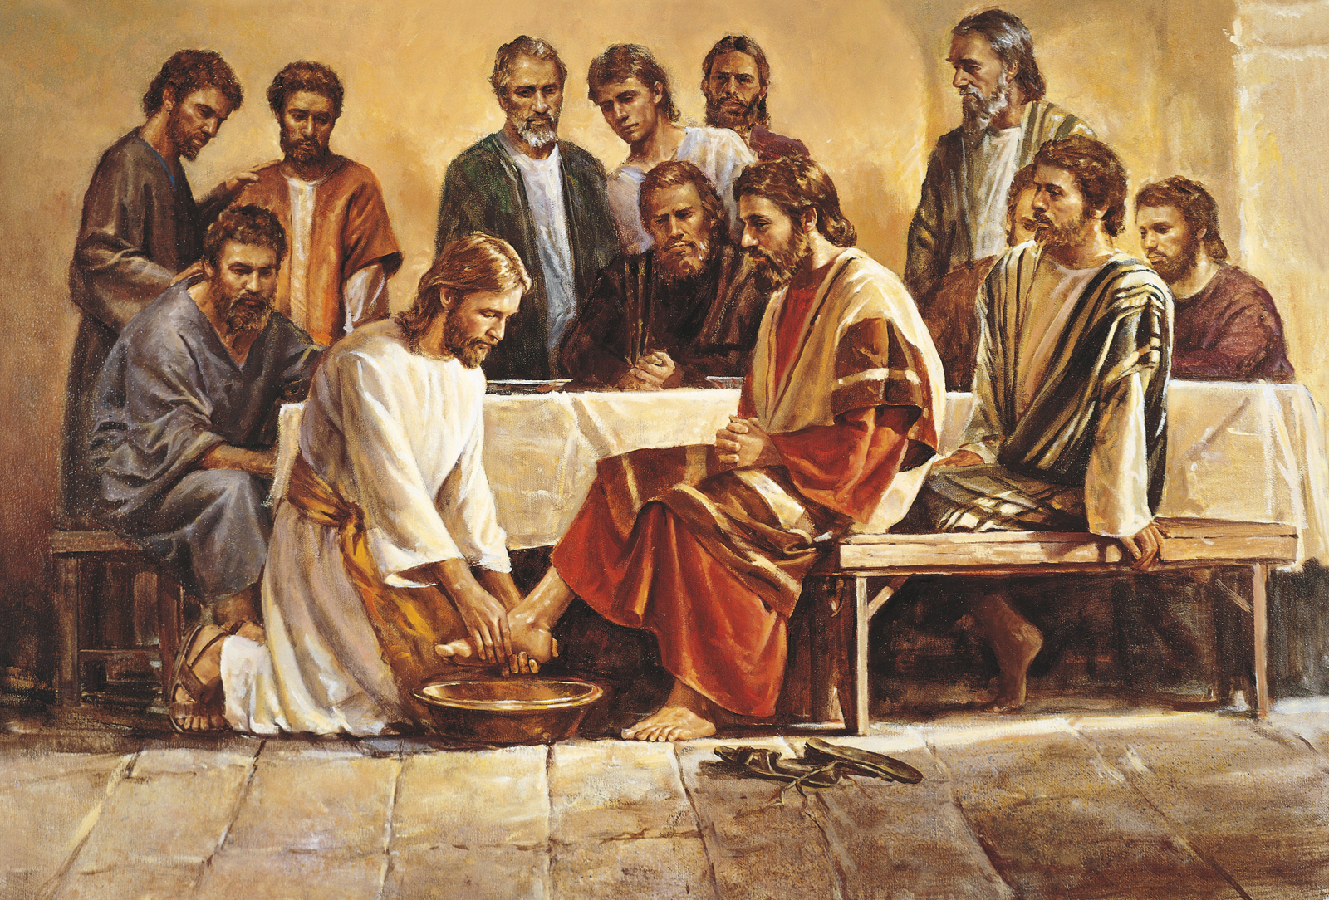
History of Social Work and Welfare

Slide 6
The History of Social Work and Social Welfare is:
Rooted in ministry and service to others.
Services began in Biblical times.
Shows the Lord’s concern for justice
1st Social Welfare System – Deut. 14:28-29
Social Justice found in God’s care for vulnerable people - Deut. 27:18-19

Slide 7
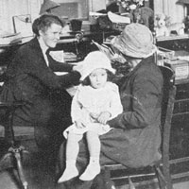
Throughout History:
The responsibility for
social welfare has shifted
between faith-based
institutions
and government
entities.

Slide 8
Origins of Social Work
Born predominantly out of three social movements
Charity Organizations Society
    Friendly visitor
Settlement Houses
Child Welfare Movement

Slide 9
Christ is the ultimate Social Work
example!
John 5:17 “My father is always at His work to this
very day, and I too am working.”
“We are to see work as a way of service to God and our neighbor.”
-Tim Keller

Slide 10
Key Social Work Perspective
Person-in-Environment (PIE)
  Whole person—mental, social, emotional, & spiritual components
Code of Ethics—What does it say?

Slide 11
Values
Service – Christ came to serve, not be served
Social Justice – “Do what is right to others”
Value of Dignity and Worth of the Individual – “You are fearfully and wonderfully made”
Importance of Human Relations – We are created to be relational
Integrity and Competence – “Speak truth”

Slide 12
“A biblical understanding of work energizes our desire to create value from the resources available to us. Recognizing the God who supplies our resources, and who gives us the privilege of joining in as cocultivators, helps us to enter into our work with a relentless spirit of creativity.”
-Tim Keller

Slide 13
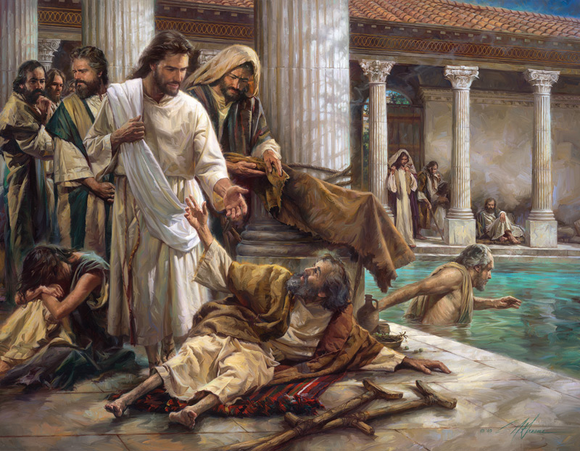
Jesus is our perfect example. He loved everyone and looked at their heart. He cared about their physical, emotional, mental, and spiritual well-being. Christ helped ALL no matter their background, crime or issue.

Slide 14
Approaches to integrating faith and social work
          Rigorous → Educate
          Relational → Example
          Relevant → Experience

Slide 15
Questions or Comments
?

Slide 16
Copy right 2017 Sheri Duffy; Nicole Johnson
All rights reserved. No part of this presentation may be copied, reproduced, stored in a retrieval system, or transmitted in any form or by any means, electronic, mechanical, recording or otherwise, without the prior written permission of the author.
Contact Information:
Sheri Duffy, LCSW, Associate Professor of Social Work
Address: 1140 College Drive Box 605,
Pineville La 71359
Phone: (318) 487-7164
Email: sheri.duffy@lacollege.edu

