Slide 1
Developing Critical Thinking: an exercise in social welfare policy analysis
Jane Hoyt-Oliver, LISW-S, Ph.D.
NACSW APM
November, 2017

Slide 2

Proverbs 18:15
The heart of the discerning acquires knowledge, for the ears of the wise seek it out

Slide 3
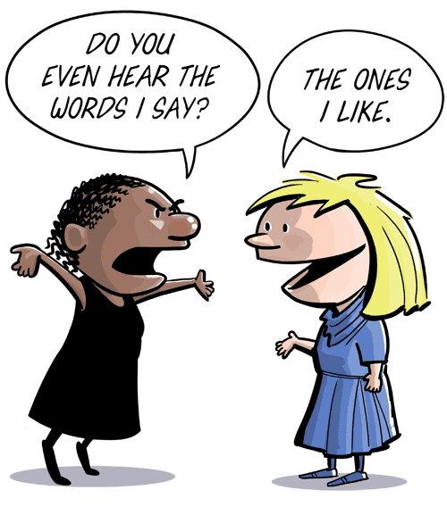
Proverbs 20:12
Ears that hear and eyes that see- the Lord has made them both

Slide 4
CSWE dimensions of practice
2.1.1b: Use reflection and self-regulation to manage personal values and maintain professionalism in practice situations
2.1.3.a: apply their understanding of social, economic, and environmental justice to advocate for human rights at the individual and system levels
2.1.4b: apply critical thinking in … the analysis of research findings
2.1.5c: apply critical thinking to analyze, formulate and advocate for policies that advance human rights and social, economic and environmental justice

Slide 5
So What is Critical Thinking?
Critical thinking is a habit of mind characterized by the comprehensive exploration of issues, ideas, artifacts, and events before accepting or formulating an opinion or conclusion. The capacity to combine or synthesize existing ideas, images, or expertise in original ways; thinking innovatively; and intellectual risk-taking — all component of creative thinking — is part of the development of critical thinking
(Adapted by Paul & Elder [2009] from AAC&U VALUE RUBRIC documents)
Calling into question the assumptions underlying our customary, habitual ways of thinking and acting and then being ready to think and act differently on th e basis of this critical questioning
( Brookfield, 1987)

Slide 6
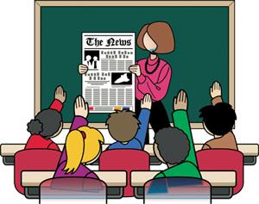
Critical Thinking: a Habit of the mind
A process not an outcome: it is never finished
Although some critical thinking skills are developmental (many 60 year olds may be better at critical analysis than many 19 year olds) , thinking critically requires practice.
When students can practice a skill in a relatively safe space, they become empowered to utilize that skill.
The classroom should be such a safe space.

Slide 7
Habit of the mind
Elder and Paul indicate that to be a critical thinker in the “fullest sense of the term” a person must display critical thinking skills in most areas of life.
Brookfield ( 1987) nots that critical thinking is both emotive and rational
In this political climate, it is easy to have an opinion, harder to have an informed opinion and even harder for students of politics and policy to critically analyze and understand competing viewpoints on important issues.
In the age of Google, the answer that rises to the top is often seen as the best the “right” or most important answer. “Why” questions are rarely addressed. Students often feel pressure to provide the “right answer” rather than taking the time to decide what the best answer might be.

Slide 8
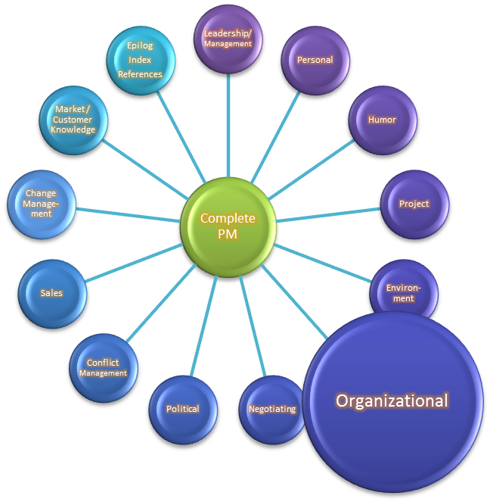
Comprehensive exploration …before accepting or formulating an opinion
Elder and Paul theorize:
* Thinking is driven by the questions we seek to answer
To answer questions, we need meaningful information and we need to interpret that information
*Once interpreted, it must be organized
Once organized, conclusions, and implications regarding the information can be drawn
Although Identifying and challenging assumptions is central to critical thinking
Challenging should not always equal arguing

Slide 9

Stages of Critical thinking:
Elder and Paul
The Unreflective thinker
The Challenged thinker
The Beginning Thinker
The Practicing Thinker
The Advanced Thinker
The Accomplished Thinker

Slide 10
Unreflective thinkers
Little self-monitoring of thoughts, inconsistent approaches to problems, and often working out of conscious or unconscious biases
Prejudices and misconceptions may undermine the ability to think through a stance on an issue
In political discussion, this may mean a student holds a view of solutions to a social problem that cannot be sustained in the real world
WHY DOESN’T THE GOVERNMENT JUST LOWER TAXES AND FIX THE ROADS? Then we’d be happy in this community!

Slide 11
The Challenged Thinker
Challenged thinkers know there are ideas “out there” that may challenge their belief system, but they may not be aware how to identify other ideas and concepts. The task here is to develop what Elder and Paul term “intellectual humility”.
In political discussion, this occurs when students are exposed to ideas that challenge their own understanding and world view, but do not feel pressured to “choose” a path.

Slide 12
The Beginning Thinker
Beginning thinkers begin to modify their thinking based on what they have learned, but have not developed the skills to assess the quality of these modifications, nor have they created a systematic way of utilizing the data.
In political discussion, students may note their views are changing, but not be able to articulate why the new views fit their worldview better than the previous ideas.
“In the past, I just believed what my parents believed, but now I am wondering about their view of the world”

Slide 13
The Practicing Thinker
Practicing thinkers “have sense of the habits they need to take charge of their thinking “ (Elder &Paul)
Practicing thinkers choose to systematically monitor their thinking. They assess their thinking for accuracy, precision and relevance…The recognize that humans default to egocentricity and self-deception
In political discussion, students who develop the skills of a practicing thinker begin to consume news from reputable sources on a regular basis. They explore alternatives to their initial stances on issues.
“I was listening to this story on NPR this morning that fits what we are talking about when we discussed immigration reform today”

Slide 14
The Advanced thinker
Advanced thinkers have established habits that they believe are beneficial. The contribute to discussions with “significant insight” and strive to be fair-minded. They are able to self-monitor and can often recognize when their own prejudices or beliefs may inhibit their assessment of a concern.
In the political conversation, students who are advanced thinkers can accurately articulate more than one way of thinking about a social policy or social problem. Even if they hold a strong opinion, they make intellectual room for the opinions of others.
Critical thinkers become suspicious of those who say they “have all the answers”
“I think that universal health care is a pro-life issue. Many of my pro-life friends are only thinking about the needs of pre-birth or the year right after birth.”

Slide 15
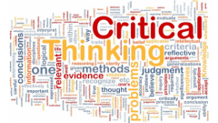
The Accomplished Thinker
[Accomplished] thinkers “ regularly, effectively and insightfully critique their own thoughts. They effectively and insightfully articulate the strengths and weaknesses of their thinking” … They have a high degree of intellectual humility, intellectual integrity intellectual perseverance, courage empathy autonomy, responsibility and fair-mindedness.( Elder and Paul)
At the BA level, faculty members will rarely come across accomplished thinkers. Indeed, it may be our role to BECOME accomplished thinkers!

Slide 16

Moving through these stages takes…..
  Time: Students are not magically transformed by one semester
  Maturity: Students make the choice to risk learning new perspectives on political thinking
  Desire: Students can block self-reflection if they choose

Slide 17
Assisting students to enter into
“The Great Political Conversation”
Providing a brief look at human History: from the cave through the 21st century
  How have governments or government entities defined who was vulnerable, what services to provide, and the length of provision. What do we know about how humans cared for one another before they wrote policy down?
Linking to the present
  Discussion of issues that “social workers care about”: the economy, the environment, poverty and family policy (Practice Behavior 2.1.5c)
Thinking Toward the future
  Reading a book that is current that deals with social policy coupled with discussion
  Optional policy reading group

Slide 18
Debate/Discussions
Lecture regarding how political philosophy influences policy making
Randomly assigned to groups (liberal, conservative, “other”; during Presidential election years, Republican, Democratic, Green, Libertarian).Students stay in their groups for the first half of the semester.
Students work in groups to discover how each group’s philosophy might influence the policies they would like to have passed in Congress
Every other week up until the Nov. election, groups bring what they have learned to class.
Each group must submit sources to the professor who uploads the sources after class for all students to explore should they so wish.

Slide 19
Assignment in the syllabus
Record where your group’s information has been gleaned, as others in the class may challenge the information you have found. Your professor will provide a list of possible places where such information may be found, but it is expected that students may go outside suggested sources if the ones suggested do not provide adequate information. The group should email the professor with the list of the websites used in preparation for each debate no later than 2 hours before each debate. The lists will be posted to the course website after completion of the debate so students can fact-check their colleagues! Students must be present for the debates to receive credit for that session or have a MU excused absence (e.g. varsity sport team excuse).If the latter occurs the student must send the website he or she has explored to the group and to the professor at least 2 days before the discussion.

Slide 20
During the class
Each group presents material
All information presented in placed by the professor on the board- with some commentary when needed (asking the source of a statement, discussing wording etc.)
Although every group goes first at least once during the semester, materials are written on the board in such a way that students are re-enforced in the terminology of “the left” and “the right”
antifa
Greens
Neo-Liberal
Lib-eral
Con-serv-ative
libertarian
Alt-right
Neo Con-
Serv-ative

Slide 21
Student reactions to the debates
I didn’t realize that there were more groups than “just Democrats and Republicans”
I surprised that every group believes it is “pro-family” but the ideas about how to help families are very different
I’ve never thought about my tax dollars being used for things I actually use (e.g. student loans)

Slide 22
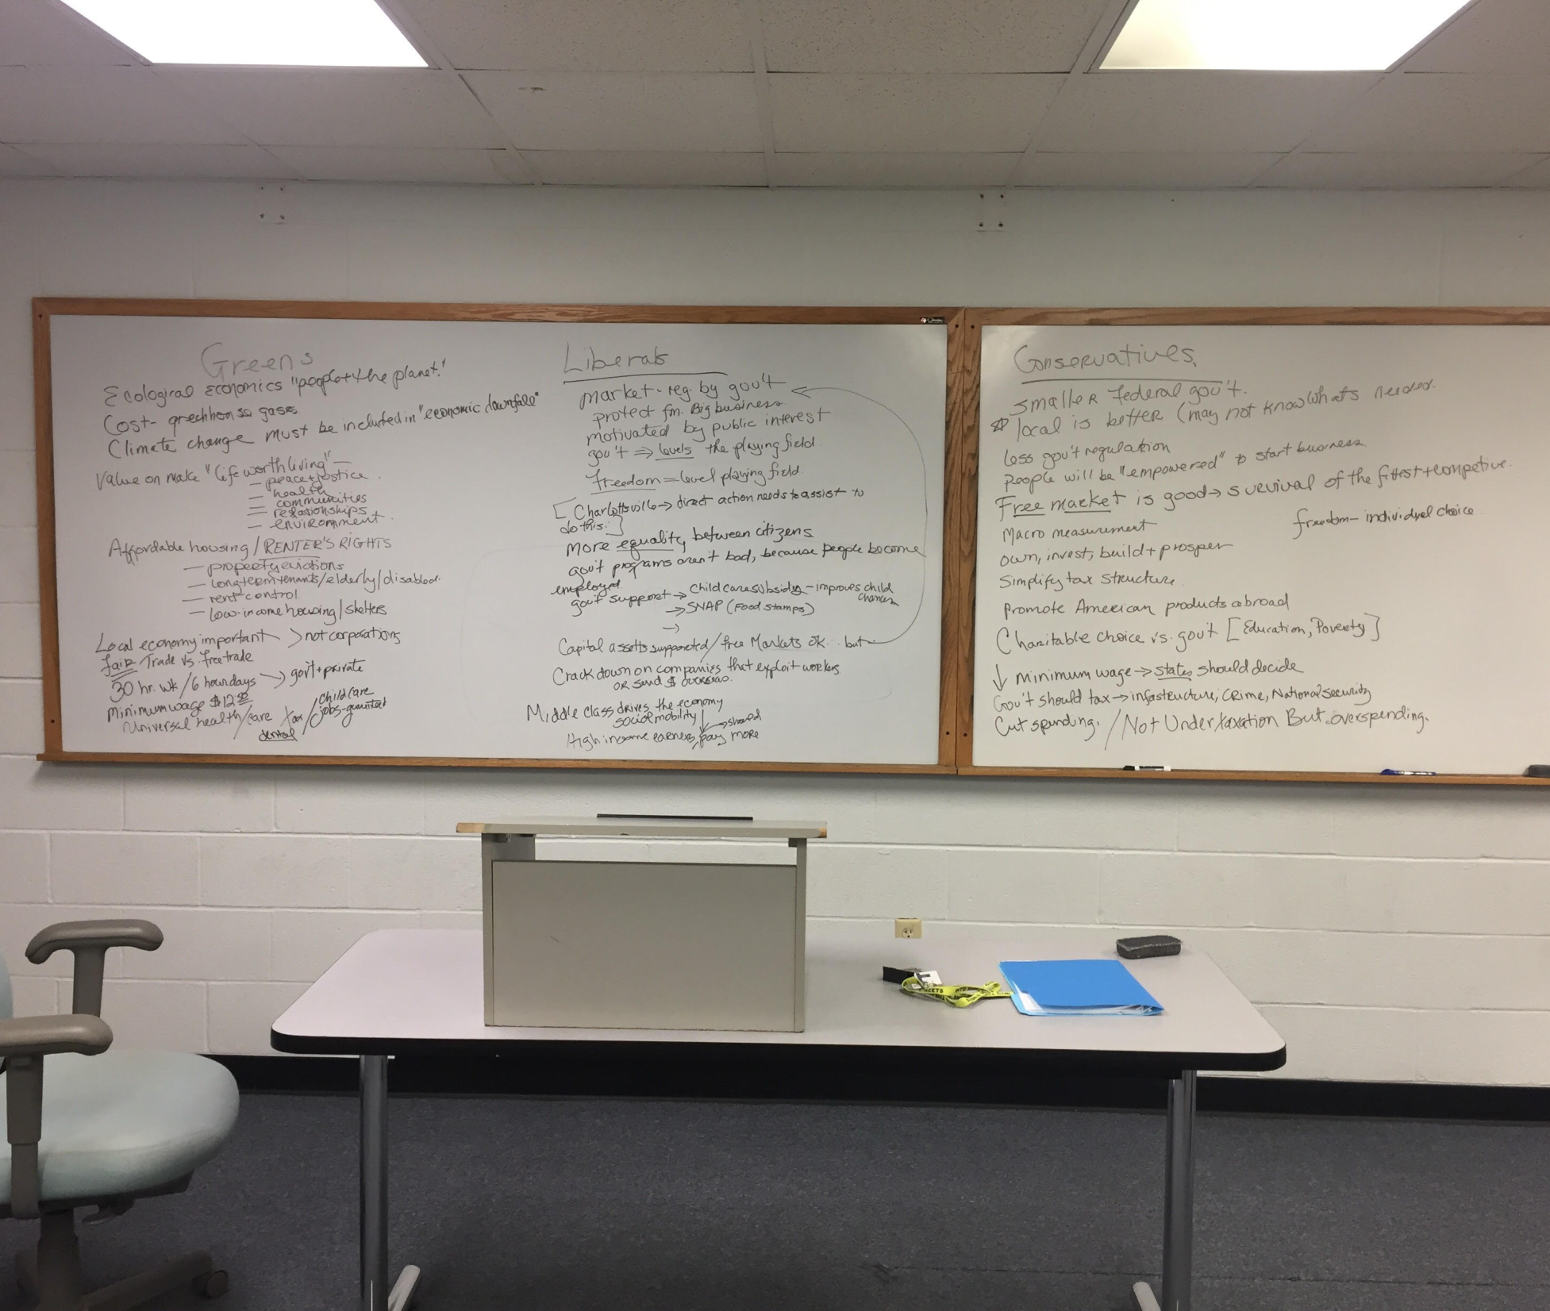
How this looks at the end of a debate

Slide 23
The next Step in critical thinking: mixing it up
For the second half of the semester students read a book about American social welfare policy
Typically this is a book that has been published less than 3 years, so that the debate about the ideas that are presented are fresh.
  Our Kids – Robert Putnam (2016)
  Hillbilly Elegy- J.D. Vance (2017: Spring semester)
  $2 a Day: Living on Almost Nothing in America – Edin and Shaefer (fall: 2017)

Slide 24
From the syllabus
During the final third of the class, our discussions will focus on the book $2 a Day: Living on Almost Nothing in American (2015) Students will continue to work in groups, but those who have been assigned to the liberal philosophy for the first 2/3 of the class will need to argue the points made by Edin and Shaefer from a conservative viewpoint, those who have been arguing from a conservative viewpoint for the first 2/3^{rds} of the semester will need to take on the liberal viewpoint. Those who have been in the third group ( “other”) will be divided evenly between the two groups
There will be 3 discussions of $2 a Day, each covering a different section of the book

Slide 25
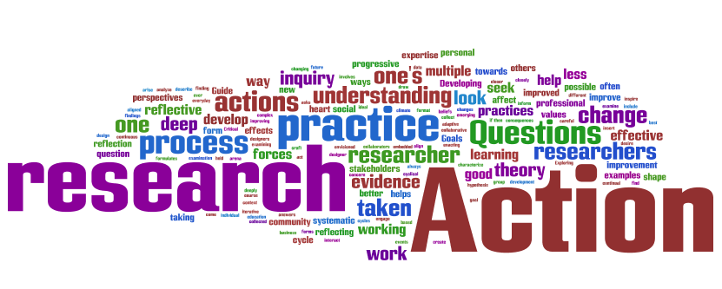
Each group is encouraged to:
  Read the book (of course!)
  Research book reviews of the book that strengthen their assigned groups political stance
  Bring their questions and/or information from other classes both in SWK and their General Education courses that re-enforce or conflict with the author’s views

Slide 26
How does this develop critical thinking?
Students must invest in exploring divergent political philosophies over the semester, creating the opportunity for each student to develop an informed opinion
Students are given the intellectual space over the course of a semester to
  Gather meaningful information
  Organize that information
  Draw conclusions and implications from that information
  This provides space for students to develop habits of the mind are critical to the development of critical thinking

Slide 27
Student reactions to the book discussions
Before I read the book, I thought that people in poverty were getting a free ride from government handouts. But it is so much more complex!
I thought that people in poverty were taken care of, at least a little bit.
I didn’t realize how hard many poor people work and they still can’t get by.
I didn’t realize that sometimes there aren’t “good choices” (This in response to the profile of a woman who went to live with a relative in another stat leaving a job where she was working 60+ hours a week in a high crime area. The relative was willing to watch her daughter when she began work at a new job, only to discover 3 months later that the relative sexually abused her daughter. She then left that home to protect her daughter, but became homeless.)

Slide 28
Does this matter?
Brookfield (1986) notes
  By providing an opportunity for reflection and analysis, educators are crucial. They are sympathizers, empathizers, …initiators and prompters. They help [students] to articulate and understand the assumptions underlying their actions (p.11)

Slide 29
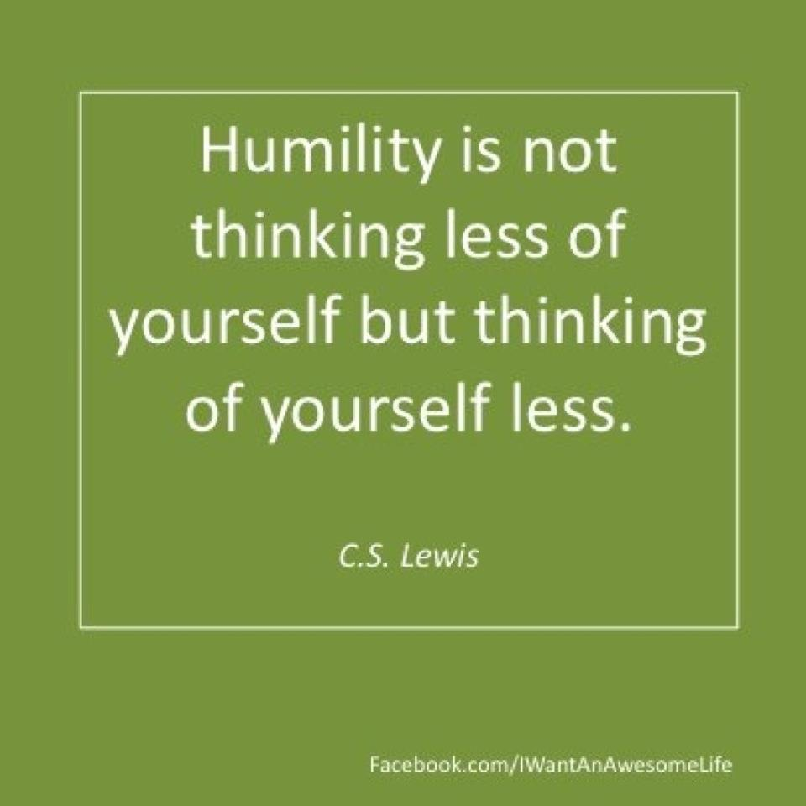
Policy to practice
Not just an intellectual exercise but practice for listening for our client’s macro issues
When we know that we “don’t know” everything, we enter situations with a heightened awareness- an openness to listening to what is being said.
Practicing political humility may allow students to be aware of their need to practice cultural humility

Slide 30

Is this a permanent change in intellectual functioning?
Elder and Paul note :
  Success … is deeply connected to the intellectual quality of student learning,
  but is not automatic
  Regression is possible
  In some ways, it is like the old joke about social workers and light bulbs: the bulb has to want to change

Slide 31

3 John 1:4
But I have no greater joy than to hear [my students] are walking in the truth

Slide 32
Resources
Association of American Colleges and Universities. (2009). Inquiry and analysis VALUE rubric. Retrieved from https://www.aacu.org/value/rubrics/inquiry-analysis
Brookfield, S.D. (1987) Developing critical thinkers: Challenging adults to explore alternative ways of thinking and acting. San Francisco: Jossey-Bass Publishers
Elder, L. & Paul R “Critical Thinking Development: A Stage Theory” retrieved 8/31/17 from http://www.criticalthinking.org/pages/critical-thinking-development-a-stage-theory/483
Edin, K.J. & Shaefer, H.L. (2015). $2 a day: Living on almost nothing in America. Boston: Houghton Mifflin Harcourt.

