Slide 1

Learning through community collaboration
Planning and Implementing a Short -Term Community Service Learning Project
Presented by Bobbye Roberts, LCSW and Karlee Beville, BSW Student
Louisiana College BSW Program

Slide 2
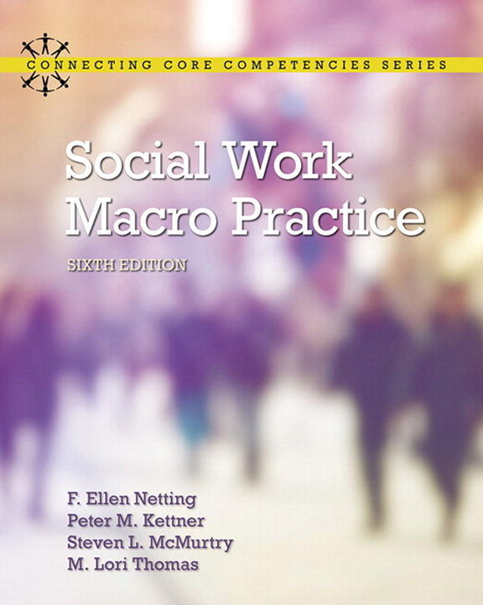
Social Work
Macro Practice
6th ed.
Netting, Kettner, McMurtry, Thomas
***Adapted and excerpted from this text

Slide 3
Why service learning?
Engages community partners
Engages students in Macro Practice
Integrates faith into action

Slide 4
Planned Change
Rational Planning Approach
Logic Model
        Inputs, Outputs, Outcomes, Impact

Slide 5
Identify a social problem and study the need for change
Collaborate with local agencies to identify a problem within the community
Problem
Population
Arena

Slide 6
Research and Analysis
  Students Explore the Professional Knowledge Base
      peer reviewed literature
      data and statistical information (quantitative and qualitative)

Slide 7
hypothesis of etiology
Identify and List:
Causal factors
Related results/outcomes

Slide 8
develop the intervention hypothesis
What interventions are implied in the hypothesis of etiology?—Cause and Effect Relationship
If the following interventions are implemented:
1)……2)……3)……
The following results can be expected:
1)……2)……3)……

Slide 9
brainstorming creative interventions
Based on hypothesis of etiology, students brainstorm several possible relevant interventions
Students rank order the most feasible to accomplish in a limited time frame
Student must agree as a group

Slide 10
Building support: community collaborations
define key participant/systems
assess support and opposition
  Controlling System
            Initiator System
          Change Agent System
  Client System
    Support System
  Host System
  Implementing System
  Target System

Slide 11
Select a change approach
Project Approach (short-term)
Other possible approaches:
policy; program; practice

Slide 12
Select strategies and tactics for intervention
Strategies—overall efforts used to ensure change effort is a success
        involve long-range linking of actions
        Collaborative Strategies and partnerships
Tactics—specific techniques and behaviors that the strategy employs

Slide 13
set goal for intervention
What is the Overall Outcome Expected?

Slide 14
write outcome objectives
Set an initial time frame: Day, Month, or Year when initial results can be seen
Set a future time: A point in future when measurable results may be seen from the intervention
Who or what group will experience a quality of life change from the intervention?
What changes are expected for the target population from this intervention?

Slide 15
write process objectives
Establish a time frame for specific actions to take place for the specified objective
Who or what will be the focus of this objective?
What will be the evidence that this objective has been achieved?

Slide 16
list activities for process objectives
What…
When…
Who…
is responsible for each activity?

Slide 17
initiate the action plan
Manage Logistics:
Facilities, Equipment, Resources, Personnel
PERT Chart/ Flow Charts

Slide 18
managing, training and practicing
Who will act as the leader or manager—keeping the project on track?
Will the intervention involve training any volunteers?
Will the intervention require preparations such as practicing a presentation, etc.?

Slide 19
monitoring and evaluation
Process Evaluation
    tracking process objectives
Outcome Evaluation
    tracking outcome objectives
    interpreting results and accurate conclusions
    cost versus benefits

Slide 20
challenges of community service learning in a macro practice course
Limited time frame to research, plan and implement project may hinder collaborative efforts
Guarding against risk of harm
Risk of not doing enough; Although, most collaborating agencies are thankful for volunteers/students efforts

Slide 21
rewards of community service learning in a macro practice course
Students’ creative and thoughtful planning of and active engagement in macro practice
Reward of positively impacting the community
Reward of putting faith into action:
David Livingston: “Sympathy is no substitue for action.”

Slide 22
references
Gardinier, L. (2017) Service-learning through community engagement: What community partners and members gain, lose, and learn from campus collaborations. New York, NY: Springer Publishing Company, LLC.
Kirst-Ashman, K. K., Hull, G. H. (2012). Generalist practice with organizations and communities. (5th ed.) Belmont, CA: Brooks/Cole.
McClendon, J., Kagotho, N., & Lane, S.R. (2016). Preparing social work students for leadership in human service organizations through student philanthropy. Human Service Organizations, Management, Leadership & Governance, 40, 500-507. doi: 10.1080/23303131.2016.1173159
Netting, F. E., Kettner, P. M., McMurtry, S. L., & Thomas, M. L. (2017). Social work macro practice (6th ed.) Boston, MA: Pearson Education.
Ramson, A.J. (2014). Service-learning: A tool to develop employment competencies for college students. Journal on Excellence in College Teaching, 25(1), 159-187. Retrieved from http://search.ebscohost.com.lacollegelibrary.idm.oclc.org/login.aspx? direct=true&db=eric&AN=EJ1026187&site=ehost-live
Stoecker, R. & Tryon, E. A. (2009). The unheard voices: Community organizations and service-learning. Philadelphia, PA: Temple University Press

